Slide 1
CS4730
Distributed Systems
The Akamai Configuration Management System (ACMS)
Revised 10/15/18

Slide 2
Required reading for this topic…
ACMS: The Akamai Configuration Management System
Alex Sherman, Phil Lisiecki, Andy Berkheimer, and Joel Wein. Proceedings of NSDI 2005. Boston, MA, May 2005
Experience with some Principles for Building an Internet-Scale Reliable System
Mike Afergan, Joel Wein, and Amy LaMeyer. Proceedings of Second Workshop on Real, Large Distributed Systems (WORLDS) '05, San Francisco, CA, December 2005.

Slide 3
What is a CDN?
Content Delivery Network
  Also sometimes called Content Distribution Network
  At least half of the world’s bits are delivered by a CDN
    Probably closer to 70/80%
Primary Goals
  Create replicas of content throughout the Internet
  Ensure that replicas are always available
  Direct clients to replicas that should give good performance

Slide 4
Key Components of a CDN
Distributed servers
  Usually located inside of other ISPs
  Often located in Internet Exchange Points (IXPs)
High-speed network connecting them
Clients (eyeballs)
  Can be located anywhere in the world
  They want fast Internet [Web|download|video|audio|…] performance
Glue
  Something that binds clients to “nearby” replica servers

Slide 5
Background
Akamai operates a CDN of ~365,000 servers distributed across 1300+ networks,135+ countries, and every continent
~25% of all web traffic
Akamai’s customers (web origins, edge computing, …) use these servers to bring their web content and applications closer to the end-users

Slide 6
Akamai Configuration Management System (ACMS)
Following material leverages presentations by Alex Sherman, Phil Lisiecki, Andy Berkheimer, Joel Wein, and Brian Cho

Slide 7
Problems: Configuration and Control
Even with the widely distributed platform customers need to maintain the control of how their content is served
  DRM, Geofencing, Differentiated content based on ISP, …
Customers need to configure their service options with the same ease and flexibility as if it was a centralized, locally hosted system
  Read, write, delete with strong consistency

Slide 8
Problems: Configuration and Control cont.
Customer profiles include hundreds of parameters. For example:
  Cache TTLs
  Allow lists
  Whether and what cookies are accepted
  Whether and what data on application sessions are stored
  …
In addition, internal Akamai services require dynamic reconfigurations (mapping, load-balancing, provisioning services) reflecting the dynamism of the Internet

Slide 9
Why is this difficult?
300,000 widely dispersed servers must synchronize to the latest configurations within a few minutes
Configuration update may be initiated from anywhere on the network and must reach all other servers
Some servers may be down or “partitioned-off” at the time of reconfiguration
A server that comes up after some downtime must re-synchronize quickly
  Do not want to deliver old data
  Strong Consistency

Slide 10
Introducing ACMS
Distributed protocols that guarantee fault-tolerance (based on earlier literature)

Slide 11
ACMS Assumptions
Configuration files may vary in size from a few hundred bytes to 100MB
Submissions may originate from anywhere on the Internet
Most updates must be distributed to every Akamai node
There is no particular arrival pattern of submissions
The Akamai CDN will continue to grow
Submissions could originate from a number of distinct applications running at distinct locations on the Akamai CDN
Each submission of a configuration file foo completely overwrites the earlier submitted version of foo
For each configuration file there is either a single writer or multiple idempotent (non-competing) writers

Slide 12
ACMS System Requirements
High availability – system must be up 24x7 and accessible from various points on the network
Fault-tolerant persistent storage of configuration files for asynchronous delivery
Efficient and Scalable delivery – configuration files must be delivered to the “live” edge servers quickly
Recovery – edge servers must “recover” quickly
Consistency – for a given configuration file the system must synchronize to a “latest” version
Security – configuration files must be authenticated and encrypted
Notes:
Discussion: Why is this easier than some other ?
No strict atomic commit required
Limited re-ordering allowed

Slide 13
ACMS Architecture: Two Subsystems
Front-end – a small collection of Storage Points
  Responsible for accepting, storing, and synchronizing configuration files
Back-End – reliable and efficient delivery of configuration files to all the edge servers
  Leverages the Akamai CDN

Slide 14
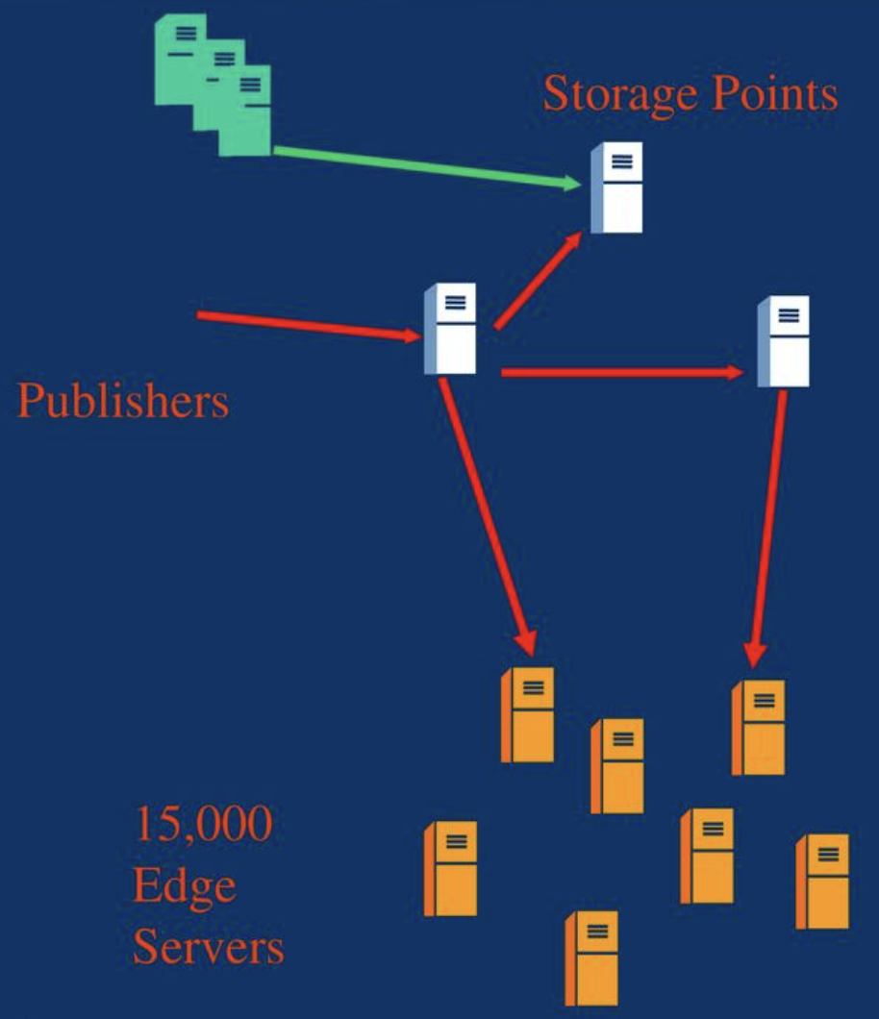
Front-end architecture
Publisher transmits a file to a storage point
Storage Points store, synchronize, and upload the new file on local web servers
300K Edge servers download the new file from the SPs via the CDN

Slide 15
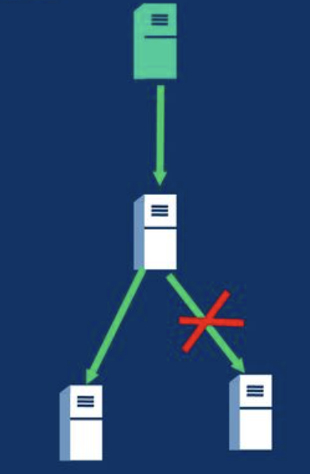
Front-end fault tolerance
Mitigate distributed communication failures
  Implement agreement protocol on top of replication
    Vector exchange (VE): a quorum based agreement scheme
    No dependence on a single Storage Point
  Eliminate dependence on any given network
    SPs hosted by distinct ISP

Slide 16
Quorum Requirement
Define a quorum as a majority (e.g. 3 out of 5 SPs)
A quorum of SPs must agree on a submission
Every future majority overlaps with the earlier majority that agreed on a file
If there is no quorum of alive and communicating SPs, pending agreements halt until a quorum is reestablished

Slide 17
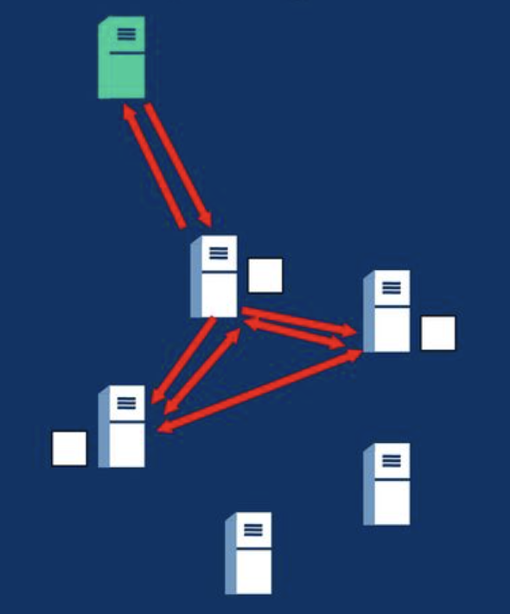
Accepting a file
A publisher contacts an accepting SP
The accepting SP replicates a temporary file to a majority of SPs
If replication succeeds the accepting SP initiates an agreement algorithm called Vector Exchange (VE)
Upon success the accepting SP “accepts” and all SPs upload the new file

Slide 18
Vector Exchange (based on vector clocks)
For each agreement SPs exchange a bit vector.
Each bit corresponds to “commitment” status of a corresponding SP.
Once a majority of bits are set “agreement” takes place
When any SP “learns” of an agreement it can upload the submission

Slide 19
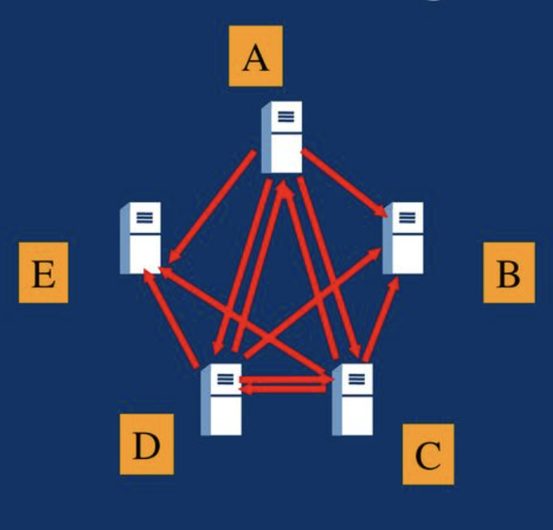
Vector Exchange: an example
“A” initiates and broadcasts a vector:
A:1 B:0 C:0 D:0 E:0
“C” sets its own bit and rebroadcasts:
A:1 B:0 C:1 D:0 E:0
“D” sets its bit and rebroadcasts:
A:1 B:0 C:1 D:1 E:0
Any SP learns of the “agreement” when it sees a majority of bits set.

Slide 20
Vector Exchange Guarantees
If a submission is accepted, at least a majority have stored and agreed on the submission
The agreement is never lost by a future quorum.
  Q: Why?
  A: Any future quorum contains at least one SP that saw an initiated agreement.
VE borrows ideas from Paxos, BFS [Castro, Liskov]
  Weaker, cannot implement a state machine with VE
  VE offers simplicity, flexibility

Slide 21
Recovery Routine
Each SP runs a recovery routine continuously to query other SPs for “missed” agreements
Recovery allows
  SPs that experience downtime to recover state
  Termination of VE messages once agreement occurs

Slide 22
Recovery Routine
The recovery protocol is called Index Merging
SPs continuously run the background recovery protocol with one another
The downloadable configuration files are represented on the SPs in the form of an index tree
The SPs “merge” their index trees to pick up any missed updates from one another
The Edge Servers also need to sync up state

Slide 23
The Index Tree
A Snapshot is a hierarchical index structure that describes latest versions of all accepted files
Each SP updates its own snapshot when it learns of a quorum agreement
For full recovery each SP needs only to merge in a snapshot from majority-1 other SPs
Snapshots are also used by the edge servers to detect changes

Slide 24
Recovery Optimization: Snapshots
Snapshot is a hierarchical index structure that describes latest versions of all accepted files
Each SP updates its own snapshot when it learns of agreements
As part of the recovery process, an SP queries snapshots on other SPs
Side-effect: snapshots are also used by the edge servers (back-end) to detect changes.

Slide 25
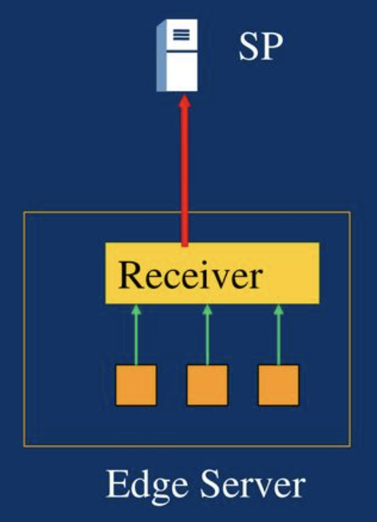
Back-end: Delivery
Processes on edge servers subscribe to specific configurations via a local Receiver process
The Receiver periodically checks for updates to the subscription tree by making HTTP IMS requests recursively
If the updates match any subscriptions the Receivers download the files

Slide 26
Back-end: Delivery cont’d
Delivery is accelerated via the CDN
  Local Akamai caches
  Hierarchical download
  Optimized overlay routing
Delivery scales with the growth of the CDN
Akamai caches use a short TTL (on the order of 30 seconds) for the configuration files

Slide 27
Operational Experience: safeguards
To prevent CDN-wide outages due to a corrupted configuration, files are “zoned”
  A zone is a set of edge servers. All edge servers are in distinct zone
  Initially, publish a file to a limited set of edge servers, e.g., zone 1
  If the system processes the file successfully, publish to zone 2, etc…
Receivers failover from CDN to SPs
Recovery = backup for VE
  Useful in building state on a fresh SP

