Slide 1
4730: Distributed Systems
Lookup services. Chord. Kademlia. DHT.
10/14/24

Slide 2
Required Reading
I. Stoica, R. Morris, D. Karger, M. F. Kaashoek, H. Balakrishnan, Chord: A Scalable Peer-to-peer Lookup Service for Internet Applications, SIGCOMM 2001.
A. Rowstron and P. Druschel. "Pastry: Scalable, decentralized object location and routing for large-scale peer-to-peer systems". IFIP/ACM International Conference on Distributed Systems Platforms (Middleware), 2001
Kademlia: A Peer-to-peer Information System Based on the XOR Metric. P. Maymounkov and D. Mazieres, IPTPS ‘02
The Sybil Attack John R. Douceur IPTPS 2002.

Slide 3
1: Lookup services

Slide 4
Traditional Internet Services Model
Client-server
  Many clients, 1 (or more) server(s)
  Web servers, DNS, file downloads, video streaming
Problems
  Scalability: how many users can a server support?
    What happens when user traffic overload servers?
    Limited resources (bandwidth, CPU, storage)
  Reliability: if # of servers is small, what happens when they break, fail, get disconnected, are mismanaged by humans?
  Efficiency: if your users are spread across the entire globe, how do you make sure you answer their requests quickly?

Slide 5
Peer-to-Peer (P2P) Systems
Applications that take advantage of resources (storage, cycles, content, human presence) available at the edges of the Internet.
Characteristics:
  System consists of clients connected through Internet and acting as peers
  System is designed to work in the presence of variable connectivity
  Peers have significant autonomy; no centralized control
  Peers are symmetric in function

Slide 6
Benefits of P2P and Applications
High capacity: all clients provide resources (bandwidth, storage space, and computing power). The capacity of the system increases as more nodes become part of the system.
Increased reliability: achieved by replicating data over multiple peers, and by enabling peers to find the data without relying on a centralized index server.
Applications:
  File sharing: Napster, Gnutella, Freenet, BitTorrent
  Distributed file systems: Ivy, IPFS
  Multicast overlays: ESM, NICE, AIML

Slide 7
Issues in P2P Systems Design
How do nodes self-organize, what are appropriate structures?
How to search efficiently or perform more complex queries?
How to route efficiently on such structures?
How to maintain performance in spite of crashes, transient failures, churn?
How to maintain availability in spite of failures and partitions?

Slide 8
The Alternative: Peer-to-Peer
A simple idea
  Users bring their own resources to the table
  A cooperative model: clients = peers = servers
The benefits
  Scalability: # of “servers” grows with users
    BYOR: bring your own resources (storage, CPU, B/W)
  Reliability: load spread across many peers
    Probability of them all failing is very low…
  Efficiency: peers are distributed
    Peers can try and get service from nearby peers

Slide 9
The Peer-to-Peer Challenge
What are the key components for leveraging P2P?
  Communication: how do peers talk to each other
  Service/data location: how do peers know who to talk to
New reliability challenges
  Network reachability: dealing with NATs (hidden networks w/private addresses)
  Dealing with churn, i.e. short peer uptimes
What about security?
  Malicious peers and cheating
  The Sybil attack

Slide 10
Outline
Unstructured P2P
BitTorrent Basics
μTP: Micro Transport Protocol
Cheating on BitTorrent

Slide 11

Centralized Approach
The original: Napster
  1999-2001
  Shawn Fanning, Sean Parker
  Invented at NEU
  Specialized in MP3s (but not for long)
Centralized index server(s)
  Supported all queries
What caused its downfall?
  Not scalable
  Centralization of liability

Slide 12






Napster Architecture
Napster
Central Server
B and C have the file
Log-in, upload list of files
Search for Batman
C
E
G
A
F
B
D

Slide 13
Centralized != Scalable?
Another centralized protocol: Maze
  Was highly active network in China / Asia [early 2000s]
  Over 2 million users, more than 13 TB transferred/day
  Central index servers run out of PKU
  Survived because RIAA/MPAA doesn’t exist in China
Why is this interesting?
  Shows centralized systems can work
    Of course have to be smart about it…
  Central servers “see” everything
    Quite useful for research / measurement studies

Slide 14


Maze Architecture
Maze
Central Server
Traffic Logs
Who downloaded
Who uploaded
How much data
Incentive system
  Encourage people to upload
  Assess the trustworthiness of files
C
E
G
A
F
B
D

Slide 15
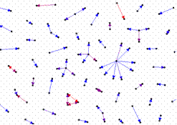
Colluding Users
  The Sybil Attack
Why and How of collusion
  Collusion gets you points in Maze (incentive system)
  Spawn fake users/identities for free
Collusion detectors (ICDCS 2007)
  Duplicate traffic across links
  Pair-wise mutual upload behavior
  Peer-to-IP ratio of clients
  Traffic concentration
  Duplicate transfer graph: 100 links w/ highest duplicate
  transfer rates

Slide 16
Unstructured P2P Applications
Centralized systems have single points of failure
Response: fully unstructured P2P
  No central server, peers only connect to each other
  Queries sent as controlled flood
  Later systems are hierarchical for performance reasons
Limitations
  Bootstrapping: how to join without central knowledge?
  Floods of traffic = high network overhead
  Probabilistic: can only search a small portion of the system (Why?)
  Uncommon files are easily lost (Why?)

Slide 17

Gnutella
First massively popular unstructured P2P application
  Justin Frankel, Nullsoft, 2000
  AOL was not happy at all
Original design: flat network
  Join via bootstrap node
  Connect to random set of existing hosts
  Resolve queries by localized flooding
    Time to live fields limit hops
Recent incarnations use hierarchical structure
Problems
  High bandwidth costs in control messages
  Flood of queries took up all avail b/w for dialup users

Slide 18
File Search via Flooding in Gnutella
Redundancy
What if the file is rare or far away?
Traffic Overhead

Slide 19
Peer Lifetimes
Study of host uptime and application uptime (MMCN 2002)
  Sessions are short (median is 60 minutes)
  Hosts are frequently offline
Percentage of Hosts
Host Uptime (out of 100%)
Notes:
17,000+ Gnutella peers for 60 hours
7,000 Napster peers for 25 hours

Slide 20
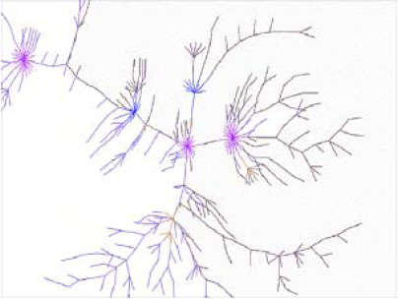
Resilience to Failures and Attacks
Previous studies (Barabasi) show interesting dichotomy of resilience for “scale-free networks”
  Resilient to random failures, but not attacks
Here’s what it looks like for Gnutella
1771 Peers in Feb, 2001
After top 4% of peers are removed
After random 30% of peers removed

Slide 21
Hierarchical P2P Networks
FastTrack network (Kazaa, Grokster, Morpheus, Gnutella++)
supernode
Improves scalability
Limits flooding
Still no guarantees of performance
What if a supernode leaves the network?

Slide 22
Kazaa
Very popular from its inception
  Hierarchical flooding helps improve scale
  Large shift to broadband helped quite a bit as well
  Based in Europe, more relaxed copyright laws
New problem: poison attacks
  Mainly used by RIAA-like organizations
  Create many Sybils that distribute “popular content”
    Files are corrupted, truncated, scrambled
    In some cases, audio/video about copyright infringement
  Quite effective in dissuading downloaders

Slide 23
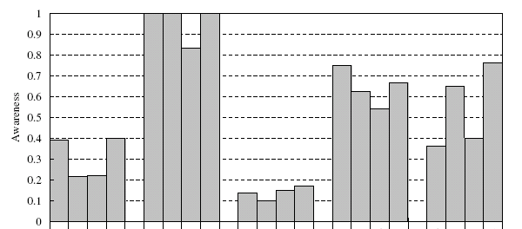
Data Poisoning on Kazaa
Why is poisoning effective? (IPTPS 2006)
  People don’t check their songs!
  Apparently not easy to detect file pollution!
Metadata
Down.Quality
Incomplete
Noise
Shuffle

Slide 24
Distribution of Poisoned Files
Why are poisoned files so widely distributed?
  “Slackness”, even when users are “asked” to check files

Slide 25

Skype: P2P VoIP
P2P client supporting VoIP, video, and
text based conversation, buddy lists, etc.
  Based on Kazaa network (FastTrack)
  Overlay P2P network consisting of ordinary and Super Nodes (SN)
  Ordinary node connects to network through a Super Node
Each user registers with a central server
  User information propagated in a decentralized fashion
Uses a variant of STUN to identify the type of NAT and firewall

Slide 26
What’s Different About Skype
MSN, Yahoo, GoogleTalk all provide similar functionality
  But generally rely on centralized servers
So why peer-to-peer for Skype?
  One reason: cost
    If redirect VoIP through peers, can leverage geographic distribution
    i.e. traffic to a phone in Berlin goes to peer in Berlin, thus becomes a local call
  Another reason: NAT traversal
    Choose peers to do P2P rendezvous of NAT’ed clients
Increasingly, MS is using infrastructure instead of P2P

Slide 27
Overlays
An Overlay is a general concept
  Networks are just about routing messages between named entities
IP Internet overlays on top of physical topology
  We assume that IP and IP addresses are the only names…
Why stop there?
  Overlay another network on top of IP

Slide 28

Example: VPN
Virtual Private Network
Private
Public
Private
34.67.0.1
34.67.0.3
VPN is an IP over IP overlay
Not all overlays need to be IP-based
Internet
74.11.0.1
74.11.0.2
34.67.0.2
34.67.0.4
Dest: 74.11.0.2
Dest: 34.67.0.4

Slide 29
VPN Layering
Host 1
Router
Host 2
Application
Application
P2P Overlay
P2P Overlay
Transport
Transport
VPN Network
VPN Network
Network
Network
Network
Data Link
Data Link
Data Link
Physical
Physical
Physical

Slide 30
Advanced Reasons to Overlay
IP provides best-effort, point-to-point datagram service
  Maybe you want additional features not supported by IP or even TCP
Like what?
  Multicast
  Security
  Reliable, performance-based routing
  Content addressing, reliable data storage

Slide 31
Outline
Multicast
Structured Overlays / DHTs
Dynamo / CAP

Slide 32
Outline
Multicast
Structured Overlays / DHTs

Slide 33
Unicast Streaming Video
Source
This does not scale

Slide 34
IP Multicast Streaming Video
IP routers forward to multiple destinations
Source
Much better scalability
IP multicast not deployed in reality
  Good luck trying to make it work on the Internet
  People have been trying for 30 years
Source only sends one stream

Slide 35
End System Multicast Overlay
This does not scale
How to build an efficient tree?
Enlist the help of end-hosts to distribute stream
Scalable
Overlay implemented in the application layer
  No IP-level support necessary
But…
Source
How to rebuild the tree?
How to join?

Slide 36
Outline
Multicast
Structured Overlays / DHTs
Dynamo / CAP

Slide 37

Unstructured P2P Review
Redundancy
What if the file is rare or far away?
Search is broken
  High overhead
  No guarantee it will work
Traffic Overhead

Slide 38
Why Do We Need Structure?
Without structure, it is difficult to search
  Any file can be on any machine
  Example: multicast trees
    How do you join? Who is part of the tree?
    How do you rebuild a broken link?
How do you build an overlay with structure?
  Give every machine a unique name
  Give every object a unique name
  Map from objects → machines
    Looking for object A? Map(A)→X, talk to machine X
    Looking for object B? Map(B)→Y, talk to machine Y

Slide 39
Hash Tables
Array
“A String”
“Another String”
Memory
Address
“Another String”
Hash(…) →
“One More String”
“A String”
“One More String”

Slide 40
(Bad) Distributed Hash Tables
Mapping of keys to nodes
Network
Nodes
“Google.com”
Machine
Address
“Alt-J.mp3”
Hash(…) →
“Diane’s Computer”
Size of overlay network will change
Need a deterministic mapping
As few changes as possible when machines join/leave

Slide 41
Structured Overlay Fundamentals
Deterministic Key→Node mapping
  Consistent hashing
  (Somewhat) resilient to churn/failures
  Allows peer rendezvous using a common name
Key-based routing
  Scalable to any network of size N
    Each node needs to know the IP of log(N) other nodes
    Much better scalability than OSPF/RIP/BGP
  Routing from node A→B takes at most log(N) hops

Slide 42
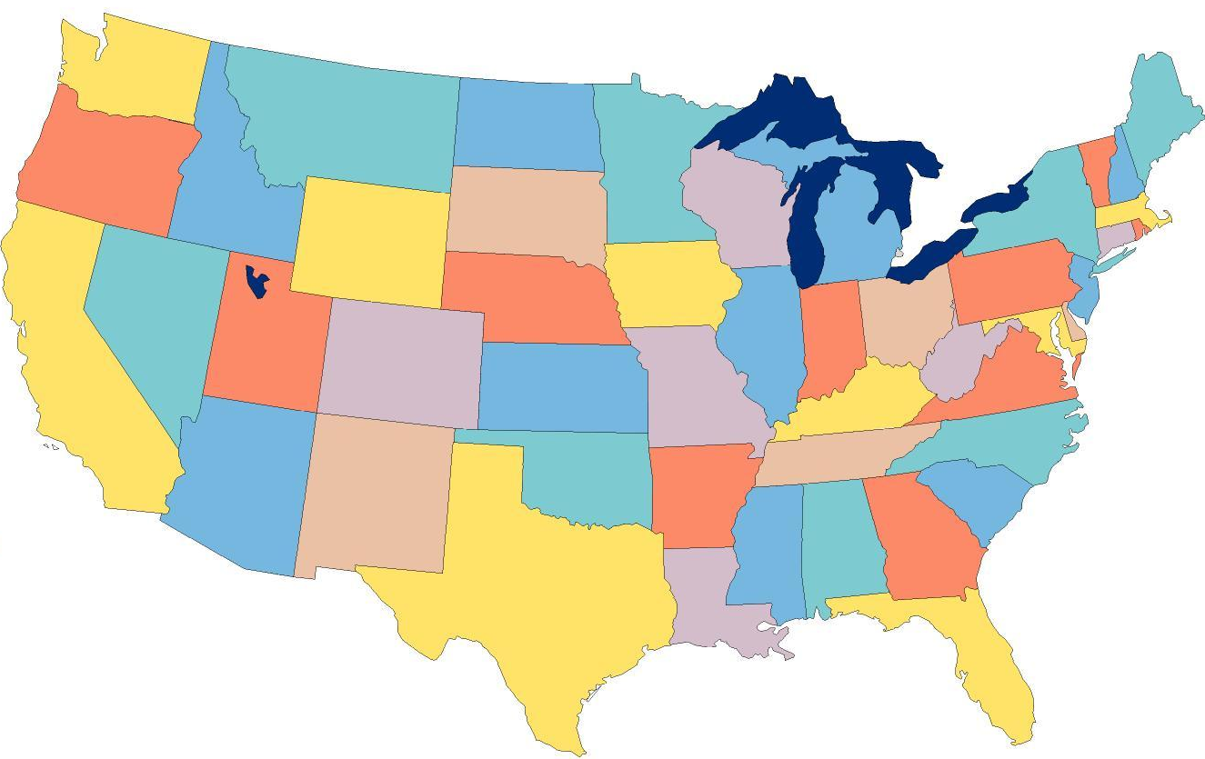

Structured Overlays at 10,000ft.
Node IDs and keys from a randomized namespace
  Incrementally route towards to destination ID
  Each node knows a small number of IDs + IPs
    log(N) neighbors per node, log(N) hops between nodes
ABCE
Each node has a routing table
ABC0
Forward to the longest prefix match
To: ABCD
AB5F
A930

Slide 43
Structured Overlay Implementations
Many P2P structured overlay implementations
  Generation 1: Chord, Tapestry, Pastry, CAN
  Generation 2: Kademlia, SkipNet, Viceroy, Symphony, Koorde, Ulysseus, …
Shared goals and design
  Large, sparse, randomized ID space
  All nodes choose IDs randomly
  Nodes insert themselves into overlay based on ID
  Given a key k, overlay deterministically maps k to its root node (a live node in the overlay)

Slide 44
Similarities and Differences
Similar APIs
  route(key, msg) : route msg to node responsible for key
    Just like sending a packet to an IP address
  Distributed hash table functionality
    insert(key, value) : store value at node/key
    lookup(key) : retrieve stored value for key at node
Differences
  Node ID space, what does it represent?
  How do you route within the ID space?
  How big are the routing tables?
  How many hops to a destination (in the worst case)?

Slide 45
Logistics
Fill out form for Project 5 NOW (see Piazza post)
Project 4 due next week

Slide 46
Tapestry/Pastry
Node IDs are numbers in a ring
  128-bit circular ID space
Node IDs chosen at random
Messages for key X is routed to live node with longest prefix match to X
  Incremental prefix routing
  1110: 1XXX→11XX→111X→1110
1111 | 0
To: 1110
0
1110
0010
1100
0100
1010
0110
1000

Slide 47
Physical and Virtual Routing
1111 | 0
To: 1110
1101
0
1110
0010
To: 1110
1100
0100
0010
1100
1010
0110
1010
1000

Slide 48
Tapestry/Pastry Routing Tables
Incremental prefix routing
How big is the routing table?
  Keep b-1 hosts at each prefix digit
  b is the base of the prefix
  Total size: b * log_{b} n
log_{b} n hops to any destination
1111 | 0
1110
0
1110
0011
0010
1100
0100
1011
1010
0110
1010
1000
1000

Slide 49
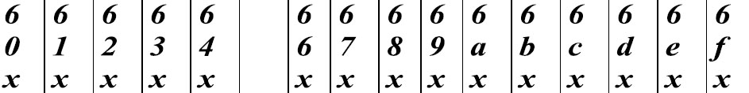
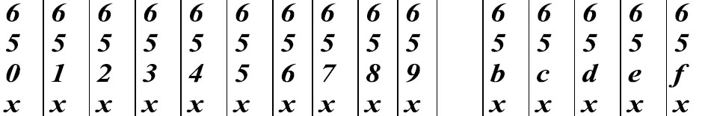
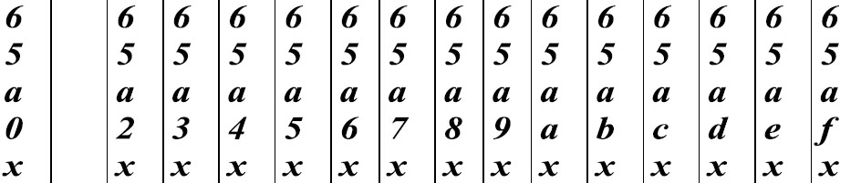
Routing Table Example
Hexadecimal (base-16), node ID = 65a1fc4
Row 0
Row 1
Row 2
Row 3
log₁₆ n
rows

Slide 50
Routing Table Example
Hexadecimal (base-16), node ID = 65a1fc4
Row 0
Each x is the
IP address of
a peer
Row 1
Row 2
Row 3
log₁₆ n
rows

Slide 51
Routing, One More Time
Each node has a routing table
Routing table size:
  b * log_{b} n
Hops to any destination:
  log_{b} n
1111 | 0
To: 1110
0
1110
0010
1100
0100
1010
0110
1000

Slide 52
Pastry Leaf Sets
One difference between Tapestry and Pastry
Each node has an additional table of the L/2 numerically closest neighbors
  Larger and smaller
Uses
  Alternate routes
  Fault detection (keep-alive)
  Replication of data

Slide 53
Joining the Pastry Overlay
Pick a new ID X
Contact a bootstrap node
Route a message to X, discover the current owner
Add new node to the ring
Contact new neighbors, update leaf sets
1111 | 0
0
1110
0010
1100
0100
1010
0110
0011
1000

Slide 54
Node Departure
Leaf set members exchange periodic keep-alive messages
  Handles local failures
Leaf set repair:
  Request the leaf set from the farthest node in the set
Routing table repair:
  Get table from peers in row 0, then row 1, …
  Periodic, lazy

Slide 55
Consistent Hashing
Recall, when the size of a hash table changes, all items must be re-hashed
  Cannot be used in a distributed setting
  Node leaves or join → complete rehash
Consistent hashing
  Each node controls a range of the keyspace
  New nodes take over a fraction of the keyspace
  Nodes that leave relinquish keyspace
… thus, all changes are local to a few nodes

Slide 56

DHTs and Consistent Hashing
Mappings are deterministic in consistent hashing
  Nodes can leave
  Nodes can enter
  Most data does not move
Only local changes impact data placement
  Data is replicated among the leaf set
1111 | 0
To: 1110
0
1110
0010
1100
0100
1010
0110
1000

Slide 57
Logistics
Final: take home; available at 12:00 AM on Saturday, 4/8/23
  Same requirements at the Midterm
  Cumulative, but focusing on new information
3 classes left for the 4700 students (welcome to attend during your finals)
Project 5 is due 4/13
  Milestone assessments released. If you are on a team and didn’t receive a grade, see my post on Piazza
Project 4 grades should be out soon

Slide 58
Content-Addressable Networks (CAN)
d-dimensional hyperspace with n zones
y
Peer
Keys
Zone
x

Slide 59
CAN Routing
d-dimensional space with n zones
Two zones are neighbors if d-1 dimensions overlap
d*n^{1/d} routing path length
y
[x,y]
Peer
Keys
lookup([x,y])
x

Slide 60
CAN Construction
Joining CAN
Pick a new ID [x,y]
Contact a bootstrap node
Route a message to [x,y], discover the current owner
Split owners zone in half
Contact new neighbors
y
[x,y]
x
New Node

Slide 61
Summary of Structured Overlays
A namespace
  For most, this is a linear range from 0 to 2¹⁶⁰
A mapping from key to node
  Chord: keys between node X and its predecessor belong to X
  Pastry/Chimera: keys belong to node w/ closest identifier
  CAN: well defined N-dimensional space for each node

Slide 62
Summary, Continued
A routing algorithm
  Numeric (Chord), prefix-based (Tapestry/Pastry/Chimera), hypercube (CAN)
  Routing state
  Routing performance
Routing state: how much info kept per node
  Chord: Log2N pointers
  ith pointer points to MyID+ ( N * (0.5)i )
  Tapestry/Pastry/Chimera: b * LogbN
  ith column specifies nodes that match i digit prefix, but differ on (i+1)th digit
  CAN: 2*d neighbors for d dimensions

Slide 63
Structured Overlay Advantages
High level advantages
  Complete decentralized
  Self-organizing
  Scalable
  Robust
Advantages of P2P architecture
  Leverage pooled resources
    Storage, bandwidth, CPU, etc.
  Leverage resource diversity
    Geolocation, ownership, etc.

Slide 64
Structured P2P Applications
Reliable distributed storage
  OceanStore, FAST’03
  Mnemosyne, IPTPS’02
Resilient anonymous communication
  Cashmere, NSDI’05
Consistent state management
  Dynamo, SOSP’07
Many, many others
  Multicast, spam filtering, reliable routing, email services, even distributed mutexes!

Slide 65
Structure of P2P File Sharing Systems
Distributed application
STORE(key, data)
RETRIEVE (key)
data
Distributed hash table
LOOKUP(key)
host IP address
Lookup service

Slide 66
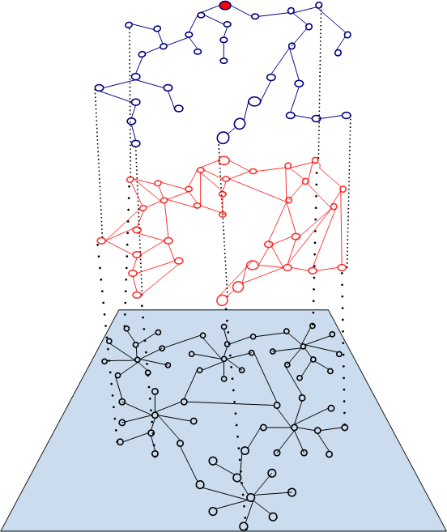
Structure of P2P Multicast Systems
Extend network functionality by providing multicast services
Usually build a multicast tree that dynamically adapts to improve suboptimal overlay meshes.
Overlay is unstructured and optimizations are done by using measurement-based heuristics
ESM, Nice, Overcast, ALMI
Notes:
that can occur as a result of:
random initial neighbor selection
aggressive partition repair
multicast group membership changes
transient nature of underlying physical network conditions

Slide 67
Structured vs. Unstructured P2P
Many file sharing P2P systems are structured:
  A small subset of nodes meeting presubscribed conditions are eligible to become neighbors
  The goal here is to bound the cost of locating objects and the number of network hops
Many multicast/broadcast P2P systems are not structured:
  The goal here is maximizing performance in terms of throughput and latency

Slide 68
Why Lookup Services
N₂
N₁
N₃
Put (Key=“cs7610_18”
Value=file data…)
Internet
?
Publisher
Client
Get(key=“cs7610_18”)
N₄
N₆
N₅

Slide 69
Challenges for Lookup Services
Availability
Scalability
Complexity
Exact-match searching vs. approximate marching
General lookup vs specialized lookup

Slide 70
Architectures for Lookup Services: Centralized
Central index server maintaining the list of files available in the system
Upon joining, a node sends the list of files it stores locally, to the central index server
When performing a search, a node contacts the central index server to find out the location of the file
Vulnerable to single point of failures
Maintains O(N) state, costly to maintain the state
Example: Napster

Slide 71
Architectures for Lookup Services: Flooded Query
There is no centralized index server
Each node stores the list of the files it stores locally, no cost on join
When performing a search, a node floods the query to every other machine in the network
More robust than the centralized approach, avoids the single point of failure
Inefficient, worst case O(N) messages per lookup
Example: Gnutella

Slide 72
Architectures for Lookup Services: Rooted Query
Completely distributed
Use a more efficient key-based routing in order to bound the cost of lookup
Less robust than flooded query approach, but more efficient
Example: Chord, Pastry, Tapestry, Kademlia

Slide 73
Distributed Hash Tables
Decentralized distributed systems that partition a set of keys among participating nodes
Goal is to efficiently route messages to the unique owner of any given key
Typically designed to scale to large numbers of nodes and to handle continual node arrivals and failures
Examples: Chord, CAN, Pastry,Tapestry

Slide 74
DHT Design Goals
Decentralized system:
  One node needs to coordinate with a limited set of participants to find the location of a file; should work well in the presence of dynamic membership
Scalability:
  The system should function efficiently even with thousands or millions of nodes
Fault tolerance:
  The system should be reliable even with nodes continuously joining, leaving, and failing

Slide 75
DHT: Keys and Overlays
Key space:
  Ownership of keys is split among the nodes according to some partitioning scheme that maps nodes to keys
Overlay network:
  Nodes self organize in an overlay network; each node maintains a set of links to other nodes (its neighbors or routing table).
  Overlay and routing information is used to locate an object based on the associated key

Slide 76
DHT: Storing an Object
Compute key according to the object-key mapping method
Send message store(k,data) to any node participating in the DHT
Message is forwarded from node to node through the overlay network until it reaches the node S responsible for key k as specified by the keyspace partitioning method
Store the pair (k,data) at node S (sometimes the object is stored at several nodes to deal with node failures)

Slide 77
DHT: Retrieving an Object
Compute key according to the object-key mapping method
Send a message to any DHT node to find the data associated with k with a message retrieve(k)
Message is routed through the overlay to the node S responsible for k
Retrieve object from node S

Slide 78
Key Partitioning
Key partitioning: defines
what node “owns what keys” <=> ”stores what objects”
Removal or addition of nodes should not result in entire remapping of key space since this will result in a high cost in moving the objects around
Use consistent hashing to map keys to nodes.
  Distance function between keys, d(k1,k2)
  A node with ID i owns all the keys for which i is the closest ID, measured according to distance function d.
Consistent hashing has the property that removal or addition of one node changes only the set of keys owned by the nodes with adjacent IDs, and leaves all other nodes unaffected.

Slide 79
Overlay Networks and Routing
Nodes self-organize in a logical network defined by the set of links to other nodes each node must maintain
Routing:
  Greedy algorithm, at each step, forward the message to the neighbor whose ID is closest to k.
  When there is no such neighbor, then this is the closest node, which must be the owner of key k

Slide 80
2: Chord

Slide 81
CHORD
Efficient lookup of a node which stores data items for a particular search key.
Provides only one operation: given a key, it maps the key onto a node.
Example applications:
  Co-operative mirroring
  Time-shared storage
  Distributed indexes
  Large-scale combinatorial search

Slide 82
Design Goals
Load balance: distributed hash function, spreading keys evenly over nodes
Decentralization: CHORD is fully distributed, nodes have symmetric functionality, improves robustness
Scalability: logarithmic growth of lookup costs with number of nodes in network
Availability: CHORD guarantees correctness, it automatically adjusts its internal tables to ensure that the node responsible for a key can always be found

Slide 83
Assumptions
Communication in underlying network is both symmetric and transitive
Assigns keys to nodes with consistent hashing
Hash function balances the load
Participants are correct, nodes can join and leave at any time
Nodes can fail

Slide 84
Chord Rings
Key identifier = SHA-1(key)
Node identifier = SHA-1(IP address)
Consistent hashing function assigns each node and key an m-bit identifier using SHA-1
Mapping key identifiers to node identifiers:
  Identifiers are ordered on a circle modulo 2^{m} called a chord ring.
  The circle is split into contiguous segments whose endpoints are the node identifiers. If i1 and i2 are two adjacent IDs, then the node with ID greater identifier i2 owns all the keys that fall between i1 and i2.

Slide 85
Example of Key Partitioning in Chord
m = 6
10 nodes
N1
N56
N8
K54
K10
N51
N14
N48
N21
N42
K24
N38
N32
K38
K30

Slide 86
How to Perform Key Lookup
Assume that each node knows only how to contact its current successor node on the identifier circle, then all node can be visited in linear order.
When performing a search, the query for a given identifier could be passed around the circle via these successor pointers until they encounter the node that contains the key corresponding to the search.

Slide 87
Example of Key Lookup Scheme
succesor(k) = first node whose ID is >= ID of k in identifier space
N1
K45
N8
N48
N14
N42
N38
N32
N21

Slide 88
Scalable Key Location
To accelerate lookups, Chord maintains additional routing information (m entries): finger table
The i^{th} entry in the table at node n contains the identity of the first node s that succeeds n by at least 2^{i-1} on the identifier circle.
s = successor(n+2^{i-1}).
s is called the i^{th} finger of node n

Slide 89
Scalable Lookup Scheme
m = 6
N1
N56
Finger Table for N8
N8
N51
N8+1 | N14
N8+2 | N14
N8+4 | N14
N8+8 | N21
N8+16 | N32
N8+32 | N42
N48
finger 6
finger 1,2,3
N14
finger 5
N42
finger 4
N38
N21
finger [i] = first node that succeeds (n+2^{i-1})mod2^{m}
N32

Slide 90
Scalable Lookup
Each node has finger entries at power of two intervals around the identifier circle
Each node can forward a query at least halfway along the remaining distance between the node and the target identifier.

Slide 91
Lookup Using Finger Table
N1
K54
N56
N8
N51
N48
N14
N42
N38
N32
N21

Slide 92
Node Joins and Failures/Leaves
When a node N joins the network, some of the keys previously assigned to N’s successor should become assigned to N.
When node N leaves the network, all of its assigned keys should be reassigned to N’s successor.
How to deal with these cases?

Slide 93
Node Joins and Stabilizations
Everything relies on successor pointer.
Up to date successor pointer is sufficient to guarantee correctness of lookups
Idea: run a “stabilization” protocol periodically in the background to update successor pointer and finger table.

Slide 94
Stabilization Protocol
Guarantees to add nodes in a fashion to preserve reachability
Does not address the cases when a Chord system thas split into multiple disjoint cycles, or a single cycle that loops multiple times around the identifier space

Slide 95
Stabilization Protocol (cont.)
Each time node N runs stabilize protocol, it asks its successor for its predecessor p, and decides whether p should be N’s successor instead.
Stabilize protocol notifies node N’s successor of N’s existence, giving the successor the chance to change its predecessor to N.
The successor does this only if it knows of no closer predecessor than N.

Slide 96
Impact of Node Joins on Lookups
If finger table entries are current then lookup finds the correct successor in O(log N) steps
If successor pointers are correct but finger tables are incorrect, correct lookup but slower
If incorrect successor pointers, then lookup may fail

Slide 97
Voluntary Node Departures
Leaving node may transfers all its keys to its successor
Leaving node may notify its predecessor and successor about each other so that they can update their links

Slide 98
Node Failures
Stabilize successor lists:
  Node N reconciles its list with its successor S by copying S’s successor list, removing its last entry, and prepending S to it.
  If node N notices that its successor has failed, it replaces it with the first live entry in its successor list and reconciles its successor list with its new successor.

Slide 99
CHORD Summary
Efficient location of the node that stores a desired data item is a fundamental problem in P2P networks
Separates correctness (successor) from performance (finger table)
Chord protocol solves it in an efficient decentralized manner
  Routing information: O(log N) nodes
  Lookup: O(log N) nodes
  Update: O(log2 N) messages
It also adapts dynamically to the topology changes introduced during the run

Slide 100
3: Attacks against CHORD

Slide 101
Node ID Assignment Implications
m = 6
10 nodes
Node ID determines where will the node be placed in the structured overlay
Determines who the neighbors are going to be
Determines what objects a node will hold
N1
K54
N56
K10
N8
N51
N14
N48
N21
N42
K24
N38
N32
K38
K30

Slide 102
Attacks Based on Node ID Assignment
What if attacker can choose the ID of a node?
  Surround a victim node
  Partition a p2p network
  Can control what object will be a replica for
  Holding objects allow an attacker to delete, corrupt or deny access to objects
Can an attacker choose the ID of a node?
  In some systems ID is randomly generated
  In some systems ID is the hash of the IP address

Slide 103
Sybil Attack
Attack particular to peer networks, a malicious attacker takes/forges multiple identities
Result: attacker controls a significant part of the system while correct nodes are not aware of this, they see different identities
  destroy cohesion of the overlay
  observe network status
  slow down, destroy overlay
  DoS
How to ensure/validate distinct identities refer to distinct entities?

Slide 104
Evaluating Identity
Straightforward form of identity: secure hash of a public key
How to evaluate/learn the identity of other entities
  Use a trusted agency (learn from trusted source)
  A node has a direct way of validating other nodes - direct validation (learn directly)
  Using other untrusted agencies - indirect validation (learn from others)
Which one is best?

Slide 105
Direct and Indirect Validation (Untrusted Sources)
Utilize computational tasks to validate distinctness;
  validate distinctness of two entities by getting them to perform some task (for example a computational puzzle) that a single entity could not
  can not assume homogeneous resources, only minimum; faulty entity could have more than minimum
  goal is to make it practical impossible for an adversary to have challenges issued simultaneously, limit the number of identities he can forge
Notes:
This is the practical result: some theoretical ability to limit impact of faulty entities by performing simultaneous and concurrent identity validation

Slide 106
Direct Validation Limitations
Even with severely resource constrains, a faulty entity can counterfeit a constant number of identities
Each correct entity must simultaneously validate all the identities it is presented otherwise a faulty entity can counterfeit an unbounded number of identities

Slide 107
Indirect Validation
A sufficiently large set of faulty entities can counterfeit an unbounded number of identities
All entities in the system must perform their identity validations concurrently, otherwise a faulty identity can counterfeit a constant number of multiple identities

Slide 108
Certified (Secure) NodeID Assignment
Delegate ID generation to trusted CAs
Bind IPs with nodeIds such that colluding attackers can not exchange certificates
Nodes must pay for certificates to prevent attackers from buying many "correct" certificates
Works for static IP addresses
Does not solve all problems: what happens if the IP changes?
What happens if the trusted CA is not available or can not be reached?

Slide 109
Certified (Secure) NodeID Assignment
How about distributed ID generation with periodic renewal of distributed IDs
  Addresses single point of failure
  Requires techniques to moderate the rate at which attackers can acquire node IDs

Slide 110
Routing Table Maintenance
m = 6
Routing table contains information about where to ‘look next’
Table is updated based on information from other nodes
Finger Table for N8
N8+1 | N14
N8+2 | N14
N8+4 | N14
N8+8 | N21
N8+16 | N32
N8+32 | N42
finger [k] = first node that succeeds (n+2^{k-1})mod2^{m}

Slide 111
Attack Against Maintaining Routing Table
Attackers can easily supply ‘malicious’ updates or can return incorrect lookup
  point to faulty or non-existent nodes
  fake the closest node
  lie about next hop
Result: lookup will fail (denial of information to a node) or the lookup algorithm will have sub-optimal performance

Slide 112
Secure Routing Table Maintenance
Constrained Routing Tables: Identify invariants in the system and look for violations of the invariants
Maintain two routing tables - one that uses proximity information and one that constrains entries to "specific" values
  Proximity routing used in normal operation
  Constrained routing used when failures occur:
Other proposed solutions involve anonymous auditing

Slide 113
Secure Bootstrapping
How to securely bootstrap the routing table?
  A new node, n, picks a subset of bootstrap nodes to query and join the network
  n uses the bootstrap information to initialize its constrained routing table

Slide 114
Attacks on Forwarding
Simply ignore forwarding messages, route to the wrong node
  Failed if ANY one in routing is faulty
  Probability of routing successfully to a replica root is (1-f)^{h-1}
  h is the number of average hops for delivering a message
  h depends on the overlay

Slide 115
Secure Message Forwarding
Ensure that with high probability, at least on copy of a message reaches every correct replica root
Collect the prospective set of replica roots from the prospective root node
Apply routing failure test to determine if routing worked correctly, If no, use redundant and/or iterative routing.

Slide 116
Testing Routing
Route Failure Test:
  Average density of nodeIds per unit of “volume” in the id space is greater than the average density of faulty nodes
  Compares density of nodeIds in the neighbor set of the sender with the density of nodeIds close to the replica roots of the destination key
  Have sender contact all prospective roots
  Timeout to detect ignoring routing msgs, selecting the appropriate threshold not easy
Use redundant routing when test fails
  Neighbor set anycast - sends copies of message towards destination until they reach a node with the key in its neighbor set.
How about false positives and false negatives when performing the routing failure test?
Redundant routing has high overhead?

Slide 117
Iterative Routing
Alternative to redundant routing
Every lookup answer goes back to the requester that can verify that the next hop gets him closer (using the distance function) to the node hosting the object associated with the requested key
Iterative routing is more secure, but more expensive

Slide 118
What Does Secure Routing Buy Us?
Prevents attacks at join time: secure nodeID assignment and bootstrapping
Ensure that when a correct node sends a message for a particular key, the message reaches all correct replica roots for the key with very high probability.
What about the data? We need other mechanisms, for example self-certifying data

Slide 119
Self-Certifying Data
Client can check data and only needs to rely on routing when certification check fails.
Reduces the reliance on the redundant, secure routing primitive (you still need secure forwarding otherwise there is no data to verify in the first place)
Uses concepts like proactive signature sharing or group keys/signatures.
Self-certifying data can eliminate the overhead of secure routing in common cases

Slide 120
4: Kademlia

Slide 121
Kademlia in a Nutshell
Similar with other services, IDs based on SHA-1 hash into a 160 bits space.
Closeness between two objects measured as their bitwise XOR interpreted as an integer.
distance(a, b) = a XOR b
Distance is symmetric, dist (a,b) = dist (b,a)
Uses parallel asynchronous queries to avoid timeout delays of the failed nodes. Routes are selected based on latency
Kademlia uses tree-based routing

Slide 122
Kademlia Binary Tree
Start from root, for any given node, dividing the binary tree into a series of successively lower subtrees that do not contain the node and each correspond to a k-bucket
Every node keeps track of at least one node from each of its subtrees.
Every node keeps a list of (IP, Port, NodeID) triples, and (key, value) tuples for further exchanging information with others.

Slide 123
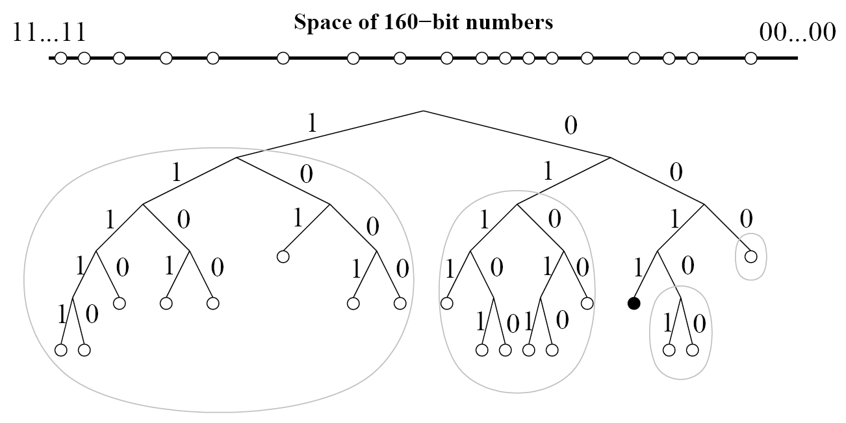
Kademlia Binary Tree
Subtrees for a node 0011……

Slide 124
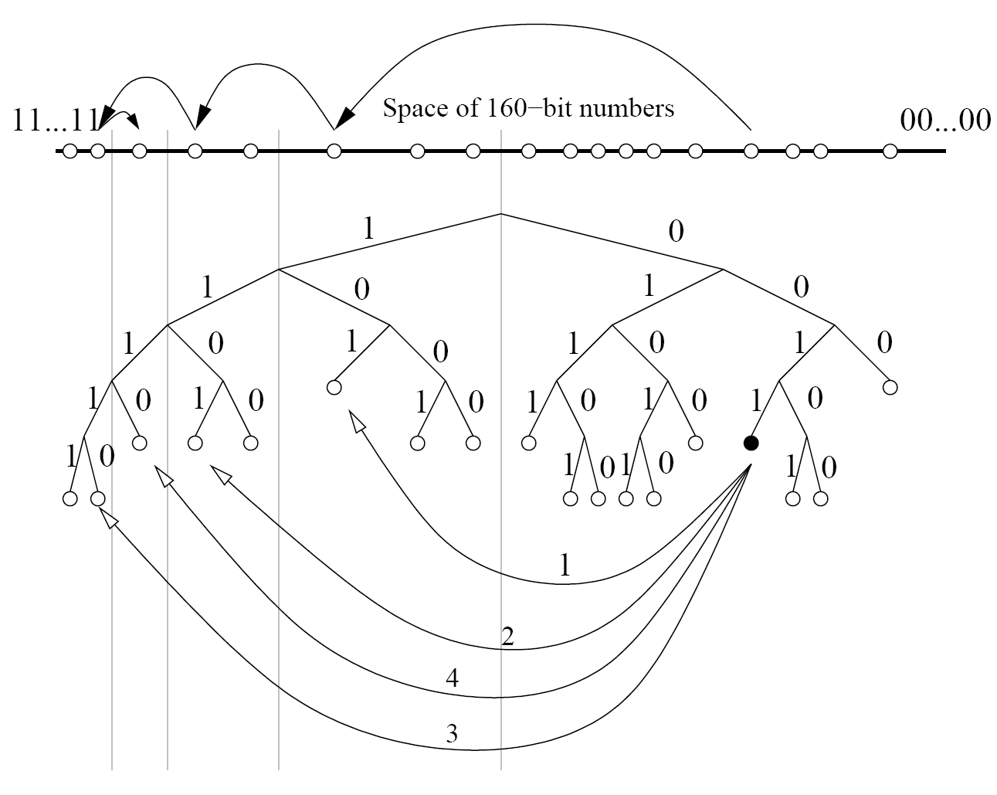
Kademlia Search
An example of lookup: node 0011 is searching for 1110……in the network

Slide 125
Kademlia Lookup
Locate the k closest nodes to a given nodeID.
Uses a recursive algorithm for node lookups.
  The lookup initiator starts by picking a node from its closest non-empty k-bucket.
  The initiator then sends parallel, asynchronous FIND_NODE to the α nodes it has chosen.
  The initiator resends the FIND_NODE to nodes it has learned about from previous requests.
  If a round of FIND_NODES fails to return a node any closer than the closest already seen, the initiator resends the FIND_NODE to all of the k closest nodes it has not already queried.

Slide 126
Kademlia Keys Store
To store a (key,value) pair, a participant locates the k closest nodes to the key.
Additionally, each node re-publishes (key,value) pairs as necessary to keep them alive
Kademlia’s current application (file sharing), requires the original publisher of a (key,value) pair to republish it every 24 hours. Otherwise, (key,value) pairs expire 24 hours after publication.

Slide 127
Kademlia Cost
Operation cost
  As low as other popular protocols
  Look up, O(logN)
  Join or leave, O(log2N)
Fault tolerance and concurrent change
  Handles well, for the use of k-buckets
Proximity routing
  Kademlia can choose from α nodes that has lower latency

