Slide 1
4730: Distributed Systems
Event Ordering
Physical and logical clocks. Global states. Failure detection. 9/10/24

Slide 2
Plan for today
Why ordering events is needed in distributed systems
Physical time
Logical time
Global state and snapshot, Chandi-Lamport
Failure detectors

Slide 3
Ordering events in distributed systems
Events in message-passing distributed systems
  Send a message
  Receive a message
Time is essential for ordering events in a distributed system
  Physical time:
    Global (wall) clock
    Local clock
  Logical time:
    Lamport clocks
    Vector clocks

Slide 4
Reading for this lecture
L. Lamport for "Time, Clocks, and the Ordering of Events in a Distributed System," Communications of the ACM, July 1978, 21(7):558-565. E.W. Dijkstra Prize 2000, SIGOPS Hall of Fame.
Mattern, F. "Virtual Time and Global States of Distributed Systems", in Cosnard, M., Proc. Workshop on Parallel and Distributed Algorithms, Chateau de Bonas, France: Elsevier, pp. 215–226, 1988
K. M. Chandy and L. Lamport, Distributed Snapshots: Determining Global States of Distributed Systems. ACM Transactions on Computer Systems, Vol. 3, No. 1, February, 1985, pp. 63-75. SIGOPS Hall of Fame.
T. Chandra and S. Toueg. Unreliable Failure Detectors for Reliable Distributed Systems, 1996.

Slide 5
1: Physical time

Slide 6

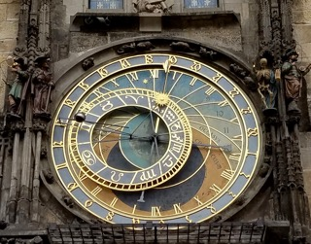


Historical clocks
Humans used a variety of devices to measure time
  Sundials
  Astronomical clocks
  Candle clocks
  Hourglasses
Mechanical clocks developed in medieval ages
  Typically maintained by monks (church bell tower)

Slide 7
Electrical clocks
First developed in 1920s
  Use carefully shaped quartz crystal
  Pass current, counts oscillations
Most oscillate at 32,768/sec
  Easy to count in hardware
  Small enough to fit (~4mm)
Typical quartz clock quite accurate
  Within 15 sec/30 days (6e-6)
  Can achieve 1e-7 accuracy in controlled conditions
  Not good enough for today’s applications

Slide 8
Atomic clocks
Based on atomic physics
  Cool atoms to near absolute zero
  Bombard them with microwaves
  Count transitions between energy levels
Most accurate timekeeping devices
  Accurate to within 10⁻⁹ seconds per day e.g., loses 1 second in 30 million years
Standard International second defined in terms of atomic oscillations
  9,192,631,770 transitions of cesium-133 atom

Slide 9
GMT, UT1, and UTC
GMT: Greenwich Mean Time
  Originally, mean solar time at 0º longitude
  This isn’t really “noon” due to Earth’s axial tilt
UT1: Universal Time
  Modernized version of GMT
  Based on rotation of Earth, ~86,400 seconds/day
UTC: Universal Coordinated Time
  UT1 + leap seconds
  Minutes can have 59-61 seconds
  Since 1972, 25 leap seconds have been introduced

Slide 10
International Atomic Time
Atomic clocks used to define a number of time standards
TAI: International Atomic Time
  Avg. of 200 atomic clocks, corrected for time dilation
Essentially, a count of the number of seconds passed
Count was 0 on Jan. 1, 1958
UTC: since January 1, 1972, it has been defined to follow TAI with an exact offset of an integer number of seconds, changing only when a leap second is added to keep clock time synchronized with the rotation of the Earth.

Slide 11
Using real clocks to order events
Each event will carry a timestamp
Global clock: processes have access to a central global clock
  The global clock gives global ordering of events
Local clock: each process has its own clock
  What if the clocks are not synchronized
  What if events happened at the same time?

Slide 12
Clocks in computers
Real-time clock: CMOS clock (counter) circuit driven by a quartz oscillator with battery backup to continue measuring time when power is off
OS generally programs a timer circuit to generate an interrupt periodically
  e.g., 60, 100, 250, 1000 interrupts per second
  (Linux 2.6+ adjustable up to 1000 Hz)
  Programmable Interval Timer (PIT) – Intel 8253, 8254
  Interrupt service procedure adds 1 to a counter in memory
Quartz oscillators oscillate at slightly different frequencies, clocks do not agree in general !!!

Slide 13
What does it mean for a clock to be correct?
Relative to an “ideal” clock
  Clock skew is magnitude
  Clock drift is difference in rates
Say clock is correct within p if
(1-p)(t’-t) ≤ H(t’) - H(t) ≤ (1+p)(t’-t)
  (t’-t) True length of interval
  H(t’) - H(t) Measured length of interval
  (1-p)(t’-t) Smallest acceptable measurement
  (1+p)(t’-t) Largest acceptable measurement
Monotonic property: t < t’ ⇒ H(t) < H(t’)

Slide 14
Monotonicity
If a clock is running “slow” relative to real time
  Can simply re-set the clock to real time
  Doesn’t break monotonicity
But, if a clock is running “fast”, what to do?
  Re-setting the clock back breaks monotonicity
  Imagine programming with the same time occurring twice
Instead, “slow down” clock
  Maintains monotonicity

Slide 15
Clock synchronization: Cristian’s Algorithm
Assumes a time server has the accurate time and a client synchronizes with it
  Client asks the time server for time
  Server sends its time T_{server}
  Client estimates how long it takes to receive an answer from server as RTT/2 where:
  RTT = (T_{client_receive} – T_{client_send})
  Client adjusts its clock
T_{client_send}
Client
Server
Time?
RTT Sample
T_server
T_{client_receive}
T_{client} = T_{server} + (RTT / 2)

Slide 16
Cristian’s Algorithm accuracy
Assumes that it takes the same amount of time to send the request and receive the answer (the network path is symmetric)
Minimum time to transmit a message one-way: min
Time to receive the server’s message is [min, RTT – min]
Time at client [T_{server} + min, T_{server} + RTT – min]
accuracy is ±(RTT /2 - min)

Slide 17
Clock synchronization: Berkeley Algorithm
Assumes no machine has an accurate time source; uses an elected master to synchronize
Master coordinates:
  Queries all clients for their local time
  Estimates the clients’ local time (as Cristian’s Algorithm)
  Averages all times including its own, excluding the ones that are too drifted
  Tells each client the offset with each they need to adjust
Some systems use multiple time servers
Time is more accurate, but still drifts

Slide 18
The Global Positioning System (GPS)
Consists of fixed constellations of special orbiting satellites that each carry:
  Stabilized atomic clock hardware
  Advanced location tracking
  Transmitters that constantly broadcast their position and clock time
These satellites are all synchronized to the same time and have known locations due to their geosynchronous orbits.
GPS (US), Galileo (EU), GLONASS (Russia), BeiDou (China)
www.masterclock.com

Slide 19
Network Time Protocol (NTP)
NTP is a distributed service that
  Keeps machines synchronized to UTC
  Deals with lengthy losses of connectivity
  Enables clients to synchronized frequently (scalable)
  Avoids security attacks
NTP deployed widely today
  Uses 64-bit value, epoch is 1/1/1900 (rollover in 2036)
  LANs: Precision to 1ms
  Internet: Precision to 10s of ms
  NTP pool is a dynamic collection of computers that volunteer to provide time via the NTP, about 4000 servers

Slide 20
NTP Hierarchy
Based on hierarchy of accuracy, called strata
  Stratum 0: High-precision atomic clocks
  Stratum 1: Hosts directly connected to atomic clocks
  Stratum 2: Hosts that run NTP with stratum 1 hosts
  Stratum 3: Hosts that run NTP with stratum 2 hosts
  …
Stratum x hosts synch with other stratum x hosts
  Provides redundancy

Slide 21
Reference clocks
Many NTP servers synchronize directly to UTC using specialized equipment
  Atomic clocks: Ultimately are the root source of time in NTP
  Global Positioning System (GPS): can synchronize with a satellite’s atomic clock
  Code Division Multiple Access (CDMA): can synchronize with a local wireless provider (who in turn most likely synchronizes using GPS)
  Radio signals: similar to CDMA, can synchronize with time/frequency radio stations
    NIST WWV: 10,000W on 5, 10, and 15 MHz; 2500W on 2.5 and 20 MHz.

Slide 22
On-the-wire protocol
Client initiates request by recording timestamp T1, placing in packet, then sending to NTP server
NTP Server records timestamp T2 when receiving request packet (and can do other processing if needed)
When ready to send a reply, the NTP server records timestamp T3, places T1, T2, T3 in reply and sends back to client
Client receives reply and records timestamp T4
T₂
T₃
NTP server
T₁
T₂
T₃
T₁
client
T₁
T₄

Slide 23
Updating the clock
Client calculates offset between her clock and server’s clock, and updates her clock by that amount
To synchronize exactly, client needs to know one-way delay between server and client
  One-way delay is difficult in practice to ascertain, so NTP assumes path is symmetrical and one-way delay is half of round trip time
  Offset is calculated to be:
  ½ [(T2 - T1) + (T3 - T4)]

Slide 24
NTP in practice
Runs on UDP port 123
  Most Internet hosts support NTP
Accuracy on general Internet is ~10ms
  Up to 1ms on local networks, ideal conditions
Many networks run local NTP servers
  E.g., time.ccs.neu.edu
NTP has been a vector for DDoS (amplification) attacks
  Best practice is for servers to filter requests outside local network

Slide 25
2: Logical time

Slide 26
From physical clocks to logical clocks
Synchronized clocks are great if we have them
Why do we need the time anyway?
In distributed systems we care about ‘what happened before what’
Message-based systems, two type of events
  Send a message
  Receive a message

Slide 27
``HAPPENED BEFORE’’ →
p₁
p₂
p₃
p₄
If events a and b take place at the same process and a occurs before b (physical time) then we have a → b
If a is a send event of message m at p₁ and b is a deliver event of the same m at p₂, p₁ ≠ p₂ then a → b
If a → b and b → c then a → c
Notes:
Shouldn’t be send and deliver of the same message???

Slide 28
Logical Clocks: Lamport Clocks (1978)
Each process maintains his own clock C_{i} (a counter)
Clock Condition: for any events a and b at process p_{i}
    if a → b then C_{i}(a) < C_{i}(b)
Implementation: each process p_{i}
  increments C_{i} between any successive events
  on sending a message m, attaches to it local clock C_{i}
      T_{m} = C_{i}(a)
  on receiving of message m from process p_{k} sets C_{i} to
  C_{i} = max(C_{i} ,T_{k}) + 1

Slide 29
Lamport Clocks: Example
p₁
2
3
6
7
8
p₂
7
1
8
p₃
4
5
6
9

Slide 30
Lamport Clocks: Total Order
Logical Clocks only provide partial order
Create Total Order by breaking the ties
Example to break ties, use process identifiers, have an order on process identifiers:
  If a is event in p_{i} and b is event in p_{j} then
  a → b iff
  C_{i}(a) < C_{j}(b) or
  C_{i}(a) = C_{j}(b) and p_{i} < p_{j}

Slide 31
Reminder: Partial and Total Order
Definition: A relation R over a set S is a partial order iff for each a, b, and c in S:
  aRa (reflexive).
  aRb ∧ bRa ⇒ a = b (antisymmetric).
  aRb ∧ bRc ⇒ aRc (transitive).
Definition: A relation R over a set S is total order if for each distinct a and b in S, R is antisymmetric, transitive and either aRb or bRa (completeness).

Slide 32
Concurrent events
Concurrent events:
If a →b and b →a then a and b are concurrent
Logical clocks assign order to events that are causally independent, i.e., events that are causally independent appear as if they happened in a certain order
For some applications (e.g. debugging) it is important to capture independence

Slide 33

Vector Clocks
Independently developed by Colin Fidge and Friedemann Mattern in 1988.
Each process p_{i} maintains a vector C_{i}
C_{i} = [0, 0, ..., 0]
When p_{i} executes an event, it increments its own clock C_{i}[i]
When p_{i} sends a message m to p_{j}, it attaches its vector C_{i} on m.
When p_{i} receives a message m, increments its own clock and updates the clock for the other processes as follows
∀ j: 1 ≤ j ≤ n, j ≠ i: C_{i}[j] = max(C_{i}[j], m.C[j])
C_{i}[i] = C_{i}[i] + 1.

Slide 34
Vector Clocks: Example
0 0 0
1 1 0
2 1 0
3 1 2
4 1 2
5 1 2
p₁
M5[412]
M2[210]
M6[512]
0 0 0
M1[010]
2 2 3
p₂
0 1 0
4 3 3
M3[212]
M4[213]
0 0 0
p₃
2 1 1
2 1 2
2 1 3
5 1 4
Notes:
P1: receives m1, sends m2, sends m5, sends m6
P2: sends messages m1, receives m4, receives m5,
P3: receives m2, sends m3, sends m4, receives m6

Slide 35
How to Order with Vector Clocks
Given two events a and b, a → b if and only if
V(a) is less than or equal to V(b) for all process indices, and at least one of those relationships is strictly smaller.
Otherwise, we say they are concurrent or independent ||
  a → b ≡ ∀ i: 1 ≤ i ≤ n: V(a)[i] ≤ V(b)[i] ∧ ∃ i: 1 ≤ i ≤ n: V(a)[i] < V(b)[i]
  a || b ≡ ∃ i: 1 ≤ i ≤ n: V(a)[i] < V(b)[i]. ∧ ∃ j: 1 ≤ j ≤ n: V(b)[j] < V(a)[j]
Notes:
Here some example

Slide 36
What Events Are Independent?
0 0 0
1 1 0
2 1 0
3 1 2
4 1 2
5 1 2
p₁
m5
m2
m6
0 0 0
m1
2 2 3
p₂
0 1 0
4 3 3
m4
0 0 0
m3
p₃
2 1 1
2 1 2
2 1 3
5 1 4
Notes:
M3 happened before m5
Sending of m3 in p3, 212, counter is 2
and receiving of m5, in p2 433, counter is 3

Slide 37
In class exercise

Slide 38
3: Global states and
Chandi-Lamport Snapshot Algorithm.

Slide 39
Why do we need global snapshots?
Global snaphot gives you the “global view” of the system
Examples of applications where global snapshots are useful:
  Checkpointing: save the state and restart the distributed application after a failure
  Garbage collection: objects at servers that don’t have any other objects (at any servers) with pointers to them
  Deadlock detection: debugging for database transaction systems
  Termination of computation: useful for batch computing systems

Slide 40
Recording global snapshots
If synchronized clocks are available, each process records its state at a
known time t
  How to obtain the state of the messages that transit the channels?
If synchronized clocks are not available
  How to determine when a process takes its snapshot?
  How to distinguish between the messages to be recorded in the snapshot from those not to be recorded?

Slide 41
Chandy-Lamport Algorithm: Model
Records a consistent global state of an asynchronous system.
System model:
  No failures and all messages arrive intact and only once
  Communication channels are unidirectional and FIFO ordered
  There is a communication path between any two processes
Other assumptions
  Any process may initiate the snapshot algorithm
  The snapshot algorithm does not interfere with the normal execution of the processes
  Each process records its local state and the state of its incoming channels

Slide 42
Chandy-Lamport Algorithm
A process needs to know
  When to start recording (in case it was not the one that initiated the algorithm)
  What messages to include in the snapshot
  When did all the other processes record their snapshot
Key design: uses a control message; marker
  Separate messages between those to be included in the snapshot from those not to be recorded in the snapshot
  Inform other processes that it has recorded its snapshot
  Inform other processes to start recording: A process must record its snapshot no later than when it receives a marker on any of its incoming channels

Slide 43
Chandy-Lamport Algorithm
Can be initiated by any process by executing the “Marker Sending Rule”
A process executes the “Marker Receiving Rule” on receiving a marker
  If the process has not yet recorded its local state, it records the state of the channel on which the marker is received as empty and executes the “Marker Sending Rule” to record its local state
The algorithm terminates after each process has received a marker on all of its incoming channels
All the local snapshots get disseminated to all other processes and all the processes can determine the global state

Slide 44
Chandy/Lamport Snapshot Algorithm
Marker-sending rule for a process p:
  Saves its own local state
  Sends a marker to all other processes on their corresponding channels before sending any other message
Marker-receiving rule for a process q on channel c
  If q has not recorded its state then
    q records its state
    q record the state of incoming channel c as “empty”
    turn on recording of messages over other incoming channels
    for each outgoing channel c, send a marker on c
  else
    q records the state of incoming channel c as all the messages received over c after q recorded its state and before q received the marker on c

Slide 45
Example of Chandy-Lamport Algorithm
Three processes p, q and r. Communication channels, c1 (p to q), c2 (q to p), c3 (q to r), and c4 (r to p).They all start with state = $500 and the channels are empty. The stable property is that the total amount of money is $1500.
Process p sends $10 to q and then starts the snapshot algorithm: records its current state 490 and sends out a marker on c1.
Meanwhile, q sent $20 to p along c2 and $10 to r along c3.

Slide 46
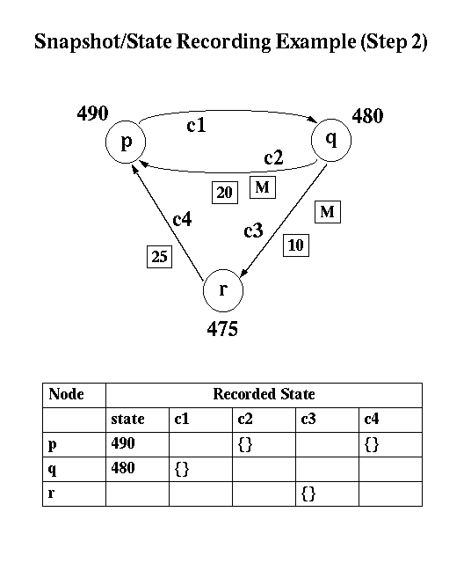
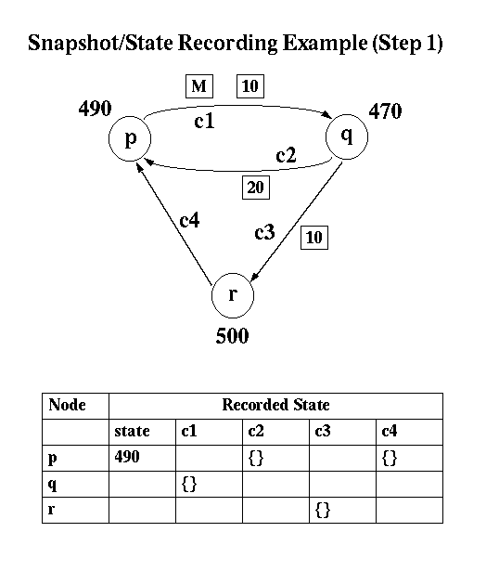
Notes:
Process p sends $10 to q and then starts the snapshot algorithm: records its current state 490 and sends out a marker on c1.
Meanwhile q has sent $20 to p along c2 and 10 to r along c3.
Process q receives the the $10 transfer (increasing its value to $480) and then recieves the marker on channel c1. Because it received a marker, process q records its state as $480 and sends markers along each of its outgoing channels c2 and c3. Meanwhile, process r has sent $25 along c4. Note that it does not matter if r sent the message before or after q received the marker.

Slide 47
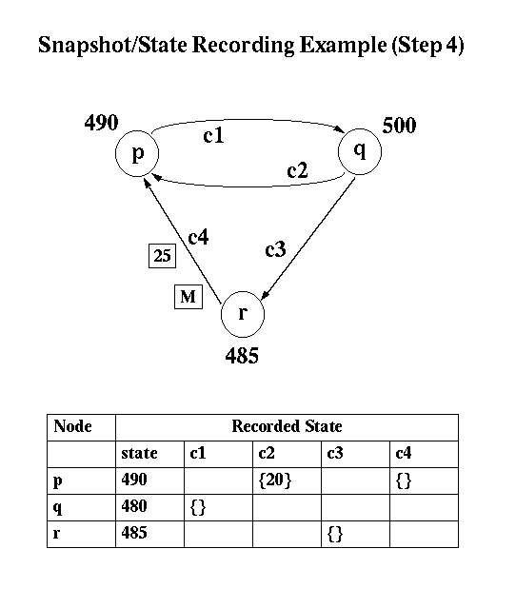
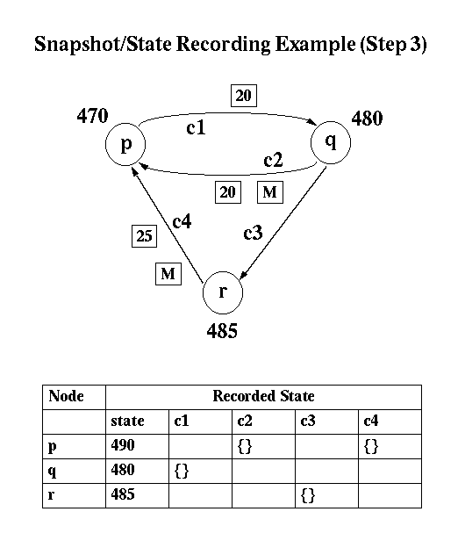
Notes:
http://courses.cs.vt.edu/~cs5204/fall00/Summaries/GlobalState/snapshot4.gif

Slide 48
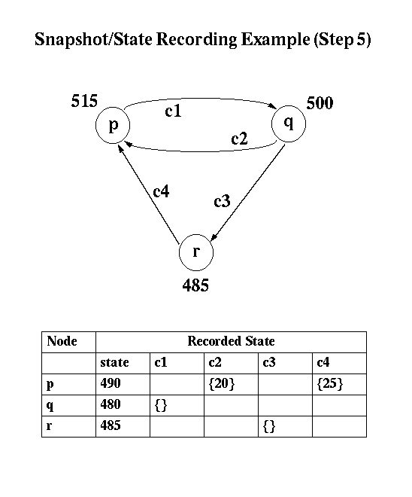

Slide 49
Correctness for Chandi-Lamport
How do we define correctness in this case?
Records a consistent global state of an asynchronous system.
We need some definitions

Slide 50
History of events
Given a process p_{i}
Event e_{i}^{j} is the event j at process i
History of process p_{i}, h_{i} is a sequence of events that happened at p_{i}
h_{i} = <e_{i}⁰, e_{i}¹, … >
Prefix history at p_{i} up to k, is the history of p_{i} up to the k^{th} event
h_{i}^{k} = <e_{i}⁰, e_{i}¹, …,e_{i}^{k} >
State S_{i}^{k} is the state of process p_{i} immediately before the k^{th} event

Slide 51
History of events: More definitions
Given a set of processes
Global history: the set of all processes’ histories
    H = ∪_{i} (h_{i})
Global state: the set of states at each process
S = ∪_{i} (S_{i}^{ki})
Cut: a set of prefix histories
  C ⊆ H = h₁^{c1} ∪ h₂^{c2} ∪ … ∪ h_{n}^{cn}
Frontier of a cut: the set of last event that happened in each prefix history
C = {e_{i}^{ci}, i = 1,2, … n}

Slide 52
Consistent Cuts
Definition: A cut C is consistent if for any event e in the cut,
if an event f ‘happened before’ e, then f is also in the cut C
∀_{e ∈ C} (if f → e then f ∈ C)
1
2
3
4
p₁
p₂
1
2
3
4
Consistent cut
Inconsistent cut

Slide 53
How do we use global states? (more definitions…)
Consistent global state: a global state that corresponds to a consistent cut
Run: a total ordering of events in history H that is consistent with each process history h_{i}’s ordering
Linearization: a run consistent with happens-before relation in H; Linearizations pass through consistent global states
Reachability: a global state S_{k} is reachable from global state S_{i}, if there is a linearization, L, that passes through S_{i} and then through S_{k}.

Slide 54
Global state predicates
How do we use global states to reason about distributed systems?
Global state predicate: a function from the set of global states:
{TRUE, FALSE}
Stable global state predicate: one that once it becomes true, it remains true in all future states reachable from that state.
Examples:
  “the system is deadlocked”
  “all tokens in a token ring have disappeared”
  “the computation has finished”

Slide 55
Safety and Liveness
Safety: a condition that must hold in every finite prefix of a sequence (from an execution)
“nothing bad happens”
Liveness: a condition that must hold a certain number of times
“something good happens”

Slide 56
Stable Global States and Safety
Look for undesirable properties, “bad things”
Assume that a ‘bad thing’ BT (for example deadlock) is a global state predicate and S₀ is the initial state of the system, then
“Safety with respect to BT” means
∀S reachable from S₀, BT(S) = FALSE

Slide 57
Stable Global States and Liveness
Look for desirable properties, “good things”
Assume that a “good thing” GT (for example reaching termination) is a global-state-predicate and S₀ is the initial state of the system then
  Liveness with respect to GT means:
  For any linearization L,
  starting at S₀ ∃ state, S_{L} reachable from S₀ such that
  GT(S_{L}) = TRUE

Slide 58
4: Detecting Failures

Slide 59
Failure detectors as an abstraction
Failure detector: distributed oracle that makes guesses about process failures
Accuracy: the failure detector makes no mistakes when labeling processes as faulty
Completeness: the failure detector “eventually” (after some time) suspects every process that actually crashes
Detectors classified based on their properties
Used to solve different distributed systems problems

Slide 60
Completeness
Strong Completeness: There is a time after which every process that crashes is suspected by EVERY correct process.
Weak Completeness: There is a time after which every process that crashes is suspected by SOME correct process.

Slide 61
Accuracy
Strong Accuracy: No process is suspected before it crashes.
Weak Accuracy: Some correct process is never suspected. (at least one correct process is never suspected)
Eventual Strong Accuracy: There is a time after which correct processes are not suspected by any correct process.
Eventual Weak Accuracy: There is a time after which some correct process is never suspected by any correct process.

Slide 62
Perfect failure detector
A perfect failure detector has strong accuracy and strong completeness
THIS IS AN ABSTRACTION
IT IS IMPOSSIBLE TO HAVE A PERFECT FAILURE DETECTOR
We have to live with … unreliable failures detectors…

Slide 63
Unreliable failure detectors
Unreliable failure detectors can make mistakes !!!
A process is suspected that it was faulty, that can be true or false, if false the list of alive processes is modified.
Failure detectors can add/remove processes from the list of suspects; different processes have different lists.
The assumptions are that:
  After awhile the network becomes stable, so the failure detector does not make mistakes anymore.
  In the unstable period, the failure detector can make mistakes.

Slide 64
Failure detection implementation
Push: processes keep sending heartbeats “I am alive” to the monitor. If no message is received for awhile from some process, that process is suspected as being dead (faulty).
Pull: monitor asks the processes “Are you alive?”, and process will respond “Yes, I am alive”. If no answer is received from some process, the process is suspected as being dead (faulty).
What are advantages and disadvantages of these two approaches?
STOP and DISCUSS

Slide 65
Failure detectors implementation (2)
Every process must know about who failed
How to disseminate the information
How about if not every node can communicate directly with another node?
  Centralized
  All-to-All
  Gossip based: provides probabilistic guarantees

Slide 66
Metrics for failure detectors
Detection time
Mistake recurrence time
Mistake duration
Average mistake rate
Query accuracy probability
Good period duration
Network load

Slide 67
Summary
Ordering events with logical clocks
    Lamport clocks uses a single clock per process,
    Vector clocks – each process maintains a clock for all the other processes
Determining global states
    Chandi-Lampprt algorithm for asynchronous systems, no failures and communication FIFO unidirectional.
Detecting failures
    There are no perfect failure detectors, both accurate and complete; push or pull methods

