Slide 1
4730: Distributed Systems
Alden Jackson & Cristina Nita-Rotaru
Dynamo. Casandra

Slide 2
1: Dynamo
Dynamo: Amazon’s Highly Available Key-value Store Giuseppe DeCandia, Deniz Hastorun, Madan Jampani, Gunavardhan Kakulapati, Avinash Lakshman, Alex Pilchin, Swaminathan Sivasubramanian, Peter Vosshall and Werner Vogels. SOSP 2007.
Slides taken from www.slideworld.com created by paper authors

Slide 3
CAP
States that any networked shared-data system can have at most two of three desirable properties:
  consistency (C)
  high availability (A) of that data (for updates)
  tolerance to network partitions (P)
During a network partition and recovery from partition one can not have perfect availability and consistency
Modern CAP goal should be to maximize combinations of consistency and availability that make sense for a specific application

Slide 4
PACELC
States that:
  In case of network partitioning (P) one has to choose between availability (A) and consistency (C)
  but else (E), even when the system is running normally in the absence of partitions, one has to choose between latency (L) and consistency (C)
Addresses the fact that CAP does not capture the consistency/latency tradeoff of replicated systems present at all times during system operation
Example: Dynamo, Cassandra are PA/EL systems if a partition occurs, they give up consistency for availability, and under normal operation they give up consistency for lower latency

Slide 5
Motivation
Even the slightest outage has significant financial consequences and impacts customer trust
The platform is implemented on top of an infrastructure of tens of thousands of servers and network components located in many datacenters around the world
Persistent state is managed in the face of these failures - drives the reliability and scalability of the software systems

Slide 6
Dynamo: Motivation
Build a distributed storage system:
  Scale
  Simple: key-value
  Highly available
  Guarantee Service Level Agreements (SLA)

Slide 7
System Assumptions and Requirements
Query Model:
  simple read and write operations to a data item that is uniquely identified by a key.
ACID Properties:
  Atomicity, Consistency, Isolation, Durability.
Efficiency:
  latency requirements which are in general measured at the 99.9th percentile of the distribution.
Other Assumptions:
  operation environment is assumed to be non-hostile and there are no security related requirements such as authentication and authorization.

Slide 8
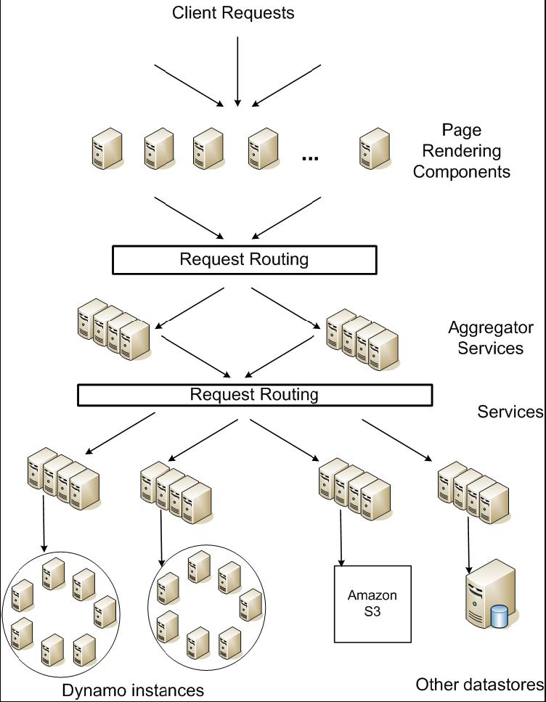
Service Level Agreements (SLA)
Application can deliver its functionality in a bounded time: Every dependency in the platform needs to deliver its functionality with even tighter bounds.
Example: service guaranteeing that it will provide a response within 300ms for 99.9% of its requests for a peak client load of 500 requests per second.
Service-oriented architecture of Amazon’s platform

Slide 9
Design Consideration
Sacrifice strong consistency for availability
Conflict resolution is executed during read instead of write, i.e. “always writeable”
Other principles:
  Incremental scalability
  Symmetry: Every node in Dynamo should have the same set of responsibilities as its peers
  Decentralization: In the past, centralized control has resulted in outages and the goal is to avoid it as much as possible
  Heterogeneity: This is essential in adding new nodes with higher capacity without having to upgrade all hosts at once

Slide 10
Design Consideration (Cont’d)
“always writeable” data store where no updates are rejected due to failures or concurrent writes
an infrastructure within a single administrative domain where all nodes are assumed to be trusted

Slide 11
Summary of techniques used in Dynamo and their advantages
Problem | Technique | Advantage
Partitioning | Consistent Hashing | Incremental Scalability
High Availability for writes | Vector clocks with reconciliation during reads | Version size is decoupled from update rates.
Handling temporary failures | Sloppy Quorum and hinted handoff | Provides high availability and durability guarantee when some of the replicas are not available.
Recovering from permanent failures | Anti-entropy using Merkle trees | Synchronizes divergent replicas in the background.
Membership and failure detection | Gossip-based membership protocol and failure detection. | Preserves symmetry and avoids having a centralized registry for storing membership and node liveness information.

Slide 12
Partition Algorithm
Consistent hashing: the output range of a hash function is treated as a fixed circular space or “ring”.
”Virtual Nodes”: Each node can be responsible for more than one virtual node.

Slide 13
Advantages of using virtual nodes
If a node becomes unavailable the load handled by this node is evenly dispersed across the remaining available nodes.
When a node becomes available again, the newly available node accepts a roughly equivalent amount of load from each of the other available nodes.
The number of virtual nodes that a node is responsible can decided based on its capacity, accounting for heterogeneity in the physical infrastructure.

Slide 14
Replication
Each data item is replicated at N hosts.
“preference list”: The list of nodes that is responsible for storing a particular key.

Slide 15
Data Versioning
A put() call may return to its caller before the update has been applied at all the replicas
A get() call may return many versions of the same object
Challenge: an object having distinct version sub-histories, which the system will need to reconcile in the future
Solution: uses vector clocks in order to capture causality between different versions of the same object

Slide 16
Vector Clock
A vector clock is a list of (node, counter) pairs
Every version of every object is associated with one vector clock
If the counters on the first object’s clock are less-than-or-equal to all of the nodes in the second clock, then the first is an ancestor of the second and can be forgotten

Slide 17
Vector clock example

Slide 18
Vector clock
In case of network partitions or multiple server failures, write requests may be handled by nodes that are not in the top N nodes in the preference list causing the size of vector clock to grow
Dynamo stores a timestamp that indicates the last time the node updated the data item
When the number of (node, counter) pairs in the vector clock reaches a threshold (say 10), the oldest pair is removed from the clock

Slide 19
Execution of get () and put () operations
Route its request through a generic load balancer that will select a node based on load information.
  Advantage: client does not have to link any code specific to Dynamo in its application
Use a partition-aware client library that routes requests directly to the appropriate coordinator nodes.
  Advantage: can achieve lower latency because it skips a potential forwarding step.

Slide 20
Temporary failures: Sloppy Quorum
R/W is the minimum number of nodes that must participate in a successful read/write operation.
Setting R + W > N yields a quorum-like system.
In this model, the latency of a get (or put) operation is dictated by the slowest of the R (or W) replicas. For this reason, R and W are usually configured to be less than N, to provide better latency.

Slide 21
Hinted handoff
Assume N = 3. When A is temporarily down or unreachable during a write, send replica to D.
D is hinted that the replica is belong to A and it will deliver to A when A is recovered.
Again: “always writeable”

Slide 22
Other techniques
Replica synchronization:
  Merkle hash tree
Membership and Failure Detection:
  Gossip

Slide 23
Replica synchronization
Merkle tree:
  A hash tree where leaves are hashes of the values of individual keys.
  Parent nodes higher in the tree are hashes of their respective children.
Advantage of Merkle tree:
  Each branch of the tree can be checked independently without requiring nodes to download the entire tree.
  Help in reducing the amount of data that needs to be transferred while checking for inconsistencies among replicas.

Slide 24
Improvement
A few customer-facing services required higher levels of performance.
Each storage node maintains an object buffer in its main memory.
Each write operation is stored in the buffer and gets periodically written to storage by a writer thread.
Read operations first check if the requested key is present in the buffer

Slide 25
Coordination
Dynamo has a request coordination component that uses a state machine to handle incoming requests. Client requests are uniformly assigned to nodes in the ring by a load balancer.
An alternative approach to request coordination is to move the state machine to the client nodes. In this scheme client applications use a library to perform request coordination locally.

Slide 26
Conclusion
Dynamo is a highly available and scalable data store for Amazon.com’s e-commerce platform
Dynamo has been successful in handling server failures, data center failures and network partitions
Dynamo is incrementally scalable and allows service owners to scale up and down based on their current request load
Dynamo allows service owners to customize their storage system by allowing them to tune the parameters N, R,and W

Slide 27
2. DynamoDB
Amazon DynamoDB: A Scalable, Predictably Performant, and Fully Managed NoSQL Database Service Mostafa Elhemali, Niall Gallagher, Nicholas Gordon, Joseph Idziorek, Richard Krog, Colin Lazier, Erben Mo, Akhilesh Mritunjai, Somu Perianayagam ,Tim Rath, Swami Sivasubramanian, James Christopher Sorenson III, Sroaj Sosothikul, Doug Terry, Akshat Vig, Amazon Web Services
USENIX ATC 2022

Slide 28
What is DynamoDB?
NoSQL database service that is offered by Amazon.com
Amazon released DynamoDB on January 18, 2012.
Amazon DynamoDB lets you create a database table that can store and retrieve any amount of data and serve any level of request traffic
Supports both document and key-value store models

Slide 29
Fully managed cloud service
Using the DynamoDB API, applications create tables and read and write data without regard for where those tables are stored or how they are managed
DynamoDB
  Handles resource provisioning
  Automatically recovers from failures
  Encrypts data
  Manages software upgrades
  Performs backups

Slide 30
Multi-tenant architecture
DynamoDB stores data from different customers on the same physical machines
Ensures high utilization of resources, the cost savings passed to customers.
Isolation between the workloads of co-resident tables
  Resource reservations
  Tight provisioning
  Monitored usage provide isolation between the workloads of co-resident tables

Slide 31
Boundless scale for tables
There are no predefined limits for the amount of data each table can store.
Tables grow elastically to meet the demand of the customers’ applications.
DynamoDB is designed to scale the resources dedicated to a table from several servers to many thousands as needed.
DynamoDB spreads an application’s data across more servers as the amount of data storage and the demand for throughput requirements grow.

Slide 32
Provides predictable performance
GetItem and PutItem operations allows it to respond to requests with consistent low latency.
An application running in the same AWS Region as its data will typically see average service-side latencies in the low single- digit millisecond range for a 1 KB item.
DynamoDB latencies are predictable due to the distributed nature of data placement and request routing algorithms in DynamoDB.
DynamoDB handles any level of traffic through horizontal scaling and automatically partitions and re-partitions data to meet an application’s I/O performance requirements.

Slide 33
Highly available
DynamoDB replicates data across multiple data centers—called Availability Zones in AWS—and automatically re-replicates in the case of disk or node failures to meet stringent availability and durability requirements.
Customers can also create global tables that are geo-replicated across selected Regions for disaster recovery and provide low latency access from anywhere.
DynamoDB offers an availability SLA of 99.99 for regular tables and 99.999 for global tables (where DynamoDB replicates across tables across multiple AWS Regions).

Slide 34
Flexible use cases
DynamoDB does not force developers into a particular data model or consistency model.
DynamoDB tables do not have a fixed schema but instead allow each data item to contain any number of attributes with varying types, including multi-valued attributes.
Tables use a key-value or document data model.
Developers can request strong or eventual consistency when reading items from a table.

Slide 35
DynamoDB Architecture

Slide 36
Dynamo vs DynamoDB
Dyanamo
DynamoDB
Single tenant
Tunable consistency
Availability over consistency
Routing and storage coupled
Custom conflict resolution
Multi-tenant
Strong and eventual consistency
Consistency over availability
Routing and storage decoupled
Last writer wins

Slide 37
Use of Paxos
Uses Paxos for leader election for replication across different availability zones (3 replicas)
Any replica of the replication group can serve eventually consistent reads.
The leader of the group extends its leadership using a lease mechanism.
In case of leader failure, a new leader is elected and the new leader won’t serve any writes or consistent reads until the previous leader’s lease expires.
A follower that wants to trigger a leader election sends a message to other replicas in the replication group asking if they can communicate with the leader. If replicas respond with yes, the follower drops its attempt to trigger a leader election.

Slide 38
Storage vs log replicas
Storage replicas: contain both the logs and data
Log replicas: contains only the logs, no data. They are similar to acceptors in Paxos.
Replication group consists of both storage and log replicas
Log replicas improve availability and durability

Slide 39
3: Cassandra
Slides by Indranil Gupta, UIUC
Based mostly on
Cassandra NoSQL presentation
Cassandra 1.0 documentation at datastax.com
Cassandra Apache project wiki
HBase

Slide 40










Cassandra
Originally designed at Facebook
Open-sourced
Some of its myriad users:

Slide 41
Issues with today’s workloads
Data: Large and unstructured
Lots of random reads and writes
Foreign keys rarely needed
Need
  Incremental Scalability
  Speed
  No Single point of failure
  Low TCO and admin
  Scale out, not up

Slide 42
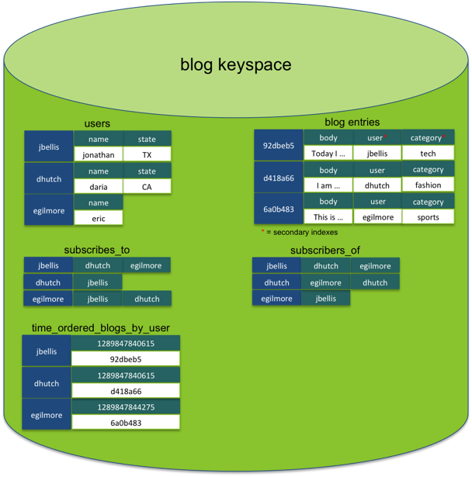
Cassandra data model
Column Families:
  Like SQL tables
  but may be unstructured (client-specified)
  Can have index tables
Hence “column-oriented databases”/ “NoSQL”
  No schemas
  Some columns missing from some entries
  “Not Only SQL”
  Supports get(key) and put(key, value) operations
  Often write-heavy workloads

Slide 43
0
Say m=7
N112
N16
Primary replica for
key K13
N96
Read/write K13
N32
N80
N45
Coordinator (typically one per DC)
Backup replicas for
key K13
Cassandra uses a Ring-based DHT but without routing

Slide 44
Writes
Need to be lock-free and fast (no reads or disk seeks)
Client sends write to one front-end node in Cassandra cluster (Coordinator)
Which (via Partitioning function) sends it to all replica nodes responsible for key
  Always writable: Hinted Handoff
    If any replica is down, the coordinator writes to all other replicas, and keeps the write until down replica comes back up.
    When all replicas are down, the Coordinator (front end) buffers writes (for up to an hour).
  Provides Atomicity for a given key (i.e., within ColumnFamily)
One ring per datacenter
  Coordinator can also send write to one replica per remote datacenter

Slide 45
Writes at a replica node
On receiving a write
1. Log it in disk commit log
2. Make changes to appropriate memtables
  In-memory representation of multiple key-value pairs
Later, when memtable is full or old, flush to disk
  Data File: An SSTable (Sorted String Table) – list of key value pairs, sorted by key
  Index file: An SSTable – (key, position in data sstable) pairs
    And a Bloom filter
Compaction: Data updates accumulate over time and sstables and logs need to be compacted
  Merge key updates, etc.
Reads need to touch log and multiple SSTables
  May be slower than writes

Slide 46
Bloom Filter
Compact way of representing a set of items
Checking for existence in set is cheap
Some probability of false positives: an item not in set may check true as being in set
Never false negatives
On insert, set all hashed bits.
On check-if-present,
return true if all hashed bits set.
False positives
False positive rate low
k=4 hash functions
100 items
3200 bits
FP rate = 0.02%
Large Bit Map
0
1
2
3
Hash1
Key-K
Hash2
.
.
69
Hashk
111
127

Slide 47
Deletes and Reads
Delete: don’t delete item right away
  Add a tombstone to the log
  Compaction will remove tombstone and delete item
Read: Similar to writes, except
  Coordinator can contact closest replica (e.g., in same rack)
  Coordinator also fetches from multiple replicas
    check consistency in the background, initiating a read-repair if any two values are different
    Makes read slower than writes (but still fast)
    Read repair: uses gossip

Slide 48
Cassandra uses Quorums
Reads
  Wait for R replicas (R specified by clients)
  In background check for consistency of remaining N-R replicas, and initiate read repair if needed (N = total number of replicas for this key)
Writes come in two flavors
  Block until quorum is reached
  Async: Write to any node
Quorum Q = N/2 + 1
R = read replica count, W = write replica count
If W+R > N and W > N/2, you have consistency
Allowed (W=1, R=N) or (W=N, R=1) or (W=Q, R=Q)

Slide 49
Cassandra uses Quorums
In reality, a client can choose one of these levels for a read/write operation:
  ANY: any node (may not be replica)
  ONE: at least one replica
  QUORUM: quorum across all replicas in all datacenters
  LOCAL_QUORUM: in coordinator’s DC
  EACH_QUORUM: quorum in every DC
  ALL: all replicas all DCs

Slide 50
Cluster Membership
1 | 10118 | 64
2 | 10110 | 64
3 | 10090 | 58
4 | 10111 | 65
1 | 10120 | 66
2 | 10103 | 62
3 | 10098 | 63
4 | 10111 | 65
2
1
Address
Time (local)
1 | 10120 | 70
2 | 10110 | 64
3 | 10098 | 70
4 | 10111 | 65
Heartbeat Counter
4
Protocol:
Nodes periodically gossip their membership list
On receipt, the local membership list is updated
3
Current time : 70 at node 2
(asynchronous clocks)
Cassandra uses gossip-based cluster membership
Fig and animation by: Dongyun Jin and Thuy Ngyuen

Slide 51
Cluster Membership, contd.
Suspicion mechanisms
Accrual detector: FD outputs a value (PHI) representing suspicion
Apps set an appropriate threshold
PHI = 5 => 10-15 sec detection time
PHI calculation for a member
  Inter-arrival times for gossip messages
  PHI(t) = - log(CDF or Probability(t_now – t_last))/log 10
  PHI basically determines the detection timeout, but is sensitive to actual inter-arrival time variations for gossiped heartbeats
Cassandra uses gossip-based cluster membership
Fig and animation by: Dongyun Jin and Thuy Ngyuen
Notes:
FD = Failure Detector

Slide 52
Vs. SQL
MySQL is the most popular (and has been for a while)
On > 50 GB data
MySQL
  Writes 300 ms avg
  Reads 350 ms avg
Cassandra
  Writes 0.12 ms avg
  Reads 15 ms avg

Slide 53
Cassandra Summary
While RDBMS provide ACID (Atomicity Consistency Isolation Durability)
Cassandra provides BASE
  Basically Available Soft-state Eventual Consistency
  Prefers Availability over consistency
Other NoSQL products
  MongoDB, Riak

