Slide 1
4730: Distributed Systems
GFS. HDFS. BigTable. Hbase.
Acknowledgements to Cristina Nita-Rotaru

Slide 2
Required Reading
Google File System. S, Ghemawat, H. Gobioff and S.-T. Leung. SOSP 2003.
http://hadoop.apache.org
A Novel Approach to Improving the Efficiency of Storing and Accessing Small Files on Hadoop: A Case Study by PowerPoint Files, Bo Dong; Jie Qiu; Qinghua Zheng; Xiao Zhong; Jingwei Li; Ying Li;, IEEE International Conference on Services Computing (SCC) 2010

Slide 3
1: GFS

Slide 4
Google File System
File system for map/reduce
Example of how to handle storage failures trading consistency for simplicity and performance
What is GFS
  Scalable, distributed file system for large distributed data-intensive applications
  Based on a different set of assumptions leading to different design choices than conventional file systems
  Implemented as a userspace library

Slide 5
Application Characteristics
Hundreds of clients must perform concurrent (atomic) appends with minimal synchronization
Sustained bandwidth more important than latency
Response time for individual read/write not important
Non-traditional access patterns
Files are very big, several gigs

Slide 6
Design Choices
Fault-tolerance: Constant monitoring, error detection, automatic recovery part of the design
Big files: I/O operations and block sizes have to be revisited
Non-traditional access patterns:
  Most files are modified by appending rather than overwriting
  Large repositories that must be scanned (archival, streams, intermediate data)
  Result: appending is the focus of optimization
Co-design applications and file system: looser consistency

Slide 7
Interface Design
Not standard API (such as POSIX)
Supports file/directory hierarchy and the usual: {create, delete, open, close, read, write}
Files identified by path names
Two additional operations:
  Snapshot: low cost file / directory tree copying
  Record append: concurrent appends, no locks

Slide 8
Architecture Overview
Base unit is chunk:
  Chunk: fixed-part of a file, typically 64 MB
  Global ID: 64 bit, unique “chunk handle”, assigned by coordinator server upon chunk creation
  Read/Write: need chunk handle + byte range
  Each chunk is replicated, minimum three copies
  Stored as a plain Linux file on a chunkserver
Servers:
  Single coordinator - metadata
  Multiple backups (chunkservers)
Multiple clients

Slide 9
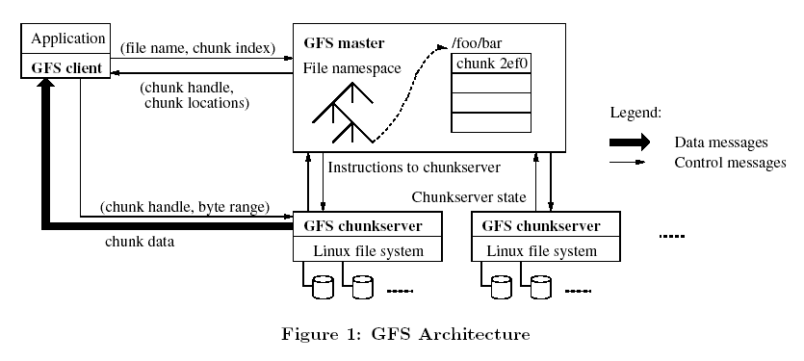
GFS Architecture
Clients cache for a limited time the chunk handle and locations so they
could interact directly with the chunckservers
Neither the client or chunservers cache file data.

Slide 10
Metadata
Coordinator server is in charge of metadata
File and chunk namespaces, logged to disk with chunk version
Mapping from files to chunks, logged to disk with chunk version
Location of chunk replicas, master obtains it at startup from each chunkserver, does not keep a persistent record of what chunkserver has what chunks
Metadata maintained in memory to speed things up

Slide 11
Why Location is not Persistent
If coordinator server keeps location of chunks persistent then the coordinator and chunkservers must be kept in sync as chunkservers join and leave
  Difficult when there is to much churn
Chunkserver ultimately knows what chunks it does or does not have on its own disks.

Slide 12
Operation Log
Persistent log of historical changes of metadata
Defines also the order of concurrent operations
It is replicated on several remote machines and response goes back to the client only after the corresponding log record was flushed to disk locally and remotely
Coordinator recovers its state by replaying the log
Log must be kept small for fast startup, periodically checkpoint

Slide 13
Design Overview: Consistency Model
File namespace modifications: atomic & handled only by coordinator server, done in memory and logged on disk
Concurrent writes, atomic appends
Chunk state can be:
  consistent if all clients see same data, no matter which replica they ask
  defined if it is consistent and known, i.e. some modification done w/o interruption
  undefined if concurrent modifications are successful, it’s consistent at all replicas but bits mixed from the different writes
  inconsistent on any failed modification, inconsistent regions may be padded or contain duplicates

Slide 14
System-Wide Activities
Coordinator server also in charge of
  chunk lease management
  garbage collection of orphaned chunks
  chunk migration between chunkservers

Slide 15
Leases
Lease: Permissions for modifications, valid 60 seconds, granted by the coordinator server to a chunkserver to modify the chunk.
Primary chunkserver:
  Primary chooses the serial number for all changes on a chunk
  It propagates the changes to the chunkservers with the backup copies. The changes are not saved until all chunkservers acknowledge.

Slide 16
Leases continued…
Clients access the chunks by first querying the coordinator,
  if the chunk is not being operated on (e.g. no outstanding leases exist), the coordinator replies with the location, and the client contacts the chunkserver directly
Coordinator can revoke a lease before it expires (for example coordinator wants to rename a file)

Slide 17
Read
Client translates the file name and offset into a chunk index within a file
Sends the coordinator a request containing filename and chunk index
Coordinator replies with chunk handle and locations of replica (this info is cached by the client, further reads do not require interaction with the coordinator)
Client sends a replica chunkserver the chunk handle and a byte range within the chunk

Slide 18
Write
Client asks coordinator what chunkserver has the lease for the chunk it wants to write to, if no lease exists, the coordinator will give one to a chunkserver it chooses
Coordinator replies with identity of primary and the other replicas for that chunkserver
Client pushes data to all replicas
Once all replicas ack, client sends the update to the primary
Primary assigns the order and sends the update to the replicas.
Replicas apply change in the same order as the primary and send ack back.
Primary replies to client.

Slide 19
Write: what can go wrong
If the client gets the reply back it means write can succeed at the primary and at some replicas, any error is reported to the client
Could the errors have happened at the primary? → Inconsistent state
If the data is larger than a chunk—multiple write operations.
  Operations may overlap with operations from other clients,
  Different clients may overwrite each other’s operations,
  Order is the same by different fragments from different clients → Undefined state

Slide 20
Record Append
Instead of writing new chunk, append to existing one
  Restricted to chunk-size / 4 to minimize chunk-boundary overflow
  if (boundary overflow) new chunk must be created
  else write into chunk @some_offset, and tell secondary replicas some_offset
If append fails, client retries the operation, no guarantee replicas are byte-wise identical!
  Guarantee: record was written at least once atomically (there can be duplicates)
  Failures at subset of chunkservers… inconsistent regions
  If a secondary server was offline and missed some updates… may have holes after record append

Slide 21
Snapshot
Makes a copy of file or directory tree
Used to quickly create branch copies of huge data sets, or to checkpoint current state before experimenting to allow rollback
Uses copy-on-write (like AFS)
  Coordinator revokes chunk leases, then snapshots
  Any time a lease is requested, chunk is copied first on same chunkserver
  After lease expires, commit to log + copy metadata

Slide 22
Snapshot Details (S1 Stop)
Coordinator receives snapshot request
Coordinator revokes existing leases, any other modification on those file have to go to the coordinator first
Coordinator logs operation on disk
Coordinator makes change in metadata in memory, newly snapshot files point to same chunks as original file
Client wants to write chunk C after snapshot, Coordinator sees count for C > 1 picks new handle id C’, tells chunkserver that has C to create a copy of C, with the new id C’.

Slide 23
Namespace Management & Locking
GFS: not your typical file system
  Lacks typical per-directory data structure to list each file in the directory
  Does not support aliases (i.e. hard or sym links)
  Namespace: lookup table that maps full pathnames to metadata
  Lookup table fits in memory (prefix compression)
Coordinator ops acquire set of locks before running
  read locks: /d1, /d1/d2, /d1/d2/…/dn, /d1/d2/../dn/leaf to lock “leaf”
  File creation does not lock parent dir: no directory or inode-esque structure to modify
  Allows concurrent modifications in same directory
  Locks always acquired in same order, prevents deadlock

Slide 24
Replica Replacement
Hundreds of chunkservers across many hardware racks, each accessed by hundreds of clients on same or different racks
Want to maximize reliability, availability but also network utilization
Must spread replicas across machines and racks
  Good: Replicas survive switch failure or power outage of entire rack, etc
  Bad: Read traffic for a chunk can exploit bandwidth of multiple racks
  Bad: Write traffic must flow through multiple racks

Slide 25
cReation, Re-replication, Rebalancing (The 3 Rs)
Creation:
  Place new replicas on servers with < average disk use
    Equalizes disk utilization across chunkservers
  Limit number of recently created chunks per server
    Creation implies chunk will be heavily written soon
    Spread anticipated load
  Place new replicas on different racks
    Requires IP addressing scheme to identify physical location of chunkservers
    Improve fault survival

Slide 26
Garbage Collection
Files that are “deleted”… really are not
  “Deleting” a file renames it… now it’s “hidden”
  Hidden files >= 3 days old are removed
    3-day limit is configurable
    Prevents accidental-and-irreversible data loss
  Undelete by renaming hidden file
  Lazy garbage collection, i.e. during idle time
    In-memory metadata erased
    Orphaned chunks gradually erased by chunkservers
    Also removes stale replicas (not up to current chunk version #)
  3-day delay caused some trouble for some users
    Temp files stick around, wasting space
    Replication level can be user specified per part of file namespace

Slide 27
Fault Tolerance and Diagnosis: Availability
Fast recovery
  Coordinator, chunk servers restore state quickly
  No distinction between normal/abnormal termination
Chunk replication
Coordinator replication
  State of coordinator server is replicated
  External watchdog can change DNS over to replica if coordinator fails
  Additional “shadow” coordinators provide RO access during outage

Slide 28
Fault Tolerance and Diagnosis: Integrity
Chunkservers checksum to detect corruption
  Corruption caused by disk failures, interruptions in r/w paths
  Each server must checksum because chunks not byte-wise equal
  Chunks are broken into 64 KB blocks
  Each block has a 32 bit checksum
  Checksums kept in memory and logged with metadata
  Can overlap with IO since checksums all in memory
Client code attempts to align reads to checksum block boundaries
During idle periods, chunkservers can checksum inactive chunks to detect corrupted chunks that are rarely read

Slide 29
2: HDFS

Slide 30
HDFS Basics
An open-source implementation of Google File System, created in 2005
Assume that node failure rate is high
Large files, some several GB large
Write-once-ready-many pattern
Reads are performed in a large streaming fashion
Large throughput instead of low latency
Moving computation is easier than moving data

Slide 31
HDFS Files
User data divided into 64MB blocks and replicated across local disks of cluster node to address:
  Cluster network bottleneck
  Cluster node crashes
Architecture
  Coordinator (Namenode) maintains a name space and metadata
  Replicas (Datanodes): maintain three copies of each data block

Slide 32
3: BigTable

Slide 33
Acknowledgement
Slides based on material from course at UMichigan, U Washington, and the authors of BigTable.

Slide 34
REQUIRED READING
Bigtable: A Distributed Storage System for Structured Data. 2008. ACM Trans. Comput. Syst. 26, 2 (Jun. 2008), 1-26

Slide 35
BigTable
Distributed storage system for managing structured data such as:
  URLs: contents, crawl metadata, links, anchors, pagerank
  Per-user data: user preference settings, recent queries/search results
  Geographic locations: physical entities (shops, restaurants, etc.), roads, satellite image data, user annotations, …
Designed to scale to a very large size: petabytes of data distributed across thousands of servers
Used for many Google applications
  Web indexing, Personalized Search, Google Earth, Google Analytics, Google Finance, … and more

Slide 36
Why BigTable?
Scalability requirements not met by existent commercial systems:
  Millions of machines
  Hundreds of millions of users
  Billions of URLs, many versions/page
  Thousands or queries/sec
  100TB+ of satellite image data
  …
Low-level storage optimization helps performance significantly

Slide 37
Goals
Simpler model that supports dynamic control over data and layout format
Want asynchronous processes to be continuously updating different pieces of data: access to most current data at any time
Examine data changes over time: e.g. contents of a web page over multiple crawls
Support for:
  Very high read/write rates (millions ops per second)
  Efficient scans over all or subsets of data
  Efficient joins of large one-to-one and one-to-many datasets

Slide 38
Design Overview
Distributed multi-level map
Fault-tolerant, persistent
Scalable
  Thousands of servers
  Terabytes of in-memory data
  Petabyte of disk-based data
  Millions of reads/writes per second, efficient scans
Self-managing
  Servers can be added/removed dynamically
  Servers adjust to load imbalance

Slide 39
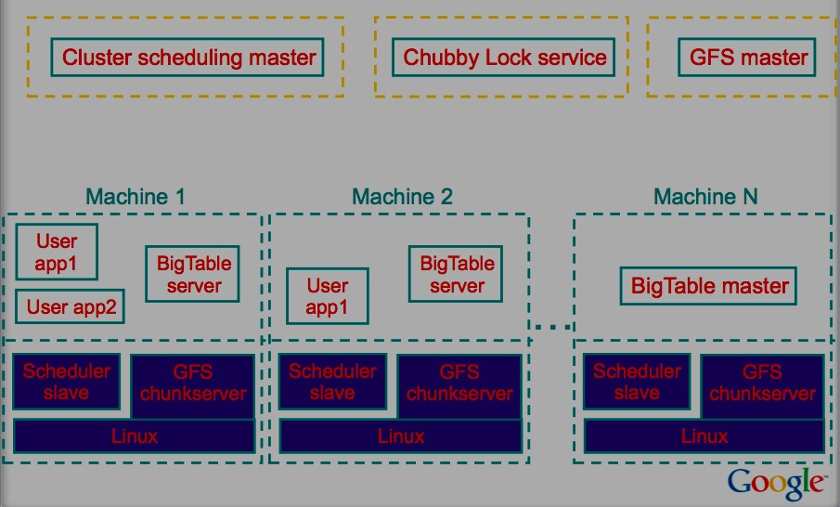
Typical Google Cluster (S2 end)
Shared pool of machines that also run other distributed applications
Notes:
AWJ: Looking for a more up to date figure….

Slide 40
Building Blocks
Google File System (GFS)
  Stores persistent data (SSTable file format)
Scheduler
  Schedules jobs onto machines
Chubby
  Lock service: distributed lock manager, master election, location bootstrapping
MapReduce (optional)
  Data processing
  Read/write BigTable data

Slide 41
Chubby
{lock/file/name} service
Coarse-grained locks
  Provides a namespace that consists of directories and small files.
  Each of the directories or files can be used as a lock.
Each client has a session with Chubby
  The session expires if it is unable to renew its session lease within the lease expiration time.
5 replica Paxos, need a majority vote to be active
Notes:
Chubby provides a namespace that consists of directories and small files.
Each of the directories or files can be used as a lock.

Slide 42
Data Model
A sparse, distributed persistent multi-dimensional sorted map
Rows, column are arbitrary strings
(row, column, timestamp) identifies the particular contents of a cell
Notes:
Rows, column are arbitrary strings
And the data is also treated as interpreted strings.

Slide 43
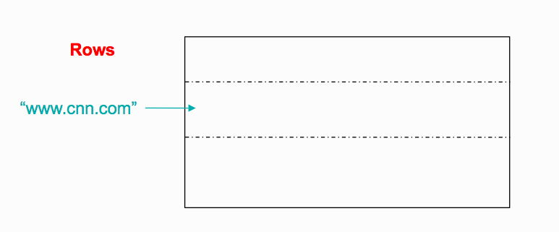
Data Model: Rows
Arbitrary string
Access to data in a row is atomic
  Row creation is implicit upon storing data
  Ordered lexicographically

Slide 44
Rows (cont.)
Rows close together lexicographically usually on one or a small number of machines
Reads of short row ranges are efficient and typically require communication with a small number of machines
Can exploit lexicographic order by selecting row keys so they get good locality for data access
Example:
  math.gatech.edu, math.uga.edu, phys.gatech.edu, phys.uga.edu
  VS
  edu.gatech.math, edu.gatech.phys, edu.uga.math, edu.uga.phys

Slide 45
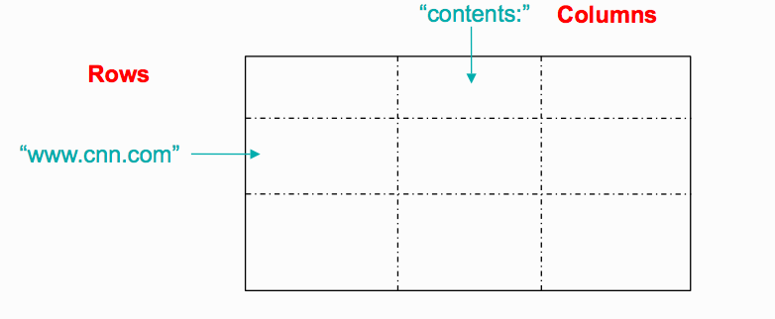
Data Model: Columns
Two-level name structure: family: qualifier
Column family:
  Is the unit of access control
  Has associated type information
Qualifier gives unbounded columns
  Additional levels of indexing, if desired

Slide 46
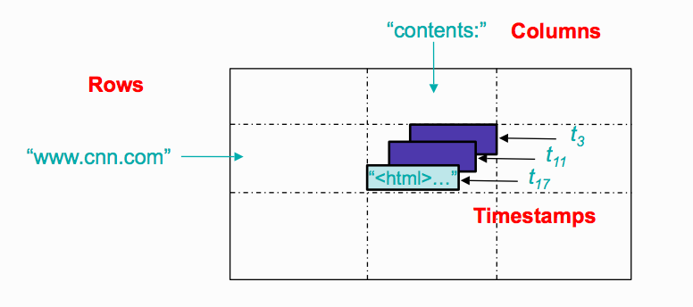
Data Model: Timestamps (64-bit integers)
Store different versions of data in a cell:
  New writes default to current time, but timestamps for writes can also be set explicitly by clients
Lookup options
  Return most recent K values
  Return all values
Column families can be marked w/ attributes:
  Retain most recent K values in a cell
  Keep values until they are older than K seconds

Slide 47
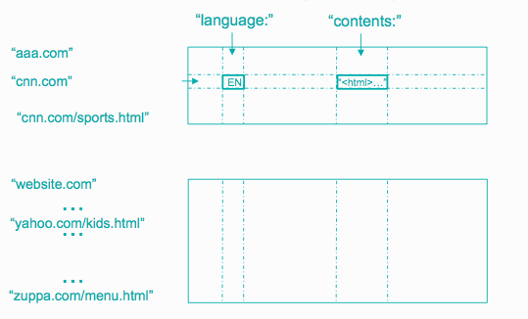
Data Model: Tablet
The row range for a table is dynamically partitioned
Each row range is called a tablet
Tablet is the unit for distribution and load balancing

Slide 48
Storage: SSTable (Sorted String Table)
Immutable, sorted file of key-value pairs
Optionally, SSTable can be completely mapped into memory
Chunks of data plus an index
  Index is of block ranges, not values
  Index is loaded into memory when SSTable is open
64K block
64K block
64K block
SSTable
Index

Slide 49
Tablet vs. SSTable
Tablet is built out of multiple SSTables
Tablet
Start:aardvark
End:apple
64K block
64K block
64K block
SSTable
64K block
64K block
64K block
SSTable
Index
Index

Slide 50
Table vs. Tablet vs. SSTable
Multiple tablets make up the table
SSTables can be shared
Tablets do not overlap, SSTables can overlap
Tablet
Tablet
aardvark
apple
apple_two_E
boat
SSTable
SSTable
SSTable
SSTable

Slide 51
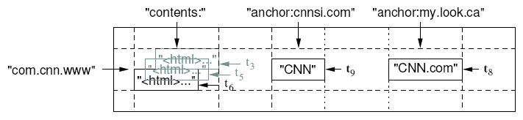
Example: WebTable
Want to keep copy of a large collection of web pages and related information
Use URLs as row keys
Various aspects of web page as column names
Store contents of web pages in the contents: column under the timestamps when they were fetched.

Slide 52
Implementation
Library linked into every client
One master server responsible for:
  Assigning tablets to tablet servers
  Detecting addition and expiration of tablet servers
  Balancing tablet-server load
  Garbage collection
  Handling schema changes such as table and column family creation
Many tablet servers, each of them:
  Handles read and write requests to its table
  Splits tablets that have grown too large
Clients communicate directly with tablet servers for reads and writes.

Slide 53
More about Tablets
Serving machine responsible for 10 - 1000
  Usually about 100 tablets
Fast recovery:
  100 machines each pick up 1 tablet for failed machine
Fine-grained load balancing:
  Migrate tablets away from overloaded machine
  Master makes load-balancing decisions

Slide 54
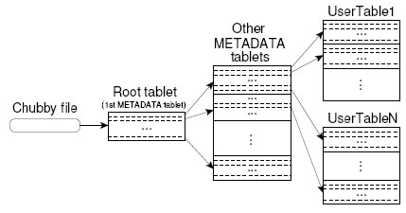
Tablet Location
Since tablets move around from server to server, given a row, how do clients find the right machine?
  Find tablet whose row range covers the target row
METADATA:
Key: table id + end row,
Data: location
Aggressive caching and prefetching at client side

Slide 55
Tablet Assignment
Each tablet is assigned to one tablet server at a time.
Coordinator server
  Keeps track of the set of live tablet servers and current assignments of tablets to servers.
  Keeps track of unassigned tablets.
When a tablet is unassigned, coordinator assigns the tablet to a tablet server with sufficient room.
It uses Chubby to monitor health of tablet servers, and restart/replace failed servers.

Slide 56
Tablet Assignment: Chubby
Tablet server registers itself with Chubby by getting a lock in a specific directory of Chubby
Chubby gives “lease” on lock, must be renewed periodically
Server loses lock if it gets disconnected
Coordinator monitors this directory to find which servers exist/are alive
  If server not contactable/has lost lock, master grabs lock and reassigns tablets
  GFS replicates data. Prefer to start tablet server on same machine that the data is already at

Slide 57
API
Metadata operations
  Create/delete tables, column families, change metadata
Writes (atomic)
  Set(): write cells in a row
  DeleteCells(): delete cells in a row
  DeleteRow(): delete all cells in a row
Reads
  Scanner: read arbitrary cells in a bigtable
    Each row read is atomic
    Can restrict returned rows to a particular range
    Can ask for just data from 1 row, all rows, etc.
    Can ask for all columns, just certain column families, or specific columns

Slide 58
Refinements: Locality Groups
Can group multiple column families into a locality group
  Separate SSTable is created for each locality group in each tablet.
Segregating column families that are not typically accessed together enables more efficient reads.
  In WebTable, page metadata can be in one group and contents of the page in another group.

Slide 59
Limitations
No transactions supported
Does not support full relational data model
Achieved throughput is limited by GFS

Slide 60
4: HBase

Slide 61
HBase
Open-source, distributed, versioned, column-oriented data store, modeled after Google's Bigtable
Random, real time read/write access to large data:
  Billions of rows, millions of columns
  Distributed across clusters of commodity hardware

Slide 62
History
2006.11
  Google releases paper on BigTable
2007.2
  Initial HBase prototype created as Hadoop contrib.
2007.10
  First useable HBase
2008.1
  Hadoop become Apache top-level project and HBase becomes subproject
Current stable release July 2024

