Slide 1
4730: Distributed Systems
Introduction. Class Policy. Examples.

Slide 2
Welcome!

Slide 3
Welcome to cs4730
Introducing the team
Class communication and resources
Class syllabus
Examples of distributed systems
Topics in the next weeks
Class time
1:35 pm - 3:15 pm | TF | West Village G 106
3:25 pm - 5:05 pm | TF | West Village G 104

Slide 4
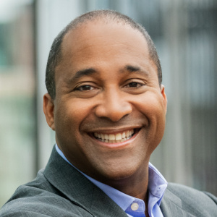
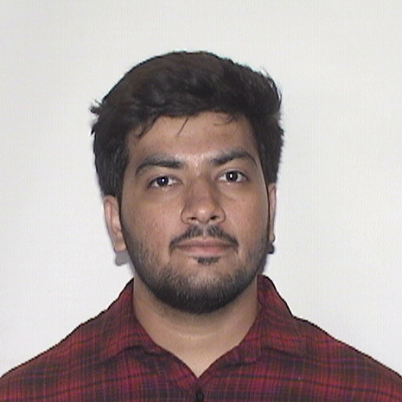
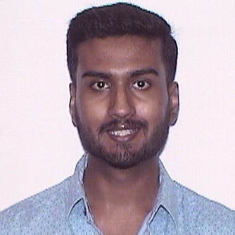
Introducing the team
Prof. Alden Jackson
Pranav Boditalupula
Sivasankara Reddy
Harshith Umesh

Slide 5
Hello!
Who am I?
Professor Alden Jackson
awjacks@northeastern.edu
Office: 324 Meserve
Office Hours: TBD. Reserve using Bookings. Will publish link on course website.

Slide 6
A little about me…
I grew up in Maryland, just outside Washington, DC.
BA in physics from the University of Dallas.
Enjoyed modeling and simulating physical systems, MSEE at Howard University.
Research in image processing and HW to support graphics libraries
Ran a research computing center.
PhD at the University of Delaware, where networking found me.
Now primarily interested in ultra high-speed network and router architecture, transport protocols, reliability of massive distributed systems, network security and privacy, and Internet censorship mitigation

Slide 7
Where I’ve been…

Slide 8
The TAs
Pranav Boditalupula Sivasankara Reddy, student in MSCS
Harshith Umesh, student in MSCS

Slide 9
Class resources

Slide 10
Class resources
CANVAS – main hub and quizzes (maybe)
PIAZZA – main communication channel
GRADESCOPE – assignments (and quizzes)

Slide 11
CANVAS
Contains links to class website and piazza
Has information that needs to be password protected such as your grades
May be used for quizzes

Slide 12
PIAZZA
Main communication environment where I will post
announcements
questions about class, projects, etc
You can post privately just to me and TAs
Public questions are anonymous to your colleagues
Signup link is posted on canvas (you may have already received an invite)

Slide 13
How to ask on Piazza
Read slides, notes, or project description
Use #hashtags (#hw2, #project3, etc.)
Describe the problem clearly, using the right terms
Add code in attached files
Add output from compiler or debugging information
Add any other relevant information
Cut and Paste MUCH preferred over Screen Caps
Don’t post publicly solutions or any code on piazza
Anything that relates to solution, Post PRIVATELY

Slide 14
OFFICE HOURS
Prof Jackson: TBD, in person (preferred) or on-line
TAs: TBD, in person or on-line (via OH app)
Additional availability outside the allocated time if you have conflicts with the office hours
Will post office hour schedule and any changes on Piazza

Slide 15
Class syllabus and policy

Slide 16
Individual meeting
It is my policy (and a requirement) to individually meet with you at least once per semester
Goal of the meeting is to get to know you and provide individual advice about the class
I will update Piazza with how to sign up to meet with me during office hours or outside office hours
If needed you can set up additional appointments by sending me a private message on Piazza

Slide 17
Academy integrity
It is allowed to discuss homework problems before writing them down; however, WRITING IS INDIVIDUAL
if you look at another student’s written or typed answers, or let another student look at your written or typed answers, that is considered cheating
It is allowed to discuss your project with your colleagues, I encourage it, but DO NOT SHARE CODE
Never have a copy of someone else's homework or program in your possession and never give your homework (or password) or program to someone else.
NO CHEATING WILL BE TOLERATED

Slide 18
Exceptional situations
Anything that impacts you and class please let me know ASAP Do not wait till the end of the semester
We will accommodate the situation and find a solution
If you can not attend class because of an exceptional situation, please let me know

Slide 19
Weather/Emergency
In the event of a major campus emergency, course requirements, deadlines and grading percentages are subject to changes that may be necessitated by a revised semester calendar or other circumstances beyond the instructor’s control.

Slide 20
This is an in-class person
Slides will be made available immediately before lecture
No recording will happen in class
If you have to miss class, read the slides, and I will be happy to meet with you and address any questions
DO NOT RECORD IN CLASS
Massachusetts prohibits the recording, interception, use or disclosure of any conversation, whether in person or over the telephone, without the permission of all the parties. The state also prohibits the recording and disclosure of images intercepted in violation of its hidden camera laws.

Slide 21
Prerequisites
Strong systems and networking background
Socket programming
Some fluency across many languages
C/C++
Java
Go
Python or some other scripting language
Linux command line proficiency
Some computer security and cryptography fundamentals

Slide 22
Grading policy
Individual projects (6) 68%
The projects are NOT evenly weighted
Homework assignments and/or quizzes (~8) 32%
The HW and quizzes are evenly weighted
There is no final exam
I do not curve grades. All fractions on your final numerical grade will be rounded up to next integer.
Notes:
Here talk more about the project

Slide 23
Homework and/or In-class exercises
Purpose of these exercises is to make you understand the theoretical results discussed in class
Homework
Individual work only, via Gradescope.
In-class
You will work on them in class in teams
We will discuss the results once you submit your answers
They are graded

Slide 24
Programming projects
Purpose of the programming projects is to help you understand practical aspects of things discussed in class
Read all material in class and the description of the project in details before starting
Programming projects are individual
All the code must be from scratch
Follow the project description

Slide 25
Late Policy
Each student is given 6 (six!) slip days that they can use at any time to extend an assignment deadline in increments of a single day
You don’t need to ask me, just turn-in stuff late
All group members must have unused slip days
i.e., if one member has zero slip days left, the whole group is late
Assignments are due at 11:59:59pm, no exceptions
1 second late = 1 hour late = 1 day late
After slip days are used, it’s 20% off per day late

Slide 26
Grade Changes
If you think there has been a grading error, log a regrade in Gradescope
The TA who graded your assignment will evaluate your request and get back to you
A regrade request must be logged within 5 days after the assignment has been returned
If you have further issue with the TA regrade, you may challenge it to an instructor
Each student is given 2 challenges to ask for instructor regrades
If the grade is incorrect, you keep your challenge
If the grade is correct, you lose your challenge
When your challenges are exhausted, you cannot challenge regrades
Detailed instructions for grade challenges are in the syllabus

Slide 27
Grade Changes (Continued)
Challenges may be used for:
Projects, homeworks
Challenges may not be used for:
Late assignments, use of slip days

Slide 28
Cheating
Do not do it
Seriously, don’t make me say it again
Cheating is an automatic -100% for the assignmenet
We send any and all suspects to OSCCR without exception
Khoury is also tracking cheating, with stricter enforcement
Project code must be original
Unless we give you starter code, obviously
StackOverflow/Quora are not your friends
Copying from public Githubs or Generative AI will get you a -100% grade
If you have questions about using an online resource, ask us

Slide 29
Question: Who Has Taken CS 3700/4700?
This course has some overlap with CS 3700
Traditionally, it has been setup to try and mitigate this overlap somewhat
Is this still necessary?
Who is taking 4700?

Slide 30
Regrading
YOU HAVE 1 WEEK to ASK for REGRADING of a project or quiz from the moment solutions were posted on piazza or discussed in class
Make sure you read and understand the solution before asking for a regrade
Request for a regrade will result in the regrading of the entire quiz or project

Slide 31
Why do we need distributed systems
Distribute load
Faster response by placing replicas closer to clients
Increased resources, computation and storage
Resilience to failures and attacks

Slide 32
Course Overview

Slide 33
What is a distributed system?
A distributed computing system is a set of computer programs executing on one or more computers and coordinating actions by exchanging messages.
A distributed system is one in which the failure
of a computer you didn't even know existed can
render your own computer unusable.
Attributed to Leslie Lamport

Slide 34
What do we expect from distributed systems
Reliability: provide continuous service
Availability: ready to use
Safety: systems do what they are supposed to do, avoiding catastrophic consequences
Security: withstands passive/active attacks from outsiders or insiders

Slide 35
…not easy to achieve because
Computers and networks fail in many (often unpredictable) ways
Computers get compromised
Real-time constraints
Performance requirements
Complexity

Slide 36
Why do computer systems fail?
Why Do Computers Stop and What can be done about it? (1985)
System administration, software faults, environmental failures, hardware failures (disks and communication controllers), power outages
Why do Internet services fail, and what can be done about it? (2003).
Configuration errors, software failures, not enough on-line testing
E.g, Facebook fell off the Internet, CrowdStrike upgrade fail
Why Does the Cloud Computing Stop Computing? (2016)
BUGS, CONFIG, CROSS, HARDWARE, HUMAN, LOAD, NATDIS, NETWORK, POWER, STORAGE, SECURITY, SERVER, UPGRADE, and UNKNOWN

Slide 37
Why do computers get compromised?
Software bugs
Administration errors
Lack of diversity, same vulnerability is exploited
The explosion of the Internet facilitates the spread of malware
Social engineering attacks

Slide 38
..how do computer systems fail…
Halting failures: no way to detect except by using timeout
Fail-stop failures: accurately detectable halting failures
Send-omission failures
Receive-omission failures
Network failures
Network partitioning failures
Timing failures: temporal property of the system is violated
Byzantine failures: arbitrary failures, include both benign and malicious failures

Slide 39
Example 1: A network partition’s impact on github
What happened: A routine maintenance work to replace failing 100G optical equipment resulted in the loss of connectivity for 43 seconds between POP US East Coast and DC East Coast.
Result:
Degraded service for 24 hours and 11 minutes.
Multiple internal systems were affected which resulted in displaying of information that was out of date and inconsistent.
No user data was lost; but required manual reconciliation of a few seconds of database writes that took hours
For the majority of the incident, GitHub was also unable to serve webhook events or build and publish GitHub Pages sites.
https://blog.github.com/2018-10-30-oct21-post-incident-analysis/

Slide 40
Example 2: Amazon

Slide 41
Example 2: Delta

Slide 42
Examples of distributed systems
Air Traffic Control
Space Shuttle
Banking Systems
Grid Power Systems
Cloud Computing

Slide 43
Looking under the hood of distributed systems
THEORY + SYSTEMS
Theory
Fundamental problems
Algorithms solving this problems
Impossibility results
Trade-offs between properties provided by distributed systems
Systems
What can go wrong when designing, implementing, testing and deploying a distributed service
Design of existing and popular software
Dependencies between different services

Slide 44
Course overview
FUNDAMENTAL TOPICS
Ordering events and distributed snapshots
Time in distributed systems. Clock synchronization. Global states and distributed snapshots. Detecting failures.
Consensus
Synchronous systems, asynchronous systems, byzantine failures (including randomized solutions).
Distributed commit and consistency models
2PC and 3PC. Weak and strong consistency in partitioned database systems. Linearizability. CAP Theorem.

Slide 45
Course overview
ADVANCED TOPICS
Process Groups
Leader election, membership, reliable multicast, virtual synchrony. Gossip protocols.
Quorums
Paxos. Viewstamped replication. BFT.
Peer-to-peer systems
File sharing, lookup services, streaming, publish-subscribe

Slide 46
Course overview
DISTRIBUTED SYSTEMS CONCEPTS IN REAL SYSTEMS (as many and as deep as time permits)
Files systems
GFS, HDFS
Databases
BigTable, HBase, Spanner, DynamoDB, Casandra
Lock services
Chubby, Zookeeper, Zab
Computational services
MapReduce, Spark

Slide 47
Course overview
DISTRIBUTED SYSTEMS CONCEPTS IN REAL SYSTEMS (cont.)
Distributed ledgers:
Digital currency (BitCoin), smart contracts (Etherum), credit systems (Ripple)
Infrastructure for ML
TensorFlow, GraphLab
Microservices
AWS Lambda

Slide 48
Reference Material
Recommended reading
Research papers that will be specified for each lecture (clearly not this one)

Slide 49
A Gentle Introduction…

Slide 50
What are Distributed Systems?
From Wikipedia:
Essentially, multiple computers working together
Computers are connected by a network
Exchange information (messages)
System has a common goal
A distributed system is a software system in which components located on networked computers communicate and coordinate their actions by passing messages.

Slide 51
Definitions
No widely-accepted definition, but…
Distributed systems comprised of hosts or nodes where
Each node has its own local CPU and memory (and storage?)
Hosts connected via a network
Originally, requirement was physical distribution
Today, distributed systems can be on one host
E.g., VMs on a single host, processes on same machine

Slide 52
Outline
Brief History of Distributed Systems
Examples
Fundamental Challenges
Design Decisions

Slide 53
History
Distributed systems developed in conjunction with networks
Early applications:
Remote procedure calls (RPC)
Remote access (login, telnet)
Human-level messaging (email)
Bulletin boards (Usenet)

Slide 54
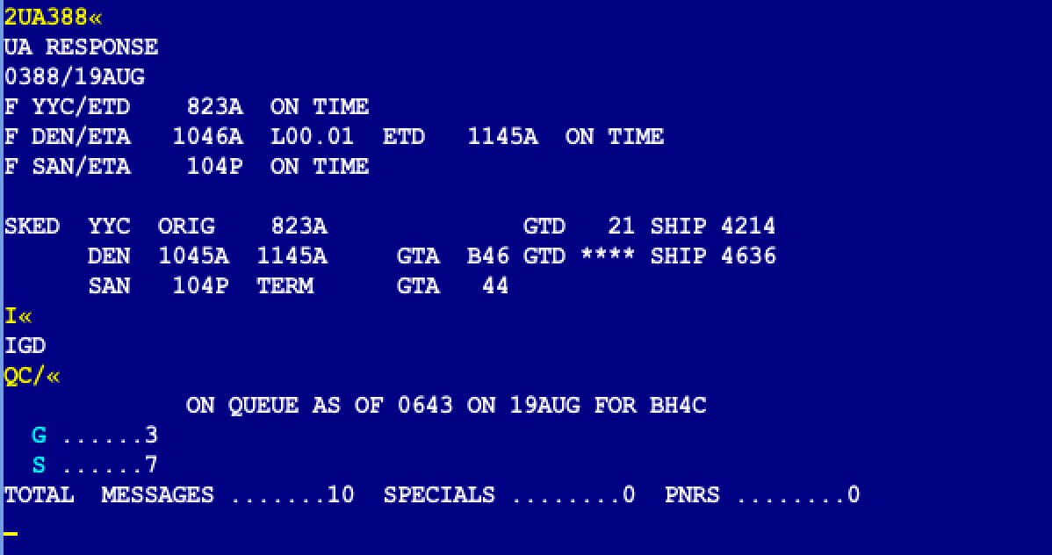
Early Example: Sabre
Global Distribution System for major airlines

Slide 55
Sabre
American Airlines had a central office with cards for each flight
Travel agent calls in, worker would mark seat sold on card
1960’s – built a computerized version of the cards
Disk (drum) with each memory location representing number of seats sold on a flight
Built network connecting various agencies
Distributed terminals to agencies
Effect: Removed human from the loop

Slide 56
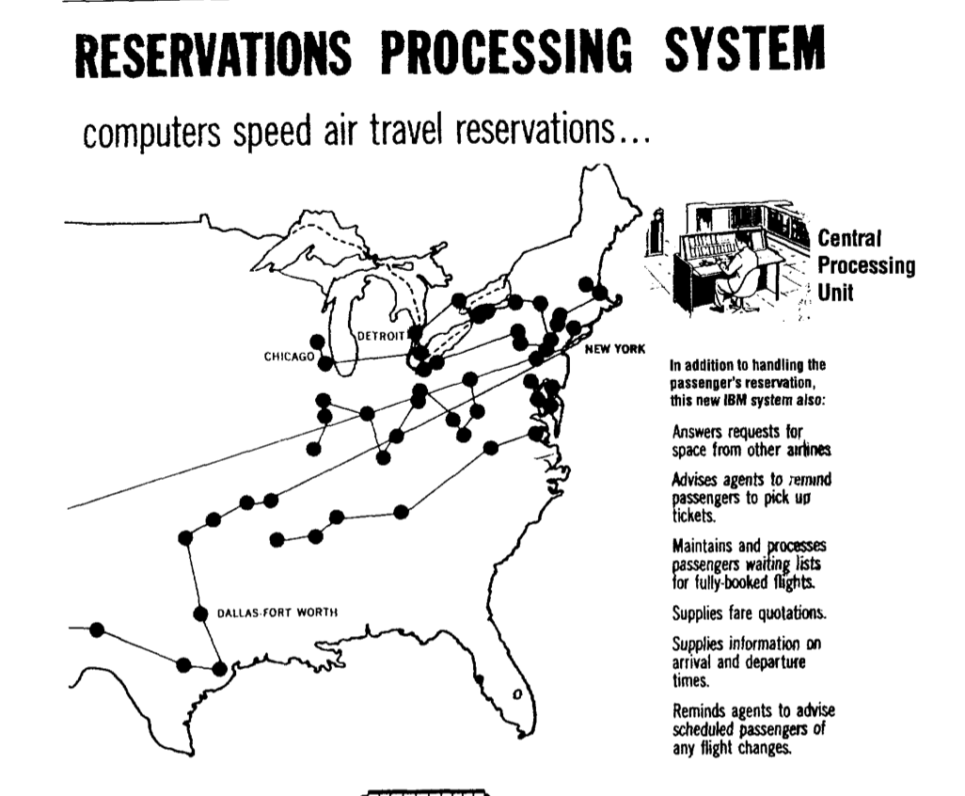

Slide 57
Move Towards Microcomputers
In the 1980s, personal computers became popular
Moved away from existing mainframes
Required development of many distributed systems
Email
Web
DNS
…
Scale of networks grew quickly, Internet came to dominate

Slide 58
Today
Growth of pervasive and mobile computing
End users connect via a variety of devices, networks
More challenging to build systems
Popularity of “cloud computing”
Essentially, can purchase computation and connectivity as a commodity
Many startups don’t own their servers
All data stored in and served from the cloud
How do we build secure, reliable systems?

Slide 59
Outline
Brief History of Distributed Systems
Examples
Fundamental Challenges
Design Decisions

Slide 60
Example 1: DNS
Distributed database
Maps “names” to IP addresses, and vice-versa
Hierarchical structure
Divides up administrative tasks
Enables clients to efficiently resolve names
Simple client/server architecture
Recursive or iterative strategies for traversing the server hierarchy
Root
edu
com
org
neu.edu
mit.edu
ccs.neu.edu

Slide 61
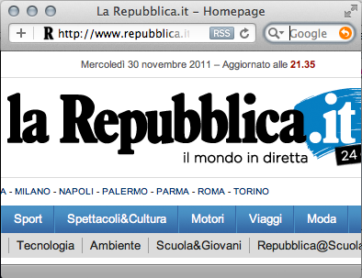
Example 2: The Web
Web is a widely popular distributed system
Has two types of entities:
Web browsers: Clients that render web pages
Web servers: Machines that send data to clients
All communication over HTTP

Slide 62
Example 3: BitTorrent
Popular P2P platform for large content distribution
All clients “equal”
Collaboratively download data
Use custom protocol over HTTP
Robust if (most) clients fail (or are removed)

Slide 63
Example 4: Stock Market
Large distributed system (NYSE, BATS, etc.)
Many players
Economic interests not aligned
All transactions must be executed in-order
E.g., Facebook IPO
Transmission delay is a huge concern
Hedge funds will buy up rack space closer to exchange datacenters
Can arbitrage millisecond differences in delay

Slide 64
Outline
Brief History of Distributed Systems
Examples
Fundamental Challenges
Design Decisions

Slide 65
Challenges
No Global Knowledge
Time
Failure is the Norm
Scalability
Concurrency
Security
Openness

Slide 66
Challenge 1: Global Knowledge
No host has global knowledge
Need to use network to exchange state information
Network capacity is limited; can’t send everything
Information may be incorrect, out of date, etc.
New information takes time to propagate
Other changes may happen in the meantime
Key issue: How can you detect and address inconsistencies?

Slide 67
Challenge 2: Time
Time cannot be measured perfectly
Hosts have different clocks, skew
Network can delay/duplicate messages
How to determine what happened first?
In a game, which player shot first?
In a GDS like Sabre, who bought the last seat on the plane?
Need to have a more nuanced abstraction to represent time

Slide 68
Challenge 3: Failures
A distributed system is one in which the failure of a computer you didn't even know existed can render your own computer unusable. — Leslie Lamport
Failure is the common case
As systems get more complex, failure more likely
Must design systems to tolerate failure
E.g., in Web systems, what if server fails?
Systems need to detect failure, recover

Slide 69
Challenge 4: Scalability
Systems tend to grow over time
How to handle future users, hosts, networks, etc?
E.g., in a multiplayer game, each user needs to send location to all other users
O(n²) message complexity
Will quickly overwhelm real networks
Can reduce frequency of updates (with implications)
Or, choose nodes who should update each other

Slide 70
Challenge 5: Concurrency
To scale, distributed systems must leverage concurrency
E.g. a cluster of replicated web servers
E.g. a swarm of downloaders in BitTorrent
Often will have concurrent operations on a single object
How to ensure object is in consistent state?
E.g., bank account: How to ensure I can’t overdraw?
Solutions fall into many camps:
Serialization: Make operations happen in defined order
Transactions: Detect conflicts, abort
Append-only structures: Deal with conflicts later
….

Slide 71
Challenge 6: Security
Distributed systems often have many different entities
May not be mutually trusting (e.g., stock market)
May not be under centralized control (e.g. the Web)
Economic incentives for abuse
Systems often need to provide
Confidentiality (only intended parties can read)
Integrity (messages are authentic)
Availability (system cannot be brought down)

Slide 72
Challenge 7: Openness
Can system be extended/re-implemented?
Can anyone develop a new client?
Requires specification of system/protocol published
Often requires standards body (IETF, etc) to agree
Cumbersome process, takes years
Many corporations simply publish own APIs (force of market share)
IETF works off of RFC (Request For Comment)
Anyone can publish, propose new protocol
“Rough consensus and running code”

Slide 73
Outline
Brief History of Distributed Systems
Examples
Fundamental Challenges
Design Decisions

Slide 74
Distributed System Architectures
Two primary architectures:
Client-server: System divided into clients (often limited in power, scope, etc) and servers (often more powerful, with more system visibility). Clients send requests to servers.
Peer-to-peer: All hosts are “equal”, or, hosts act as both clients and servers. Peers send requests to each other. More complicated to design, but with potentially higher resilience.

Slide 75
Transport Protocol
At a minimum, system designers have two choices for transport
UDP
Good: low overhead (no retries or order preservation), fast (no congestion control)
Bad: no reliability, may increase network congestion
TCP:
Good: highly reliable, fair usage of bandwidth
Bad: high overhead (handshake), slow (slow start, ACK clocking, retransmissions)
However, you can always roll your own protocol on top of UDP
Microtransport Protocol (uTP) – used by BitTorrent
QUIC – invented by Google, used in Chrome to speed up HTTP
Warning: making your own transport protocol is very difficult

Slide 76
Messaging Interface
Messaging is fundamentally asynchronous
Client asks network to deliver message
Waits for a response
What should the programmer see?
Synchronous interface: Thread is “blocked” until a message comes back. Easier to reason about.
Asynchronous interface: Control returns immediately, response may come later. Programmer has to remember all outstanding requests. Potentially higher performance.

Slide 77
Serialization/Marshalling
All hosts must be able to exchange data, thus choosing data formats is crucial
On the Web – form encoded, URL encoded, XML, JSON, …
In “hard” systems – MPI, Protocol Buffers, Thrift
Considerations
Openness: is the format human readable or binary? Proprietary?
Efficiency: text is bloated compared to binary, but easy to debug
Versioning: can you upgrade your protocol to v2 without breaking v1 clients?
Language support: do your formats and types work across multiple languages?

Slide 78
Naming
Need to be able to refer to hosts/processes
Naming decisions should reflect system organization
E.g., with different entities, hierarchal system may be appropriate (entities name their own hosts)
Naming must also consider
Mobility: hosts may change locations
Authenticity: how do hosts prove who they are?
Scalability: how many hosts can a naming system support?
Convergence: how quickly do new names propagate?

Slide 79
Debugging distributed protocols
They are known to be difficult to debug
Write proactively – print all the info you send/receive over the network;
Have finite state machine design before implementation and make sure you understand what your state machine is supposed to do before you implement your code
Have message detailed description in design before implementation
Focus on testcases to understand specific behavior
Delay, interleave, drop messages
Crash processes

Slide 80
Containers Basic docker commands

Slide 81
Why containerize applications
-- build once, run anywhere --
A container packs together an application and all its dependencies and isolates the application from the rest of the machine it runs on.
Running multiple instances: Because the dependencies are isolated from each other you can run multiple containers on the same machine without them interfering with each other.
Automated installation on clusters: Orchestrators (such as Kubernetes) automatically distribute containerized applications across a cluster of servers so you do not have to manually install applications.

Slide 82
Linux features that make containers work
Control groups (Cgroups): limits the resources, such as memory, CPU, and network input/output, that a group of Linux processes can use
By limiting the resources a process can use, containers provide protection against attacks that consume excessive resources
Linux Namespaces: restricts visibility of resources to a process
By putting a process in a namespace, you can restrict the resources that are visible to that process
Changing the Root Directory: limits the set of files and directories that a process can see
By changing the root directory when the container is created, a container can not see the host’s entire filesystem

Slide 83
Containers vs VMs
Hypervisors: pure virtual machine environment, a dedicated kernel-level VMM program runs instead of the OS kernel.
Hosted VM: VMs are hosted by the host OS, a VMM runs on the host OS and the guest OS runs on the VMM – e.g. VirtualBox on your laptop
Containers share the kernel with the OS on the machine they are running on
VM – fixed resources, overhead of running a whole kernel.
Faster to start a container than a kernel
VMs offer better isolation

Slide 84
What is Docker:
Docker in an application that allows you to create and built containers
Set of commands to manipulate images and containers
Image: complete and executable version of an application
Container: is the instantiation of an image
Docker maintains a repository of images

Slide 85
Docker basic commands: push/pull
Allow you to pull an image from repo or push; you need to have a docker account to run push
docker push [OPTIONS] NAME[:TAG]
docker pull [OPTIONS] NAME[:TAG|@DIGEST]
$ docker push registry-host:5000/myadmin/rhel-httpd
$ docker pull Debian
https://docs.docker.com/engine/reference/commandline/push/
https://docs.docker.com/engine/reference/commandline/pull/

Slide 86
Docker basic commands: run/stop
Run a command in a new container
docker run [OPTIONS] IMAGE [COMMAND] [ARG...]
docker stop [OPTIONS] CONTAINER [CONTAINER...]
$ docker run mydockerhello
$ docker stop mydockerhello
https://docs.docker.com/engine/reference/commandline/run/
https://docs.docker.com/engine/reference/commandline/stop/

Slide 87
Docker basic commands: ps
Allows to see containers running or finished (finished containers are saved on disk)
docker ps [OPTIONS]
Examples:
$ docker ps
$ docker ps –a
https://docs.docker.com/engine/reference/commandline/ps/

Slide 88
Docker basic commands: images
List all images
docker images [OPTIONS] [REPOSITORY[:TAG]]
$docker images java
https://docs.docker.com/engine/reference/commandline/images/

Slide 89
Docker basic commands: rm/rmi
Allows to remove containers/images, you can not remove an image before you removed all containers that are using it
docker rm [OPTIONS] CONTAINER [CONTAINER...]
docker rmi [OPTIONS] IMAGE [IMAGE...]
$ docker rm redis
$ docker rmi test:latest
https://docs.docker.com/engine/reference/commandline/rm/
https://docs.docker.com/engine/reference/commandline/rmi/

Slide 90
Docker basic commands: volume mapping
When the container ends, data is not persistent, it is lost.
To have data persistent after the container ends you can mount in the container a volume (file, directory) from the host
$ docker run –v /opt/data:/ var/lib/mysql mysql
/var/lib/mysql of the container is mapped to /opt/data of the host.
https://docs.docker.com/engine/reference/commandline/run

Slide 91
Docker basic commands: port mapping
Containers are not accessible via networking from outside the host by default
Using port mapping you can access them from outside, using host ports
You can run multiple instances, but each host port can be mapped only once
$ docker run –p 8001:5000 mycontainer1
$ docker run –p 8002:5000 mycontainer2
When accessing via host port 8001 you will access mycontainer1
https://docs.docker.com/engine/reference/commandline/run

Slide 92
Docker basic commands: stdin, stdout,stderr
Containers are not mapped to stdin, stdout, stderr by default, option –i for run command
$ docker run –i mycontainer
When running mycontainer, if you’re reading from stdin, you will be prompted to input from the keyboard
https://docs.docker.com/engine/reference/commandline/run

Slide 93
Docker basic commands: attach/detach
run option –d runs the container in the background
run option –a attaches stdout, stdin, stderr for a container
$ docker run –d mycontainer
$ docker run –a mycontainer
$ docker run –i –a STDERR mycontainer
https://docs.docker.com/engine/reference/commandline/run

Slide 94
Docker basic commands: exec
Run a command in a running container
docker exec [OPTIONS] CONTAINER COMMAND [ARG...]
$ docker run --name ubuntu_bash --rm -i -t ubuntu bash
$ docker exec -d ubuntu_bash touch /tmp/execWorks
Result is creating a new file /tmp/execWorks inside the running container ubuntu_bash, in the background.
https://docs.docker.com/engine/reference/commandline/exec

Slide 95
Docker basic commands: Networking
When you install docker it creates three networks: bridge, host and none
Bridge is an internal private network, all containers get an IP address on this internal network (172.17)
Containers can talk to each other using this IP
If you want to access them from outside there are several solutions, one is port mapping
You can also create your own private network using docker network create
https://docs.docker.com/engine/reference/commandline/network/

Slide 96
Docker basic commands: Dockerfile
It tells docker how to build a container
FROM ubuntu:latest
RUN apt-get update
RUN apt-get install -y gcc
ADD hello.c /app/
WORKDIR /app/ RUN gcc hello.c -o hello
ENTRYPOINT /app/hello
https://github.com/iowaguy/docker-tutorial

Slide 97
Docker basic commands: passing args
FROM ubuntu:latest
RUN apt-get update
RUN apt-get install -y gcc
ADD hello.c /app/
WORKDIR /app/ RUN gcc hello.c -o hello
ENTRYPOINT /app/hello classnumber
$docker run hello 4730

