Slide 1
CS 4730 Distributed Systems
Networking Overview / Primer
Revised 9/13/24

Slide 2
Network Layer
Function:
Route packets end-to-end on a network, through multiple hops
Key challenge:
How to represent addresses
How to route packets
Scalability
Convergence
Application
Presentation
Session
Transport
Network
Data Link
Physical

Slide 3
Routers, Revisited
How to connect multiple LANs?
LANs may be incompatible
Ethernet, Wifi, etc…
Connected networks form an internetwork
The Internet is the best-known example
Routers

Slide 4
Structure of the Internet
Network 3
Network 1
Network 4
Network 2
Ad-hoc interconnection of networks
No organized topology
Vastly different technologies, link capacities
Packets travel end-to-end by hopping through networks
Routers “peer” (connect) different networks
Different packets may take different routes

Slide 5
Internetworking Issues
Internet Service Model
Best-effort (i.e. things may break)
Store-and-forward datagram network
Lowest common denominator
Naming / Addressing
How do you designate hosts?
Routing
Must be scalable (i.e. a switched Internet won’t work)
Service Model
What gets sent?
How fast will it go?
What happens if there are failures?
Must deal with heterogeneity
Remember, every network is different

Slide 6
Outline
Addressing
Class-based
CIDR
IPv4 Protocol Details
Packed Header
Fragmentation
IPv6

Slide 7
Possible Addressing Schemes
Flat
e.g., each host is identified by a 48-bit MAC address
Router needs an entry for every host in the world
Too big
Too hard to maintain (hosts come and go all the time)
Hierarchy
Addresses broken down into segments
Each segment has a different level of specificity

Slide 8
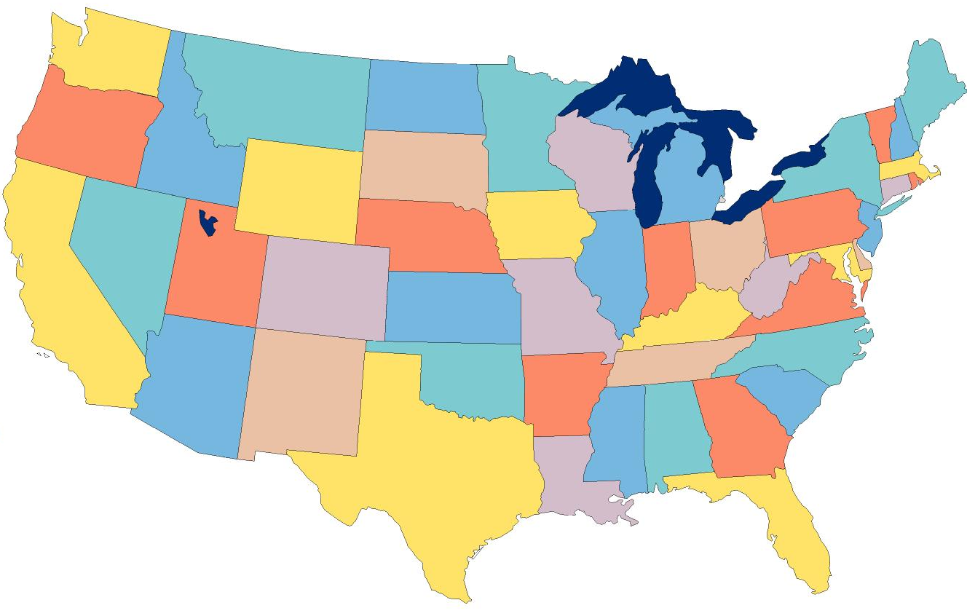
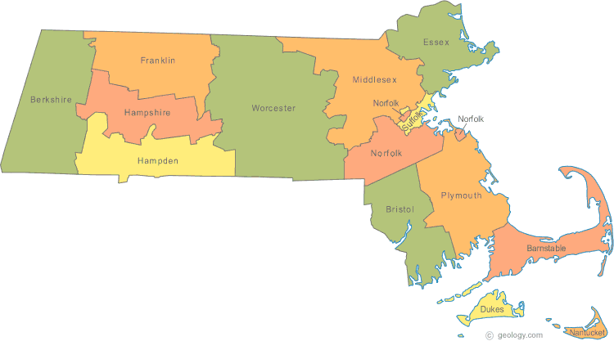
Example: Telephone Numbers
1-617-373-2177
3278
Very General
West Village G
Room 213
West Village H
Room 248
Updates are Local
Very Specific

Slide 9
Binary Hierarchy Example
1**
Datagram, Destination = 101
10*
100
101
11*
0**
110
00*
111
000
001
01*
010
011

Slide 10
IP Addressing
IPv4: 32-bit addresses
Usually written in dotted notation, e.g., 192.168.21.76
Each number is a byte
Stored in Big Endian (Network Byte) order
0
8
16
24
31
Decimal
192
168
21
76
Hex
C0
A8
15
4C
Binary
11000000
10101000
00010101
01001100

Slide 11
IP Addressing and Forwarding
Routing Table Requirements
For every possible IP, give the next hop
But for 32-bit addresses, 2³² possibilities!
Too slow: 4 * 10GE ports needs 176Gbps memory bandwidth
DRAM is 1-6 Gbps, TCAM is faster but 400x more expensive than DRAM
Hierarchical address scheme
Separate the address into a network and a host
0
31
Pfx
Network
Host
Known by all routers
Known by edge (LAN) routers

Slide 12
IP Address Naming Hierarchy
Original, Old School Method
Modern Method
Class-based hierarchy
First three bits of the IP address are the prefix
Each prefix denotes:
Class of network
Size of the network
The “name” or prefix of the network
Classless Interdomain Routing (CIDR)

Slide 13
Classes of IP Addresses
0
1
8
16
24
31
Class A
0
Ntwk
Host
Example: MIT
18.*.*.*
1-126
0
2
8
16
24
31
Class B
10
Network
Host
Example: NU
129.10.*.*
128-191
0
3
8
16
24
31
Class C
110
Network
Host
Example:
216.63.78.*
192-223

Slide 14
Two Level Hierarchy
Pfx
Network
Host
…
Subtree size determined by network class
…

Slide 15
Class Sizes
Way too big
Class | Prefix Bits | Network Bits | Number of Classes | Hosts per Class
A | 1 | 7 | 2⁷ – 2 = 126 (0 and 127 are reserved) | 2²⁴ – 2 = 16,777,214 (All 0 and all 1 are reserved)
B | 2 | 14 | 2¹⁴ = 16,398 | 2¹⁶ – 2 = 65,534 (All 0 and all 1 are reserved)
C | 3 | 21 | 2²¹ = 2,097,512 | 2⁸ – 2 = 254 (All 0 and all 1 are reserved)
 |  |  | Total: 2,114,036
Too many network IDs
Too small to be useful

Slide 16
Subnets
Problem: need to break up large A and B classes
Solution: add another layer to the hierarchy
From the outside, appears to be a single network
Only 1 entry in routing tables (this becomes an issue)
Internally, manage multiple subnetworks
Split the address range using a subnet mask
Subnet Mask is 255.255.192.0
Pfx
Ntwk
Subnet
Host
Subnet Mask:
11111111 11111111 11000000 00000000

Slide 17
Subnet Example
10 means this is a class B network
Class B uses 16 bits total for the network name
IP Address:
10110101 11011101 01010100 01110010
Extract network:
Network Mask:
Subnet mask is 255.255.192.0
& 11111111 11111111 00000000 00000000
Result:
10110101 11011101 00000000 00000000
IP Address:
10110101 11011101 01010100 01110010
Extract subnetwork:
Subnet Mask:
& 11111111 11111111 11000000 00000000
Result:
10110101 11011101 01000000 00000000
IP Address:
10110101 11011101 01010100 01110010
Extract host:
Subnet Mask:
& ~(11111111 11111111 11000000 00000000)
Result:
00000000 00000000 00010100 01110010

Slide 18
N-Level Subnet Hierarchy
Pfx
Network
Subnet
Host
…
Tree does not have a fixed depth
Increasingly specific subnet masks
…
Subtree size determined by length of subnet mask
…

Slide 19
Example Routing Table
Address Prefix | Subnet Mask | Prefix After Masking (in Binary) | Next Hop
0.0.0.0 | 0.0.0.0 | ******** ******** ******** ******** | Port 4
18.0.0.0 | 255.0.0.0 | 00010010 ******** ******** ******** | Port 2
128.42.0.0 | 255.255.0.0 | 10000000 00101010 ******** ******** | Port 3
128.42.128.0 | 255.255.128.0 | 10000000 00101010 1******* ******** | Port 5
128.42.222.0 | 255.255.255.0 | 10000000 00101010 11011110 ******** | Port 1
Question: 128.42.222.198 matches four rows
Which router do we forward to?
Longest prefix matching
Use the row with the longest number of 1’s in the mask
This is the most specific match

Slide 20
Subnetting Revisited
Question: does subnetting solve all the problems of class-based routing?
NO
Classes are still too coarse
Class A can be subnetted, but only 126 available
e.g., company w/ a Class A and subnets to multiple locations has only 1 routing table entry
Class C is too small
Class B is nice, but there are only 16,398 available
Routing tables are still too big
2.1 million entries per router

Slide 21
IP Address Naming Hierarchy
Original, Old School Method
Modern Method
Class-based hierarchy
First three bits of the IP address are the prefix
Each prefix denotes:
Class of network
Size of the network
The “name” or prefix of the network
Classless Interdomain Routing (CIDR)
Each network is assigned a bitmask
The bitmask separates the network “name” portion of the IP address from the host portion

Slide 22
Classless Inter Domain Routing
CIDR, pronounced ‘cider’
Key ideas:
Get rid of IP classes
Use bitmasks for all levels of routing
Aggregation to minimize FIB (Forwarding Information Base)
Arbitrary split between network and host
Specified as a bitmask or prefix length
Example: Northeastern
129.10.0.0 with netmask 255.255.0.0
129.10.0.0 / 16

Slide 23
Example CIDR Routing Table
Prefix | Netmask | Prefix After Masking (in Binary) | IP Address Range
207.46.0.0 | 19 | 11001111 00101110 000***** ******** | 207.46.0 – 31.*
207.46.32.0 | 19 | 11001111 00101110 001***** ******** | 207.46.32 – 63.*
207.46.64.0 | 19 | 11001111 00101110 010***** ******** | 207.46.64 – 95.*
207.46.128.0 | 18 | 11001111 00101110 10****** ******** | 207.46.128 – 191.*
207.46.192.0 | 18 | 11001111 00101110 11****** ******** | 207.46.192 – 255.*
Hole in the Routing Table: No coverage for 96 – 127
Missing entry: 207.46.96.0/19

Slide 24
Aggregation with CIDR
Original use: aggregating class C ranges
One organization given contiguous class C ranges
Example: Microsoft, 207.46.192.* – 207.46.255.*
Represents 2⁶ = 64 class C ranges
Specified as CIDR address 207.46.192.0/18
0
8
16
24
31
Decimal
207
46
192
0
Hex
CF
2E
C0
00
Binary
11001111
00101110
11xxxxxx
xxxxxxxx
18 Bits Frozen By Netmask
14 Arbitrary Bits

Slide 25
CIDR Aggregation Example
Same length netmask
All bits match except for the last one
Same port
Prefix | Netmask | Prefix After Masking (in Binary) | Next Hop
207.46.0.0 | 19 | 11001111 00101110 000***** ******** | Port 1
207.46.32.0 | 19 | 11001111 00101110 001***** ******** | Port 1
207.46.64.0 | 18 | 11001111 00101110 01****** ******** | Port 1
207.46.128.0 | 18 | 11001111 00101110 10****** ******** | Port 2
207.46.192.0 | 18 | 11001111 00101110 11****** ******** | Port 3
207.46.0.0
18
11001111 00101110 00****** ********
Port 1
207.46.0.0
17
11001111 00101110 0******* ********
Port 1
Aggregation allows multiple routes to be compressed together to shrink the size of the routing table

Slide 26
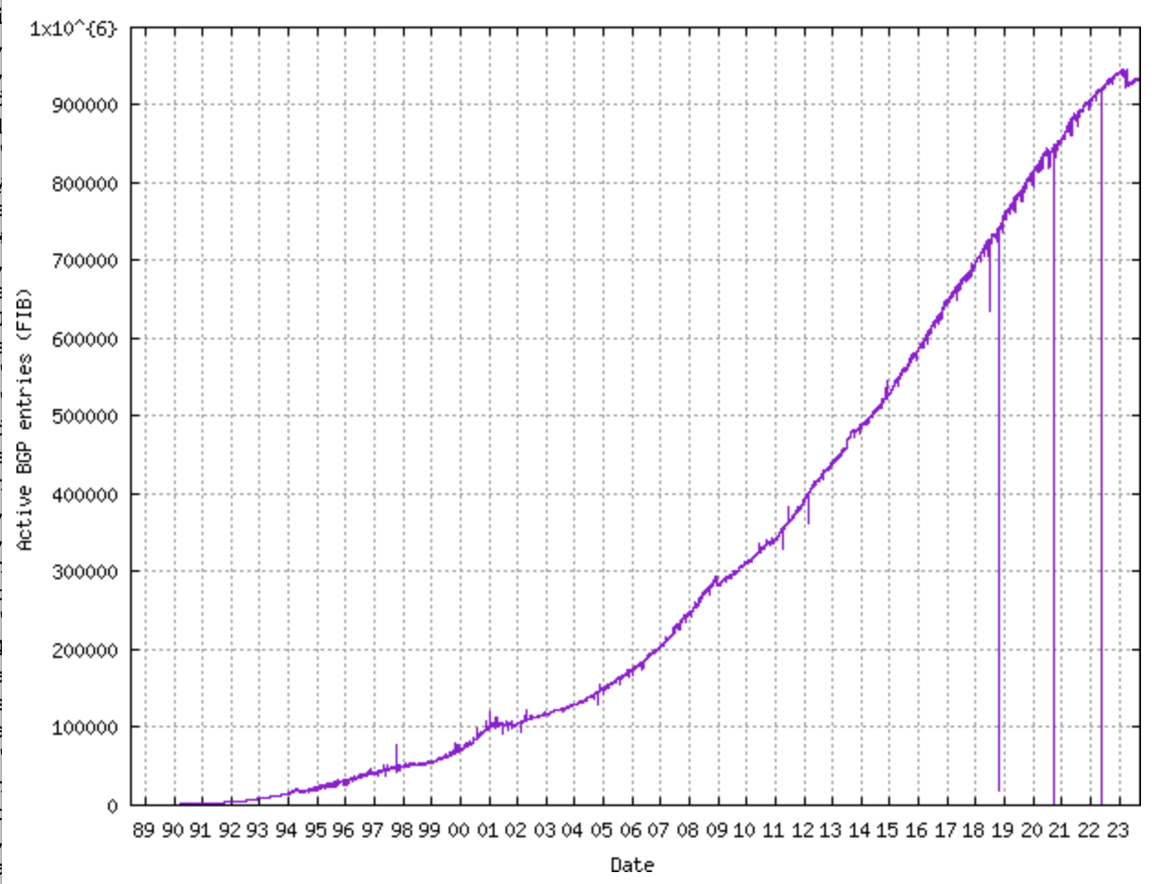
Size of CIDR Routing Tables
From www.cidr-report.org
CIDR has kept IP routing table sizes in check
Currently ~900,000 entries for a complete IP routing table
Only required by backbone routers

Slide 27
Takeaways
Hierarchical addressing is critical for scalability
Not all routers need all information
Limited number of routers need to know about changes
Non-uniform hierarchy useful for heterogeneous networks
Class-based addressing is too course
CIDR improves scalability and granularity
Implementation challenges
Longest prefix matching is more difficult than schemes with no ambiguity

Slide 28
How Do You Get IPs?
IP address ranges controlled by IANA
Internet Assigned Number Authority
Roots go back to 1972, ARPANET, UCLA
Today, part of ICANN
IANA grants IPs to regional authorities
ARIN (American Registry of Internet Numbers) may grant you a range of IPs
You may then advertise routes to your new IP range
There are now secondary markets, auctions, …

Slide 29
Outline
Addressing
Class-based
CIDR
IPv4 Protocol Details
Packed Header
Fragmentation
IPv6

Slide 30
IP Datagrams
IP Datagrams are like a letter
Totally self-contained
Include all necessary addressing information
No advanced setup of connections or circuits
0
4
8
12
16
19
24
31
Version
HLen
DSCP/ECN
Datagram Length
Identifier
Flags
Offset
TTL
Protocol
Checksum
Source IP Address
Destination IP Address
Options (if any, usually not)
Data

Slide 31
IP Header Fields: Word 1
Version: 4 for IPv4
Header Length: Number of 32-bit words (usually 5)
Type of Service: Priority information (unused)
Datagram Length: Length of header + data in bytes
0
4
8
12
16
19
24
31
Version
HLen
DSCP/ECN
Datagram Length
Identifier
Flags
Offset
TTL
Protocol
Checksum
Limits packets to 65,535 bytes
Source IP Address
Destination IP Address
Options (if any, usually not)
Data

Slide 32
IP Header Fields: Word 3
Time to Live: decremented by each router
Used to kill looping packets
Protocol: ID of encapsulated protocol
6 = TCP, 17 = UDP
Checksum
0
4
8
12
16
19
24
31
Version
HLen
DSCP/ECN
Datagram Length
Identifier
Flags
Offset
TTL
Protocol
Checksum
Source IP Address
Used to implement trace route
Destination IP Address
Options (if any, usually not)
Data

Slide 33
IP Header Fields: Word 4 and 5
Source and destination address
In theory, must be globally unique
In practice, this is often violated
0
4
8
12
16
19
24
31
Version
HLen
DSCP/ECN
Datagram Length
Identifier
Flags
Offset
TTL
Protocol
Checksum
Source IP Address
Destination IP Address
Options (if any, usually not)
Data

Slide 34
Problem: Fragmentation
MTU = 4000
MTU = 2000
MTU = 1500
Datagram
Dgram1
Dgram2
1
2
3
4
Problem: each network has its own Maximum Transmission Unit (MTU)
DARPA principles: networks allowed to be heterogeneous
Minimum MTU may not be known for a given path
IP Solution: fragmentation
Split datagrams into pieces when MTU is reduced
Reassemble original datagram at the receiver

Slide 35
IP Header Fields: Word 2
Identifier: a unique number for the original datagram
Flags: M flag, i.e. this is the last fragment
Offset: byte position of the first byte in the fragment
Divided by 8
0
4
8
12
16
19
24
31
Version
HLen
TOS
Datagram Length
Identifier
Flags
Offset
TTL
Protocol
Checksum
Source IP Address
Destination IP Address
Options (if any, usually not)
Data

Slide 36
Fragmentation Example
MTU = 4000
MTU = 2000
MTU = 1500
Length = 1996, M = 1,
ID=123, Offset = 0
IP
Data
ID = 123 Length = 3820, M = 0
1976
+ 1824
= 3800
20
1976
IP Hdr
Data
20
3800
Length = 1844, M = 0,
ID = 123, Offset = 247
Why 247? Offset is the previous length divided by 8
IP
Data
20
1824

Slide 37
Fragmentation Example
MTU = 2000
MTU = 1500
Length = 1996, M = 1,
ID = 123, Offset = 0
Length = 1500, M = 1,
ID = 123, Offset = 0
IP
Data
IP
Data
Length = 1500, M = 1,
ID = 123, Offset = 247
20
1976
20
1480
IP
Data
Length = 516, M = 1,
ID = 123, Offset = 185
20
1480
1480
+ 496
= 1976
Length = 1844, M = 0,
ID = 123, Offset = 247
IP
Data
Length = 364, M = 0,
ID = 123, Offset = 432
IP
Data
20
496
IP
Data
20
1824
20
344

Slide 38
IP Fragment Reassembly
Length = 1500, M = 1, ID = 123, Offset = 0
Performed at destination
All fragments with matching IDs belong together
Sort them by offset for reconstruction
M = 0 fragment gives us total data size
364 – 20 + 432 * 8 = 3800
Challenges:
Out-of-order fragments
Missing fragments
Duplicate fragments
Overlapping fragments
Basically, memory management nightmare
IP
Data
20
1480
Length = 516, M = 1, ID = 123, Offset = 185
IP
Data
20
496
Length = 1500, M = 1, ID = 123, Offset = 247
IP
Data
20
1480
Length = 364, M = 0, ID = 123, Offset = 432
IP
Data
20
344

Slide 39
Fragmentation Concepts
Highlights many key Internet characteristics
Decentralized and heterogeneous
Each network may choose its own MTU
Connectionless datagram protocol
Each fragment contains full routing information
Fragments can travel independently, on different paths
Best effort network
Routers/receiver may silently drop fragments
No requirement to alert the sender
Most work is done at the endpoints
i.e. reassembly

Slide 40
Fragmentation in Reality
Fragmentation is expensive
Memory and CPU overhead for datagram reconstruction
Want to avoid fragmentation if possible
MTU discovery protocol
Send a packet with “don’t fragment” bit set
Keep decreasing message length until one arrives
May get “can’t fragment” error from a router, which will explicitly state the supported MTU
Router handling of fragments
Fast, specialized hardware handles the common case
Dedicated, general purpose CPU just for handling fragments

Slide 41
Fragmentation Exercise
Length = 1196, M = 1,
ID=123, Offset = 0
MTU = 2500
MTU = 1200
IP
Data
20
1176
1176
+ 1176
+ 48
= 2400
Length = 1196, M = 1,
ID = 123, Offset = 147
ID = 123 Length = 2420, M = 0
IP Hdr
Data
IP
Data
20
2400
20
1176
Length = 68, M = 0,
ID = 123, Offset = 294
IP
Data
20
48

Slide 42
Outline
Addressing
Class-based
CIDR
IPv4 Protocol Details
Packed Header
Fragmentation
IPv6

Slide 43
The IPv4 Address Space Crisis
Problem: the IPv4 address space is too small
2³² = 4,294,967,296 possible addresses
Less than one IP per person
Parts of the world have already run out of addresses
IANA assigned the last /8 block of addresses in 2011
Region | Regional Internet Registry (RIR) | Exhaustion Date
Asia/Pacific | APNIC | April 19, 2011
Europe/Middle East | RIPE | November 25, 2019
South America | LACNIC | August 21, 2020
North America | ARIN | September 22, 2015
Africa | AFRINIC | January 2022 (Projected)

Slide 44
IPv6
IPv6, first introduced in 1998
128-bit addresses
4.8 * 10²⁸ addresses per person
Address format
8 groups of 16-bit values, separated by ‘:’
Leading zeroes in each group may be omitted
Groups of zeroes can be omitted using ‘::’
2001:0db8:0000:0000:0000:ff00:0042:8329
2001:0db8:0:0:0:ff00:42:8329
2001:0db8::ff00:42:8329

Slide 45
IPv6 Trivia
Who knows the IP for localhost?
127.0.0.1
What is localhost in IPv6?
::1

Slide 46
IPv6 Header
Double the size of IPv4 (320 bits vs. 160 bits)
0
4
8
12
16
19
24
31
Version
DSCP/ECN
Flow Label
Datagram Length
Next Header
Hop Limit
Version = 6
Same as IPv4
Groups packets into flows, used for QoS
Source IP Address
Same as IPv4
Same as Protocol in IPv4
Same as TTL in IPv4
Destination IP Address

Slide 47
Differences from IPv4 Header
Several header fields are missing in IPv6
Header length – rolled into Next Header field
Checksum – was useless, so why keep it
Identifier, Flags, Offset
IPv6 routers do not support fragmentation
Hosts are expected to use path MTU discovery
Reflects changing Internet priorities
Today’s networks are more homogeneous
Instead, routing cost and complexity dominate
No security vulnerabilities due to IP fragments

Slide 48
Performance Improvements
No checksums to verify
No need for routers to handle fragmentation
Simplified routing table design
Address space is huge
Different role for CIDR
Standard subnet size is 2⁶⁴ addresses
Simplified auto-configuration
Neighbor Discovery Protocol
Used by hosts to determine network ID
Host ID can be random!

Slide 49
Deployment Challenges
HTTP, FTP, SMTP, RTP, IMAP, …
TCP, UDP, ICMP
IPv4
Ethernet, 802.11x, DOCSIS, …
Fiber, Coax, Twisted Pair, Radio, …
Switching to IPv6 is a whole-Internet upgrade
All routers, all hosts
ICMPv6, DHCPv6, DNSv6
June 2012: 0.2% of global traffic was IPv6; Today ~33%

Slide 50
IPv6 Growth seen from Google
Notes:
https://www.google.com/intl/en/ipv6/statistics.html

Slide 51
Consequences of IPv6
Beware unintended consequences of IPv6
Example: IP blocklists
Currently, blocklists track IPs of spammers/bots
Few IPv4 addresses mean list sizes are reasonable
Hard for spammers/bots to acquire new IPs
Blocklists will not work with IPv6
Address space is enormous
Acquiring new IP addresses is trivial

Slide 52
Additional IPv6 Features
Source Routing
Host specifies the route to wants packet to take
Mobile IP
Hosts can take their IP with them to other networks
Use source routing to direct packets
Privacy Extensions
Randomly generate host identifiers
Make it difficult to associate one IP to a host
Jumbograms
Support for 4Gb datagrams

Slide 53
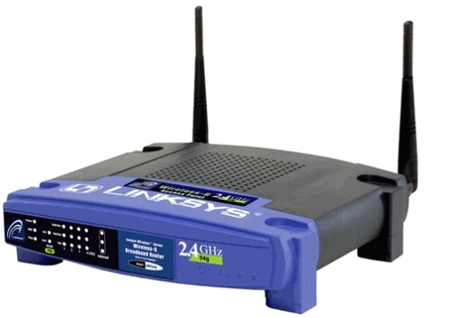
Transitioning to IPv6
How do we ease the transition from IPv4 to IPv6?
Today, most network edges are IPv6 ready
Windows/OSX/iOS/Android all support IPv6
Your wireless access point probably supports IPv6
The Internet core is hard to upgrade
… but a IPv4 core cannot route IPv6 traffic
IPv6 Ready
IPv4 Only :(
IPv6 Ready
IPv6 Packets
Home
Network
Core
Internet
Business
Network

Slide 54
Transition Technologies
How do you route IPv6 packets over an IPv4 Internet?
Transition Technologies
Use tunnels to encapsulate and route IPv6 packets over the IPv4 Internet
Several different implementations
6to4
IPv6 Rapid Deployment (6rd)
Teredo
… etc.

Slide 55
6to4 Basics
Problem: you’ve been assigned an IPv4 address, but you want an IPv6 address
Your ISP can’t or won’t give you an IPv6 address
You can’t just arbitrarily choose an IPv6 address
Solution: construct a 6to4 address
6to4 addresses always start with 2002::
Embed the 32-bit IPv4 inside the 128-bit IPv6 address
IPv4:
207.
46.
192.
0
IPv6:
20 02:
CF 2E:
C0 00:
0000

Slide 56
Routing from 6to4 to 6to4
How does a host using 6to4 send a packet to another host using 6to4?
Dest: 16.79.8.0
Dest: 2002:104F:0800::
IPv4
Internet
IPv4 – 207.46.192.0
IPv6 – 2002:CF2E:C000::
IPv4 – 16.79.8.0
IPv6 – 2002:104F:0800::

Slide 57
Routing from 6to4 to Native IPv6
Special, anycasted IPv4 address for
6to4 Relay Routers
Dest: 192.88.99.1
Dest: 1893:92:13:99::
IPv4
Internet
IPv4 – 192.88.99.1
IPv6 – 2002:: /16
IPv4 – 207.46.192.0
IPv6 – 2002:CF2E:C000::
IPv6
Internet
Many ISPs provide 6to4 relay routers
IPv6 – 1893:92:13:99::

Slide 58
Routing from Native IPv6 to 6to4
IPv4
Internet
Dest: 207.46.192.0
IPv4 – 192.88.99.1
IPv6 – 2002:: /16
IPv4 – 207.46.192.0
IPv6 – 2002:CF2E:C000::
IPv6
Internet
Dest: 2002:CF2E:C000::
Use normal IPv6 routing to reach a 6to4 relay router
IPv6 – 1893:92:13:99::

Slide 59
Problems with 6to4
Uniformity
Not all ISPs have deployed 6to4 relays
Quality of service
Third-party 6to4 relays are available
…but, they may be overloaded or unreliable
Reachability
6to4 doesn’t work if you are behind a NAT
Possible solutions
IPv6 Rapid Deployment (6rd)
Each ISP sets up relays for its customers
Does not leverage the 2002:: address space
Teredo
Tunnels IPv6 packets through UDP/IPv4 tunnels
Can tunnel through NATs, but requires special relays

Slide 60
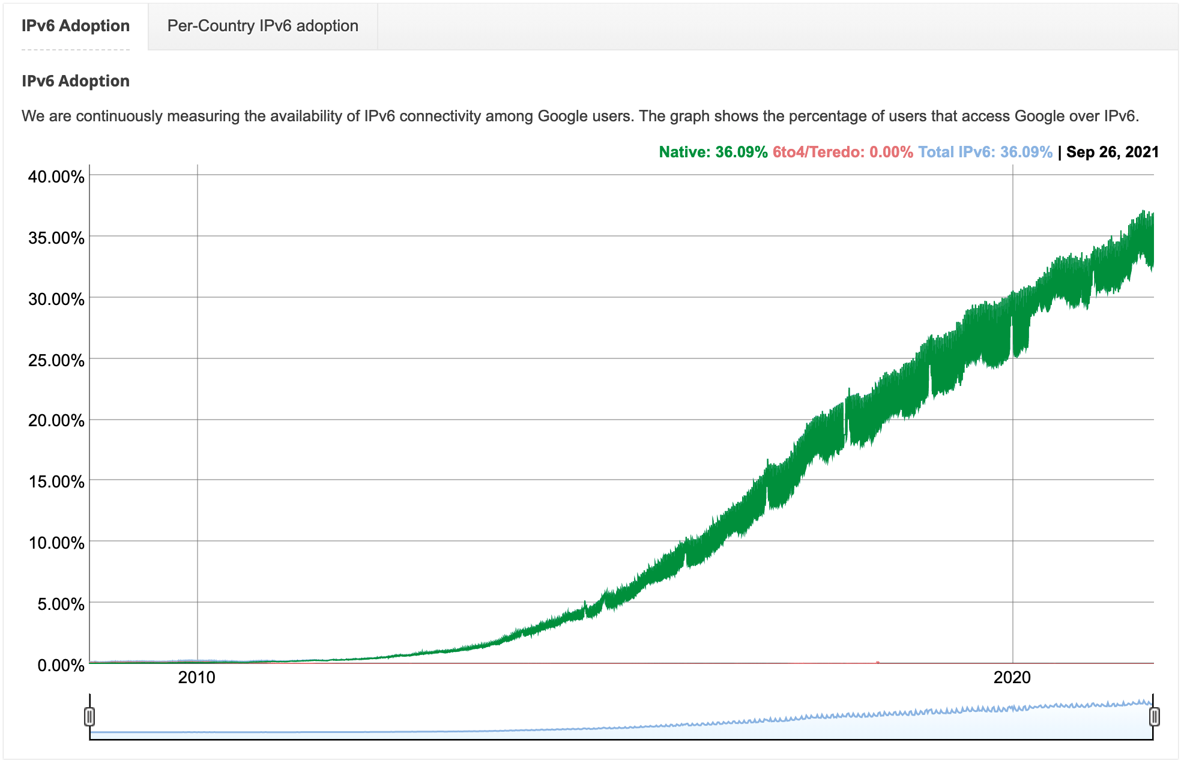
What transition technologies do we see today?
Why?
Widespread prevalence of dual stacks

Slide 61
CS 4700 / 5700 Network Fundamentals
Transport Layer
(UDP, but mostly TCP)
Revised 2/20/24

Slide 62
Transport Layer
Why does the Transport Layer exist
UDP and TCP Sockets Semantics
Reading a socket: recv semantics
Resources

Slide 63
Transport Layer
Function:
Demultiplexing of data streams
Optional functions:
Creating long lived “connections”
Reliable, in-order packet delivery
Error detection
Flow and congestion control
Key challenges:
Detecting and responding to congestion
Balancing fairness against high utilization
Application
Presentation
Session
Transport
Network
Data Link
Physical

Slide 64
Outline
UDP
TCP
Header Format, Semantics
Connection Lifecycle, Sequence Numbers
Error Detection and Recovery
TCP Options

Slide 65
The Case for Multiplexing
Datagram network
No circuits
No connections
Clients run many applications at the same time
Who to deliver packets to?
IP header “protocol” field
8 bits = 256 concurrent streams
Insert Transport Layer to handle demultiplexing
Transport
Network
Data Link
Physical
Packet

Slide 66
Demultiplexing Traffic
Server applications communicate with multiple clients
Unique port for each application
Host 1
Host 2
Host 3
Application
Transport
P1
P2
P3
P4
P5
P6
P7
Network
Applications share the same network
Endpoints identified by <src_ip, src_port, dest_ip, dest_port>

Slide 67
Layering
Layers communicate peer-to-peer
Host 1
Router
Host 2
Application
Application
Transport
Transport
Network
Network
Network
Data Link
Data Link
Data Link
Physical
Physical
Physical
Lowest level end-to-end protocol (in theory)
Transport header only read by source and destination
Routers view transport header as payload

Slide 68
User Datagram Protocol (UDP)
0
16
31
Source Port
Destination Port
Payload Length
Checksum
Simple, connectionless datagram
C sockets: SOCK_DGRAM
Port numbers enable demultiplexing
16 bits = 65535 possible ports
Port 0 is invalid
Checksum for error detection
Detects (some) corrupt packets
Does not detect dropped, duplicated, or reordered packets

Slide 69
Usage Example (Python)
No “connection”, UDP sockets are mostly stateless.
One UDP socket may send to many destinations.
Sending on a client socket
import socket
sock = socket.socket(socket.AF_INET, socket.SOCK_DGRAM)
sock.sendto(“message”, (“127.0.0.1”, 3456))
Receiving on a server socket
OS needs to be told what port this application is listening to
import socket
sock = socket.socket(socket.AF_INET, socket.SOCK_DGRAM)
sock.bind((“127.0.0.1”, 3456))
data, addr = sock.recvfrom(2048)
One UDP socket may receive from multiple destinations

Slide 70
UDP Socket Semantics
Sending
Receiving
sock.sendto(msg1, destination)
sock.sendto(msg2, destination)
sock.sendto(msg3, destination)
data, addr = sock.recvfrom(2048) #msg1
data, addr = sock.recvfrom(2048) #msg2
data, addr = sock.recvfrom(2048) #msg3
UDP Header
Datagram 1:
Src Prt
Dst Prt
msg1
Datagram 2:
Src Prt
Dst Prt
msg2
Datagram 3:
Src Prt
Dst Prt
msg3

Slide 71
UDP Socket Semantics
Sending a buffer will produce exactly one datagram containing the data from the buffer
Warning: UDP datagrams may hold up to 65,000 bytes of data…
If len(UDP datagram) > MTU, IP will need to fragment it
Receiving will return exactly one, full datagram
Not a partial datagram, not >1 datagrams

Slide 72
Uses for UDP
Invented after TCP
Why?
Not all applications can tolerate TCP
Custom protocols can be built on top of UDP
Reliability? Strict ordering?
Flow control? Congestion control?
Examples
RTMP – real-time media streaming (e.g. voice, video)
uTP – “microtransport” protocol used by BitTorrent
QUIC – app-level transport protocol developed by Google to speed up HTTP

Slide 73
Outline
UDP
TCP
Header Format, Semantics
Connection Lifecycle, Sequence Numbers
Error Detection and Recovery
TCP Options

Slide 74
Transmission Control Protocol
Reliable, in-order, bi-directional byte streams
Port numbers for demultiplexing
Virtual circuits (connections)
Flow control
Congestion control, approximate fairness
0
4
16
31
Source Port
Destination Port
Sequence Number
Acknowledgement Number
HLen
Flags
Advertised Window
Checksum
Urgent Pointer
Options

Slide 75
TCP Header Fields
0
4
16
31
Used to detect out of order, duplicate, and missing packets
Source Port
Destination Port
Sequence Number
Acknowledgement Number
Header length. Default length is 20 bytes, but may be longer with options.
HLen
Flags
Advertised Window
Checksum
Urgent Pointer
Options
Used for flow control (protecting the receiver from overloading)
Used for connection establishment (SYN), acknowledgement (ACK), connection close (FIN), and errors (RST).
Not used.

Slide 76
Usage Example
TCP is stateful, connections must be formed
One TCP socket only sends over one connection
Sending on a client socket
import socket
sock = socket.socket(socket.AF_INET, socket.SOCK_STREAM)
sock.connect((“127.0.0.1”, 3456))
sock.sendall(“message”)
OS needs to be told what port this application is listening to
Receiving on a server socket
import socket
sock = socket.socket(socket.AF_INET, socket.SOCK_STREAM)
sock.bind((“127.0.0.1”, 3456))
sock.listen()
conn, addr = sock.accept()
data = conn.recv(2048)
Socket “listens” for incoming connections
Accept spawns a second socket

Slide 77
TCP Socket Semantics
Sending
sock.send(msg1)
sock.send(msg2)
sock.send(msg3)
TCP Header
Src Prt
Src Prt
Src Prt
Dst Prt
Dst Prt
Dst Prt
msg1 + msg2a
msg1 + msg2 + msg3
Segment 1:
msg1
Segment 1:
Segment 1:
Src Prt
Src Prt
Dst Prt
Dst Prt
msg2b + msg3
Segment 2:
msg2
Segment 2:
Segment 3:
Src Prt
Dst Prt
msg3

Slide 78
TCP Socket Semantics
Sending
Receiving
sock.send(msg1)
sock.send(msg2)
sock.send(msg3)
data = sock.recv(2048)
msg1
msg2
msg3

Slide 79
TCP Socket Semantics
Sending a buffer may produce any number of segments
In practice, TCP tries to optimize by putting close to 1460 bytes in each segment
But this is not true under all circumstances
Receiving may return any number of data bytes
Could return part of a segment…
Or a full segment…
Or multiple segments…

Slide 80
send* semantics
send(bytes), sendto(bytes, addr): send data bytes to the socket
TCP
Multiple TCP segments sent depending number of bytes and max size packet in the Data Link, e.g., Ethernet max size is 1500 bytes less headers for IP and TCP
UDP
A single datagram is sent at one time up to bytes long (up to 65535 bytes → BEWARE MAX ethernet packet size only holds 1472 bytes)
No guarantee a sent datagram will be delivered

Slide 81
recv* semantics
Socket semantics are somewhat similar to File I/O semantics
recv(size), recvfrom(size): size = maximum amount of data that can be read at once
TCP
No guarantee to receive all the data sent in a single read, but all data will arrive
UDP
A single datagram is read at one time (up to 65535 bytes → BEWARE MAX ethernet packet size only holds 1472 bytes)
No guarantee a sent datagram will be received

Slide 82
Asynchronous communication
recv() is a blocking call
It waits until the socket has something to read
If nothing is there, it waits forever
OK if the communication is synchronous
client sends, server responds, client sends, server responds, …
But what is the client doesn’t know when the message will arrive or needs to read multiple open sockets or look for multiple messages
More on this on Friday

Slide 83
UDP sockets are naturally asynchronous
UDP sockets `bind` to a port, NOT to (address, port)
UDP ‘bind’ delivers packets from any host sending to the port
Challenge: what is the source IP address and port of the sending host?
Does the app care about this packet from this host
`revcfrom()` returns the data and the source IP and port of the sender
`sendto(data, address)’ does the for sending
address is (dest_IPaddr, dest_port)

Slide 84
Idleness, or how to get more work from the server
Recall, recv*() is a blocking call
If messages are not arriving frequently, the code is blocked from continuing
App goes idle
Can impact performance
Commonly addressed by:
Using `select()` or `poll()`; single threaded solutions
MUCH simpler to reason and debug
Performance lower than tuned threaded solutions
Threading
MUCH MORE complicated to debug
MUCH higher performance when Tuned CORRECTLY

Slide 85
For our next class:
Review the material(s) on the schedule for Week 3

Slide 86
Examples in Python

Slide 87
Resources & examples — all on the course website
The web has tons of examples. If the one’s below don’t work for you, look for others.
C
Beej’s Guide to Network Programming: https://beej.us/guide/bgnet/html/
TCP echo server example: https://www.geeksforgeeks.org/tcp-server-client-implementation-in-c/
UDP echo server example: https://www.geeksforgeeks.org/udp-client-server-using-connect-c-implementation/
Python
Socket Programming HOWTO: https://docs.python.org/3/howto/sockets.html
TCP echo server (1st example): https://docs.python.org/3/library/socket.html#example
UDP echo server (nice design, but needs to be converted to Python3): https://svn.python.org/projects/python/trunk/Demo/sockets/udpecho.py
Java
Distributed Systems text: Chapters 3 and 4
TCP echo server: https://www.geeksforgeeks.org/socket-programming-in-java/
UDP echo server: https://www.baeldung.com/udp-in-java , https://www.geeksforgeeks.org/working-udp-datagramsockets-java/

Slide 88
Phases of TCP
Connection setup, a.k.a. the three-way handshake
Establish connection state
Data transfer
Sequence numbers for reliable, in-order delivery
Perform flow control
Connection close
Free resources

Slide 89
Connection Setup
Why do we need connection setup?
To establish state on both hosts
Most important state: sequence and acknowledgement numbers
Count the number of bytes that have been sent
Initial value chosen at random
Why?
Important TCP flags (1 bit each)
SYN – synchronization, used for connection setup
ACK – acknowledge received data
FIN – finish, used to tear down connection

Slide 90
Three Way Handshake
Seq #
Ack#
Client
Server
Seq #
Ack #
C
?
<SYN, Seq # C, Ack # ?>
S
C
<SYN/ACK, Seq # S, Ack # C+1>
Why
Sequence # +1?
C+1
S
<ACK, Seq # C+1, Ack # S+1>
S+1
C+1
Each side:
Notifies the other of starting sequence number
ACKs the other side’s starting sequence number (+1)
Sequence # must increment on receiving a SYN
Notes:
211

Slide 91
Why Random Initial Sequence Numbers?
Connection confusion
How to disambiguate connections from the same host?
Random sequence numbers
Preventing packet injection
How Kevin Mitnick hacked into the SDSC
Need good random number generators!
Connection state management
Each SYN allocates state on the server
SYN flood is a common denial of service attack
Solution: SYN cookies

Slide 92
Phases of TCP
Connection setup, a.k.a. the three-way handshake
Establish connection state
Data transfer
Sequence numbers for reliable, in-order delivery
Perform flow control
Connection close
Free resources

Slide 93
Data Transfer
TCP uses a byte stream abstraction
Initial, random values selected during setup
Each byte in each stream is numbered
32-bit value, wraps around
Byte stream broken down into segments (packets)
Size limited by the Maximum Segment Size (MSS, typically 1460 bytes)
Set to limit fragmentation
Each segment has a sequence number
13450
14950
16050
17550
Byte stream to send
Segment 8
Segment 9
Segment 10

Slide 94
Bidirectional Communication
Seq #
Ack#
Client
Server
Seq #
Ack #
7
23
23
7
<Seq # 7, Ack # 23> 1460 data bytes
Problem: this depicts a stop-and-wait protocol
Will not be able to utilize all available bandwidth
23
1467
<ACK, Seq # 23, Ack # 1467> 730 data bytes
1467
753
<ACK, Seq # 1467, Ack # 753> 1460 data bytes
Data and ACK in the same packet
753
2927
<ACK, Seq # 753, Ack # 2927> 240 data bytes
2927
993
Each side of the connection can send and receive
Different sequence numbers for each direction

Slide 95
Review from Layer 2: Stop and Wait Protocol
Simplest form of reliability
Example: Bluetooth
Problems?
Low utilization: can only have one segment in flight at any time
10Gbps link and 10ms delay
Need 100 Mb to fill the pipe
Assume packets are 1500B
1500B * (8b/1B) / 2 = 6000b = 0.006Mb
Utilization is 0.006%
Sender
Receiver
Segment
Timeout
ACK
Segment
Timeout
Retransmit Segment
Notes:
10ms is one-way delay.
Assume path is symmetrical. 2*10ms is round trip time.
Can only send next packet after ACK is received.

Slide 96
Review from Layer 2: Sliding Window
Allow multiple outstanding, un-ACKed segments
Number of un-ACKed segments is called the window
Sender
Receiver
Segments
Window
ACKs
Made famous by TCP

Slide 97
Flow Control
Problem: how big should the window be?
Too many packets may overwhelm the receiver
Size of the receiver's buffers may change over time
Solution: advertised window
Receiver tells the sender how big their buffer (the window) is
For window size n, sender may transmit n bytes without receiving an ACK
After each ACK, the window slides forward
Advertised window may go to zero!

Slide 98
Flow Control: View from the Sender Side
Packet Sent
Packet Received
Src. Port
Dest. Port
Src. Port
Dest. Port
Sequence Number
Sequence Number
Acknowledgement Number
Acknowledgement Number
HL
Flags
Adv. Window
HL
Flags
Adv. Window
Checksum
Urgent Pointer
Checksum
Urgent Pointer
Must be buffered until ACKed
sock.send()
Buffer of Bytes to Send
ACKed
Sent
To Be Sent
Outside Window
Window
Notes:
Each side acts and sender and receiver
Every message contains sequence number, even if payload length is zero
Every message contains acknowledgements, even if no data was received
Every message advertises the window size

Slide 99
Sliding Window Example
1460
1460
1460
1460
1460
1460
1460
Buffer of Bytes to Send
Window = 3* MSS
Seq #
Ack#
Client
Server
Seq #
Ack #
7
23
23
7
<Seq # 7> 1460 data bytes
<Seq # 1467> 1460 data bytes
23
1467
<ACK, Ack # 1467>
23
2927
<Seq # 2927> 1460 data bytes
1467
23
<ACK, Ack # 2927>
23
4387
2927
23
<Seq # 4387> 1460 data bytes
<ACK, Ack # 4387>
<Seq # 5847> 1460 data bytes
23
5847
4387
23
<Seq # 7307> 1460 data bytes
23
7307
23
8767

Slide 100
What Should the Receiver ACK?
ACK every packet
Use cumulative ACK, where an ACK for sequence n implies ACKS for all k < n
Use negative ACKs (NACKs), indicating which packet did not arrive
Use selective ACKs (SACKs), indicating those that did arrive, even if not in order
SACK is an actual TCP extension

Slide 101
Sequence Numbers, Revisited
32 bits, unsigned
Why so big?
To avoid acknowledgement ambiguity in the window you need…
|Sequence # Space| > 2 * |Sending Window Size|
2³² > 2 * 2¹⁶

Slide 102
Ambiguous Window Example
Imagine that sequence numbers are 1-bit
Segments are numbered zero or one
Assume window size = 3 segments
Client
<Seq # 0>
Which segment was acknowledged?
<Seq # 1>
<Seq # 0>
<ACK, Ack # 0>

Slide 103
Phases of TCP
Connection setup, a.k.a. the three-way handshake
Establish connection state
Data transfer
Sequence numbers for reliable, in-order delivery
Perform flow control
Connection close
Free resources

Slide 104
Connection Tear Down
Client
Server
Either side can initiate tear down
Other side may continue sending data
Half open connection
shutdown()
Acknowledge the last FIN
Sequence number + 1
<FIN, Seq # X, Ack # Y>
<ACK, Seq # Y, Ack # X+1>
<…> Data
<ACK, …>
<FIN, Seq # Z, Ack # X+1>
<ACK, Seq # X+1, Ack # Z+1>

Slide 105
Error Detection and Recovery in TCP

Slide 106
Error Detection
Checksum detects (some) packet corruption
Computed over IP header, TCP header, and data
Corrupt packets are dropped
Sequence numbers catch sequence problems
Duplicates are ignored
Out-of-order packets are reordered or dropped

Slide 107
Out-of-Order (OoO) Delivery Example
Assume windows size = 3, all segments contain 1460 bytes of data
Assume OoO segments are buffered by the receiver
Ack # only increments in order
Seq #
Ack#
Client
Server
Seq #
Ack #
Duplicate ACK
7
23
23
7
<Seq # 7>
23
1467
<Seq # 2927>
<ACK, Ack # 1467>
23
1467
1467
23
<Seq # 1467>
<ACK, Ack # 1467>
23
4387
1467
23
<ACK, Ack # 4387>
<Seq # 4387>
23
5847
4387
23
Windows does not slide, no transmission
<Seq # 5847>
Ack # catches up by two segments
Window slides by two segments
23
7307
<Seq # 7307>
23
8767

Slide 108
Packet Loss Example
Assume windows size = 3, all segments contain 1460 bytes of data
Assume OoO segments are buffered by the receiver
Ack # only increments in order
Seq #
Ack#
Client
Duplicate ACK
Server
Seq #
Ack #
7
23
23
7
<Seq # 1467>
<Seq # 7>
23
1467
<Seq # 2927>
<ACK, Ack # 1467>
23
1467
1467
23
<ACK, Ack # 1467>
1467
23
<Seq # 4387>
23
1467
<ACK, Ack # 1467>
1467
23
Windows does not slide, no transmission

Slide 109
Seq #
Ack#
Client
Server
Seq #
Ack #
7
23
23
7
<Seq # 1467>
<Seq # 7>
23
1467
<Seq # 2927>
<ACK, Ack # 1467>
23
1467
1467
23
<ACK, Ack # 1467>
1467
23
<Seq # 4387>
23
1467
<ACK, Ack # 1467>
1467
23
Timeout, retransmit
<Seq # 1467>
23
5847
<Seq # 2927>
<ACK, Ack # 5847>
<Seq # 4387>
5847
23
Window slides by three segments

Slide 110
Error Detection
Checksum detects (some) packet corruption
Computed over IP header, TCP header, and data
Corrupt packets are dropped
Sequence numbers catch sequence problems
Duplicates are ignored
Out-of-order packets are reordered or dropped
Lost segments detected by sender
Use timeout to detect lost segments and missing ACKs
Need to estimate RTT to calibrate the timeout
Sender must keep copies of all data until ACK

Slide 111
Retransmission Time Outs (RTO)
Problem: time-out is linked to round trip time
Timeout is too short
Initial Send
Initial Send
RTO
RTO
ACK
Retry
Retry
What about if timeout is too long?
ACK

Slide 112
Round Trip Time Estimation
Data
RTT Sample
ACK
Original TCP round-trip estimator
RTT estimated as a moving average
new_rtt = α (old_rtt) + (1 – α)(new_sample)
Recommended α: 0.8-0.9 (0.875 for most TCPs)
RTO = 2 * new_rtt (i.e. TCP is conservative)

Slide 113
RTT Sample Ambiguity
Initial Send
Initial Send
RTO
RTO
ACK
Retry
Sample?
Retry
Sample
ACK
Karn’s algorithm: ignore samples for retransmitted segments

Slide 114
TCP Options

Slide 115
Common TCP Options
0
4
16
31
Source Port
Destination Port
Sequence Number
Acknowledgement Number
HLen
Flags
Advertised Window
Checksum
Urgent Pointer
Options
Window scaling
Timestamp
SACK: selective acknowledgement
Maximum segment size (MSS)

Slide 116
Utilization, Revisited
Sequence numbers are 32 bits, advertised windows are 16 bits
The most data that can be in flight in parallel is 2^16 bytes
Recall that link capacity is measured by the bandwidth delay product
bandwidth * delay = capacity
What is the maximum bandwidth TCP can utilize?
100 ms of delay → 2^16 bytes / 100 ms ~ 5 Kbps
500 ms of delay → 2^16 bytes / 500 ms ~ 1 Kbps
But ethernet scales to 1 Gbps, 10 Gbps, 100 Gbps…

Slide 117
Window Scaling
Problem: the advertised window is only 16-bits
Effectively caps the window at 65536 bytes, 64 KB
Solution: introduce a window scaling value
scaled_adv_wnd = adv_wnd << wnd_scale;
Maximum shift is 14 bits, 1GB maximum window

Slide 118
Sequence Number Scaling
Problem: sequence numbers are only 32 bits
Effectively caps the window at 2^32 ~ 4 GB
What is the maximum bandwidth TCP can utilize?
100 ms of delay → 2^32 bytes / 100 ms ~ 344 Mbps
500 ms of delay → 2^32 bytes / 500 ms ~ 69 Mbps
Solution: the PAWS algorithm
32-bit timestamp option in TCP header
When was the packet sent (approximately)
Effectively extends the sequence numbers space to 64 bits

Slide 119
SACK: Selective Acknowledgment
Problem: duplicate ACKs only tell us about 1 missing packet
Multiple rounds of dup ACKs needed to fill all holes
Solution: selective ACK
Include received, out-of-order sequence numbers in TCP header
Explicitly tells the sender about holes in the sequence
4
5
6
7
4
8
9
4
10
11
4
4
4

Slide 120
Other Common Options
Maximum segment size (MSS)
Essentially, what is the hosts MTU
Saves on path discovery overhead

Slide 121
Phases of TCP
Connection setup, a.k.a. the three-way handshake
Establish connection state
Data transfer
Sequence numbers for reliable, in-order delivery
Perform flow control
Connection close
Free resources

Slide 122
Connection Setup
Why do we need connection setup?
To establish state on both hosts
Most important state: sequence and acknowledgement numbers
Count the number of bytes that have been sent
Initial value chosen at random
Why?
Important TCP flags (1 bit each)
SYN – synchronization, used for connection setup
ACK – acknowledge received data
FIN – finish, used to tear down connection

Slide 123
Three Way Handshake
Seq #
Ack#
Client
Server
Seq #
Ack #
C
?
<SYN, Seq # C, Ack # ?>
S
C
<SYN/ACK, Seq # S, Ack # C+1>
Why
Sequence # +1?
C+1
S
<ACK, Seq # C+1, Ack # S+1>
S+1
C+1
Each side:
Notifies the other of starting sequence number
ACKs the other side’s starting sequence number (+1)
Sequence # must increment on receiving a SYN
Notes:
211

Slide 124
Why Random Initial Sequence Numbers?
Connection confusion
How to disambiguate connections from the same host?
Random sequence numbers
Preventing packet injection
How Kevin Mitnick hacked into the SDSC
Need good random number generators!
Connection state management
Each SYN allocates state on the server
SYN flood is a common denial of service attack
Solution: SYN cookies

Slide 125
Phases of TCP
Connection setup, a.k.a. the three-way handshake
Establish connection state
Data transfer
Sequence numbers for reliable, in-order delivery
Perform flow control
Connection close
Free resources

Slide 126
Data Transfer
TCP uses a byte stream abstraction
Initial, random values selected during setup
Each byte in each stream is numbered
32-bit value, wraps around
Byte stream broken down into segments (packets)
Size limited by the Maximum Segment Size (MSS, typically 1460 bytes)
Set to limit fragmentation
Each segment has a sequence number
13450
14950
16050
17550
Byte stream to send
Segment 8
Segment 9
Segment 10

Slide 127
Bidirectional Communication
Seq #
Ack#
Client
Server
Seq #
Ack #
7
23
23
7
<Seq # 7, Ack # 23> 1460 data bytes
Problem: this depicts a stop-and-wait protocol
Will not be able to utilize all available bandwidth
23
1467
<ACK, Seq # 23, Ack # 1467> 730 data bytes
1467
753
<ACK, Seq # 1467, Ack # 753> 1460 data bytes
Data and ACK in the same packet
753
2927
<ACK, Seq # 753, Ack # 2927> 240 data bytes
2927
993
Each side of the connection can send and receive
Different sequence numbers for each direction

Slide 128
Review from Layer 2: Stop and Wait Protocol
Simplest form of reliability
Example: Bluetooth
Problems?
Low utilization: can only have one segment in flight at any time
10Gbps link and 10ms delay
Need 100 Mb to fill the pipe
Assume packets are 1500B
1500B * (8b/1B) / 2 = 6000b = 0.006Mb
Utilization is 0.006%
Sender
Receiver
Segment
Timeout
ACK
Segment
Timeout
Retransmit Segment
Notes:
10ms is one-way delay.
Assume path is symmetrical. 2*10ms is round trip time.
Can only send next packet after ACK is received.

Slide 129
Review from Layer 2: Sliding Window
Allow multiple outstanding, un-ACKed segments
Number of un-ACKed segments is called the window
Sender
Receiver
Segments
Window
ACKs
Made famous by TCP

Slide 130
Flow Control
Problem: how big should the window be?
Too many packets may overwhelm the receiver
Size of the receiver's buffers may change over time
Solution: advertised window
Receiver tells the sender how big their buffer (the window) is
For window size n, sender may transmit n bytes without receiving an ACK
After each ACK, the window slides forward
Advertised window may go to zero!

Slide 131
Flow Control: View from the Sender Side
Packet Sent
Packet Received
Src. Port
Dest. Port
Src. Port
Dest. Port
Sequence Number
Sequence Number
Acknowledgement Number
Acknowledgement Number
HL
Flags
Adv. Window
HL
Flags
Adv. Window
Checksum
Urgent Pointer
Checksum
Urgent Pointer
Must be buffered until ACKed
sock.send()
Buffer of Bytes to Send
ACKed
Sent
To Be Sent
Outside Window
Window
Notes:
Each side acts and sender and receiver
Every message contains sequence number, even if payload length is zero
Every message contains acknowledgements, even if no data was received
Every message advertises the window size

Slide 132
Sliding Window Example
1460
1460
1460
1460
1460
1460
1460
Buffer of Bytes to Send
Window = 3* MSS
Seq #
Ack#
Client
Server
Seq #
Ack #
7
23
23
7
<Seq # 7> 1460 data bytes
<Seq # 1467> 1460 data bytes
23
1467
<ACK, Ack # 1467>
23
2927
<Seq # 2927> 1460 data bytes
1467
23
<ACK, Ack # 2927>
23
4387
2927
23
<Seq # 4387> 1460 data bytes
<ACK, Ack # 4387>
<Seq # 5847> 1460 data bytes
23
5847
4387
23
<Seq # 7307> 1460 data bytes
23
7307
23
8767

Slide 133
What Should the Receiver ACK?
ACK every packet
Use cumulative ACK, where an ACK for sequence n implies ACKS for all k < n
Use negative ACKs (NACKs), indicating which packet did not arrive
Use selective ACKs (SACKs), indicating those that did arrive, even if not in order
SACK is an actual TCP extension

Slide 134
Sequence Numbers, Revisited
32 bits, unsigned
Why so big?
To avoid acknowledgement ambiguity in the window you need…
|Sequence # Space| > 2 * |Sending Window Size|
2³² > 2 * 2¹⁶

Slide 135
Ambiguous Window Example
Imagine that sequence numbers are 1-bit
Segments are numbered zero or one
Assume window size = 3 segments
Client
<Seq # 0>
Which segment was acknowledged?
<Seq # 1>
<Seq # 0>
<ACK, Ack # 0>

Slide 136
Phases of TCP
Connection setup, a.k.a. the three-way handshake
Establish connection state
Data transfer
Sequence numbers for reliable, in-order delivery
Perform flow control
Connection close
Free resources

Slide 137
Connection Tear Down
Client
Server
Either side can initiate tear down
Other side may continue sending data
Half open connection
shutdown()
Acknowledge the last FIN
Sequence number + 1
<FIN, Seq # X, Ack # Y>
<ACK, Seq # Y, Ack # X+1>
<…> Data
<ACK, …>
<FIN, Seq # Z, Ack # X+1>
<ACK, Seq # X+1, Ack # Z+1>

Slide 138
Error Detection and Recovery in TCP

Slide 139
Error Detection
Checksum detects (some) packet corruption
Computed over IP header, TCP header, and data
Corrupt packets are dropped
Sequence numbers catch sequence problems
Duplicates are ignored
Out-of-order packets are reordered or dropped

Slide 140
Out-of-Order (OoO) Delivery Example
Assume windows size = 3, all segments contain 1460 bytes of data
Assume OoO segments are buffered by the receiver
Ack # only increments in order
Seq #
Ack#
Client
Server
Seq #
Ack #
Duplicate ACK
7
23
23
7
<Seq # 7>
23
1467
<Seq # 2927>
<ACK, Ack # 1467>
23
1467
1467
23
<Seq # 1467>
<ACK, Ack # 1467>
23
4387
1467
23
<ACK, Ack # 4387>
<Seq # 4387>
23
5847
4387
23
Windows does not slide, no transmission
<Seq # 5847>
Ack # catches up by two segments
Window slides by two segments
23
7307
<Seq # 7307>
23
8767

Slide 141
Packet Loss Example
Assume windows size = 3, all segments contain 1460 bytes of data
Assume OoO segments are buffered by the receiver
Ack # only increments in order
Seq #
Ack#
Client
Duplicate ACK
Server
Seq #
Ack #
7
23
23
7
<Seq # 1467>
<Seq # 7>
23
1467
<Seq # 2927>
<ACK, Ack # 1467>
23
1467
1467
23
<ACK, Ack # 1467>
1467
23
<Seq # 4387>
23
1467
<ACK, Ack # 1467>
1467
23
Windows does not slide, no transmission

Slide 142
Seq #
Ack#
Client
Server
Seq #
Ack #
7
23
23
7
<Seq # 1467>
<Seq # 7>
23
1467
<Seq # 2927>
<ACK, Ack # 1467>
23
1467
1467
23
<ACK, Ack # 1467>
1467
23
<Seq # 4387>
23
1467
<ACK, Ack # 1467>
1467
23
Timeout, retransmit
<Seq # 1467>
23
5847
<Seq # 2927>
<ACK, Ack # 5847>
<Seq # 4387>
5847
23
Window slides by three segments

Slide 143
Error Detection
Checksum detects (some) packet corruption
Computed over IP header, TCP header, and data
Corrupt packets are dropped
Sequence numbers catch sequence problems
Duplicates are ignored
Out-of-order packets are reordered or dropped
Lost segments detected by sender
Use timeout to detect lost segments and missing ACKs
Need to estimate RTT to calibrate the timeout
Sender must keep copies of all data until ACK

Slide 144
Retransmission Time Outs (RTO)
Problem: time-out is linked to round trip time
Timeout is too short
Initial Send
Initial Send
RTO
RTO
ACK
Retry
Retry
What about if timeout is too long?
ACK

Slide 145
Round Trip Time Estimation
Data
RTT Sample
ACK
Original TCP round-trip estimator
RTT estimated as a moving average
new_rtt = α (old_rtt) + (1 – α)(new_sample)
Recommended α: 0.8-0.9 (0.875 for most TCPs)
RTO = 2 * new_rtt (i.e. TCP is conservative)

Slide 146
RTT Sample Ambiguity
Initial Send
Initial Send
RTO
RTO
ACK
Retry
Sample?
Retry
Sample
ACK
Karn’s algorithm: ignore samples for retransmitted segments

Slide 147
TCP Options

Slide 148
Common TCP Options
0
4
16
31
Source Port
Destination Port
Sequence Number
Acknowledgement Number
HLen
Flags
Advertised Window
Checksum
Urgent Pointer
Options
Window scaling
Timestamp
SACK: selective acknowledgement
Maximum segment size (MSS)

Slide 149
Utilization, Revisited
Sequence numbers are 32 bits, advertised windows are 16 bits
The most data that can be in flight in parallel is 2^16 bytes
Recall that link capacity is measured by the bandwidth delay product
bandwidth * delay = capacity
What is the maximum bandwidth TCP can utilize?
100 ms of delay → 2^16 bytes / 100 ms ~ 5 Kbps
500 ms of delay → 2^16 bytes / 500 ms ~ 1 Kbps
But ethernet scales to 1 Gbps, 10 Gbps, 100 Gbps…

Slide 150
Window Scaling
Problem: the advertised window is only 16-bits
Effectively caps the window at 65536 bytes, 64 KB
Solution: introduce a window scaling value
scaled_adv_wnd = adv_wnd << wnd_scale;
Maximum shift is 14 bits, 1GB maximum window

Slide 151
Sequence Number Scaling
Problem: sequence numbers are only 32 bits
Effectively caps the window at 2^32 ~ 4 GB
What is the maximum bandwidth TCP can utilize?
100 ms of delay → 2^32 bytes / 100 ms ~ 344 Mbps
500 ms of delay → 2^32 bytes / 500 ms ~ 69 Mbps
Solution: the PAWS algorithm
32-bit timestamp option in TCP header
When was the packet sent (approximately)
Effectively extends the sequence numbers space to 64 bits

Slide 152
SACK: Selective Acknowledgment
Problem: duplicate ACKs only tell us about 1 missing packet
Multiple rounds of dup ACKs needed to fill all holes
Solution: selective ACK
Include received, out-of-order sequence numbers in TCP header
Explicitly tells the sender about holes in the sequence
4
5
6
7
4
8
9
4
10
11
4
4
4

Slide 153
Other Common Options
Maximum segment size (MSS)
Essentially, what is the hosts MTU
Saves on path discovery overhead

