Slide 1
4730: Distributed Systems
Quorums. Paxos. View-stamped replication. BFT. Raft
Acknowledgements to Prof Cristina Nita-Rotaru and Christo Wilson

Slide 2
Required reading for this topic…
Implementing Fault-Tolerant Services Using the State Machine Approach: A Tutorial. F. B. Schneider
Quorums
  Quorum Systems. Chapter in The Encyclopedia of Distributed Computing, D. Malkhi
Paxos
  Paxos Made Simple, L. Lamport
  Paxos for System Builders, J. Kirsch and Y. Amir (the technical report)
  The Part-time Parliament, L. Lamport
Viewstamped Replication Revisited, B. Liskov and J. Cowling
From Viewstamped replication to Byzantine replication. B Liskov.

Slide 3
1: The State Machine Approach

Slide 4
The State Machine Approach
The system consists of clients that invoke commands on deterministic state machines
The state of a state machine depends only on its initial state and the sequence of (deterministic) commands it has been given
All non-faulty state machines, being deterministic, will give the same response to a command

Slide 5

How it works
Clients
shl
Consensus
Module
State
Machine
Consensus
Module
State
Machine
Consensus
Module
State
Machine
Servers
Log
Log
Log
add
jmp
mov
shl
add
jmp
mov
shl
add
jmp
mov
shl
Replicated log => replicated state machine
  All servers execute same commands in same order
Consensus module ensures proper log replication
System makes progress as long as any majority of servers are up
Failure model: fail-stop (not Byzantine), delayed/lost messages

Slide 6
How it works …
All replicas start in the same initial state
Every replica apply operations in the same order
All operations must be deterministic
All replicas end up in the same state

Slide 7

At the core: Consensus
Each process sends its value (proposal) to all the other processes, all processes have the same set they can make a decision
Each process sends its value (proposal) to a leader which makes the decision and informs the other processes

Slide 8
Challenges
Can nodes trust each other
Can a node crash and/or recover
Can a network partition occur
Can messages be delayed or lost
How to detect that
  processes crashed
  network partitions
  messages are lost

Slide 9
Crash, Recovery, and Network Partition
Process crashes: the leader may not have enough values to reach a decision
Network partition: leader may not have enough values, some components will have no leaders and have to select one
Leader crashes: if it crashes after deciding but before announcing results everybody is blocked
Process or leader recovers: they will not know what they were doing (unless they write some information on the disk)

Slide 10
Process Groups Approach
One way of building distributed fault-tolerant systems by organizing them in a group:
  Ensure group membership
  Ensure group multicast, with different ordering properties.
Easier to work with when providing in the form of a toolkit

Slide 11
Limitations of Process Groups Approach
Need to respond to leader failure
  Costly agreement on membership
Virtual synchrony: simplify recovery from partitioned views
Servers need to monitor for failures (correct but slow participants may be excluded)
Reconfiguration

Slide 12
Go To Consensus Deck…

Slide 13
2: Quorums

Slide 14
A different approach: Quorum Systems
In law, a quorum is the minimum number of members of a deliberative body necessary to conduct the business of that group
When quorum is not met, a legislative body cannot hold a vote, and cannot change the status quo

Slide 15
Quorum Systems
Increase availability and efficiency of replicated services
Availability: Operations succeed in spite of failures; quorum systems can be defined to tolerate both benign and arbitrary/malicious failures
Efficiency: Can significantly reduce communication complexity, do not require all servers in order to perform an operation, requires a subset of them for each operation

Slide 16
Using Quorums to Read and Write
Read
Write(7)
The set of processors from which a variable is read must
intersect the set of processors to which a variable was written.
Notes:
3

Slide 17
Shared Variable with Quorums
Use a quorum system to implement a multi-reader multi-writer shared variable, replicated across n servers
Write:
Client queries each server in some quorum (writing quorum) to obtain a set A of value/timestamp pairs
Client chooses a timestamp greater than the highest value in the set A and updates the value and the timestamp at each server in the writing quorum

Slide 18
Shared Variable with Quorums (II)
Read:
Client queries each server in a quorum to obtain a set A of value/timestamp
Then chooses the pair with the highest timestamp
For both read and write each server updates its local variable and timestamp to the received values, only if received timestamp is greater than the one they had for that value

Slide 19
Replication with Quorums
Replicated data items have “versions”, and these are numbered
  I.e. can’t just say “Xp=3”. Instead say that Xp has timestamp [7,q] and value 3
  Timestamp must increase monotonically and includes a process id to break ties

Slide 20
Read Operation
Send request and wait until Qr (read quorum) processes reply
Then use the value with the largest timestamp
  Break ties by looking at the process id
  For example
    [6,x] < [9,a] (first look at the “time”)
    [7,p] < [7,q] (but use process id as a tie-breaker)

Slide 21
Write Operation
When a process initiates a write, it does not know if it will succeed in updating a quorum (writing quorum) of processes
  Need to use a commit protocol
Moreover, must implement a mechanism to determine the version number as part of the protocol.

Slide 22
Write Operation: Details
Propose the write: “I would like to set X=3”
Members “lock” the variable against reads, put the request into a queue of pending writes, and send back:
  “OK. I propose time [t,pid]”
  Here, time is a logical clock. Pid is the member’s own pid
Initiator collects replies, hoping to receive Q_{w} (or more)
≥ Q_{w} OKs
< Q_{w} OKs
Compute maximum of proposed [t,pid] pairs.
Commit at that time
Abort

Slide 23
Quorum constructions: Weighted Majorities
  Assume that every server s in the universe U is assigned a number of votes w_{s}.
  Then, the set system
  Q = {Q ⊆ U: Σ_{q∈Q}w_{q} > 1/2Σ_{q∈U}w_{q}}
  is a quorum system called Weighted Majorities.
  When all the weights are the same, simply call this the system of Majorities

Slide 24
Quorum constructions: Grid
Previous example was not very efficient, requiring more than half of the servers to be contacted
Arrange servers into a logical grid, and use rows/columns for writes/reads, respectively
Can cut the number of servers contacted in an operation
Can change row/column sizes to optimize for write-heavy/read-heavy scenarios
read
write
x

Slide 25
2: Paxos
Based on slides from, John, Diego Ongaro, Lorenzo Alvisi, Ali Ghodsi, and David Mazières

Slide 26
Paxos
More robust that process groups approach
Safety does not require synchronous communication
Liveness requires that we are able to detect failures within a certain timeout
  Requires a stable-enough network to elect a leader that will stay stable for a while
  Requires a (potentially changing) majority of members to support the leader (in order to make progress)

Slide 27
The Paxos Approach
Decompose the problem:
Basic Paxos (aka Paxos) (“single decree”):
  One or more servers propose values
  System must agree on a single value as chosen
  Only one value is ever chosen
Multi-Paxos:
  Combine several instances of Basic Paxos to agree on a series of values forming the log

Slide 28
Paxos: Goals
Provides a solution to consensus (agreement) in an asynchronous model
Safety
  Only a value that has been proposed may be chosen
  Only a single value is chosen
  A node never learns that a value has been chosen unless it actually has been
Liveness (as long as majority of servers up and communicating with reasonable timeliness)
  Some proposed value is eventually chosen
  If a value has been chosen, a node can eventually learn the value

Slide 29
The Model
N servers, uniquely identified
Messages:
  Can take arbitrarily long to be delivered (Asynchronous communication)
  Can be duplicated
  Can be lost
Nodes:
  Operate at arbitrary speed
  May fail by stopping, and may restart
  Must remember what they were doing (in case they fail and restart, they have to know what to do next)

Slide 30
Paxos: Main Idea
One node is chosen as the leader (we will see later how this is done)
Leader proposes a value (to be chosen by all) and asks the other nodes to accept it
Leader announces result to the rest of the nodes or tries again if he could not have reached a decision
Why this algorithm?

Slide 31
Types of nodes from the Lamport paper, Paxos made simple
Observes nodes perform three different types of actions:
  (1) Propose values, (2) Accept values, (3) Learn values
Classifies nodes as:
  Proposer:
    Proposes a value and solicits acceptance from acceptors
  Acceptor:
    Responds to messages from proposers, responses represent votes that form consensus
    Stores chosen value, state of the decision process
    Wants to know which value was chosen
  Learner: finds out the outcome
A node can have all three roles

Slide 32
Need for Multiple Acceptors
Assume a single node A acts as acceptor
  Each proposer sends its value to A
  A decides on one of the values
  A announces its decision to all learners
What can go wrong?
  If the acceptor fails, the protocol will block since nobody will decide
Solution: We need multiple acceptors, quorum
  Multiple acceptors (3, 5, ...)
  Value v is chosen if accepted by majority of acceptors
  If one acceptor crashes, chosen value still available (i.e. Liveness)

Slide 33
Solution with Multiple Acceptors
Each proposer proposes to all acceptors
Each acceptor accepts the first proposal it receives and rejects the rest
If the proposer receives positive replies from a majority of acceptors, it chooses its own value (that’s what she proposed)
Proposer sends chosen value to all learners
What if multiple proposers propose simultaneously so there is no majority accepting?

Slide 34
Problem: Split Votes
Acceptor accepts only first value it receives?
If simultaneous proposals, no value might be chosen
How to fix it: Acceptors must sometimes accept multiple (different) values
s₁
accept?(red)
accepted(red)
s₂
accepted(red)
s₃
accept?(blue)
accepted(blue)
s₄
accepted(blue)
s₅
accept?(green)
accepted(green)
time

Slide 35
Problem: Conflicting Choices
Acceptor accepts every value it receives?
Could choose multiple values
How to fix it: Once a value has been chosen, future proposals must propose/choose that same value (2-phase protocol)
Red Chosen
s₁
accept?(red)
accepted(red)
s₂
accepted(red)
s₃
accepted(red)
accepted(blue)
s₄
accepted(blue)
s₅
accepted(blue)
accept?(blue)
time
Blue Chosen

Slide 36
Conflicting Choices (2)
Red Chosen??
s₁
accept?(red)
accepted(red)
s₂
accepted(red)
s₃
accepted(blue)
accepted(red)
s₄
accepted(blue)
s₅
accepted(blue)
prop(blue)
time
Blue Chosen
s₅ doesn’t need to propose red (it hasn’t been chosen yet)
s₁’s proposal must be aborted (s₃ must reject it)
How to fix it: Must order proposals, reject old ones

Slide 37
Solution with Multiple Proposals
Proposals are ordered by proposal number
We can allow multiple proposals but we must guarantee that all chosen proposals have the same value
Each acceptor may accept multiple proposals
  If a proposal with value v is chosen, all higher-numbered proposals have value v

Slide 38
Invariant
For any v and n, if a proposal with value v and number n is issued then there is a set S consisting of a majority of acceptors such that:
  No acceptor in S has accepted any proposal numbered less than n, or
  v is the value of the highest-numbered proposal among all proposals numbered less than n accepted by the acceptors in S

Slide 39
How to Ensure the Invariant
Can not predict the future, what acceptor will accept
Can obtain promise from acceptors with respect to what they will accept:
“The proposer requests that the acceptors not accept any more proposals numbered less than n”

Slide 40
Issuing Proposals
A proposer chooses a new proposal number n and sends a request to a set of acceptors, asking them:
  Promise to never accept a proposal numbered less than n
  Send the proposal with the highest number less than n that it has accepted, if any.
If the proposer receives the requested responses from a majority of acceptors it can issue a proposal with number n and value v, where v is:
  the value of the highest-numbered proposal among the responses, or
  any value selected by the proposer if the responders reported no proposals.

Slide 41
Optimization
Given that an acceptor receives a request numbered n, but it has already responded to a request numbered greater than n, thereby promising not to accept any new proposal numbered n.
Acceptor can ignore
  such a request
  a request for a proposal it has already accepted

Slide 42
Accepting Proposals
Phase 1 (Prepare)
  A proposer selects a proposal number n and sends a Prepare_Request<n> to a majority of acceptors.
  If an acceptor receives a Prepare_Request<n> with n greater than that of any Prepare_Request to which it has already responded, then it responds to the request with an ACK which promises not to accept any more proposals numbered less than n and includes the highest-numbered proposal (if any) that it has accepted.
Phase 2 (Accept)
  If the proposer receives an ACK to its Prepare_Request<n> from a majority of acceptors, then it sends an Accept_Request<, n, v> to each of those acceptors, where v is the value of the highest-numbered proposal among the responses, or is any value if the responses reported no proposals.
  If an acceptor receives an accept request for a proposal numbered n, it accepts the proposal unless it has already responded to a prepare request having a number greater than n.

Slide 43
Learning about Accepted Proposals
Lower cost by using a leader for learners
Acceptors send their accepts to the leader for the learners
It is possible that a value has been accepted and some learners did not learn it
They will learn it when a new proposal is issued

Slide 44
Proposal Numbers
Each proposal has a unique number
  Higher numbers take priority over lower numbers
  It must be possible for a proposer to choose a new proposal number higher than anything it has seen/used before
One simple approach:
  Each server stores maxRound: the largest Round Number it has seen so far
  To generate a new proposal number:
    Increment maxRound
    Concatenate with Server Id
  Proposers must persist maxRound on disk: must not reuse proposal numbers after crash/restart
Proposal Number
Round Number
Server Id

Slide 45
Paxos
Two-phase approach:
Phase 1: broadcast Prepare
  Find out about any chosen values
  Block older proposals that have not yet completed
Phase 2: broadcast Accept
  Ask acceptors to accept a specific value

Slide 46
Paxos: Putting it All Together
Proposers
1) Choose new proposal number n
2) Broadcast Prepare(n) to all servers
4) When responses received from majority:
  If any acceptedValues returned, replace value with acceptedValue for highest acceptedProposal
5) Broadcast Accept(n, value) to all servers
7) When responses received from majority:
  Any rejections (result > n)? goto (1)
  Otherwise, value is chosen
Acceptors
3) Respond to Prepare(n):
  If n > minProposal then minProposal = n
  Return(acceptedProposal, acceptedValue)
Respond to Accept(n, value):
  If n ≥ minProposal then
  acceptedProposal = minProposal = n
  acceptedValue = value
  Return(minProposal)
Acceptors must record minProposal, acceptedProposal, and acceptedValue on stable storage (disk)

Slide 47
Examples: later proposal prepares
Previous value already chosen:
  New proposer will find it and use it
“Prepare proposal 3.1 (from s3)
“Accept proposal 3.1
with value X (from s₁)”
“Accept proposal 4.5
with value X (from s₅)”
X
s₁
P 3.1
A 3.1 X
s₂
P 3.1
A 3.1 X
values
s₃
P 3.1
A 3.1 X
P 4.5
A 4.5 X
s₄
P 4.5
A 4.5 X
Y
s₅
P 4.5
A 4.5 X
time
“Prepare proposal 4.5 (from s₅)”
The response to prepare from s3 included the accepted proposal 3.1 with value x, so s5 generates Accept 4.5 value x

Slide 48
Examples: later proposal prepares:
Previous value not chosen, but new proposer sees it:
  New proposer will use existing value
  Both proposers can succeed
X
s₁
P 3.1
A 3.1 X
s₂
P 3.1
A 3.1 X
values
s₃
P 3.1
A 3.1 X
P 4.5
A 4.5 X
s₄
P 4.5
A 4.5 X
Y
s₅
P 4.5
A 4.5 X
time

Slide 49
Examples: later proposal prepares
Previous value not chosen, new proposer doesn’t see it:
  New proposer chooses its own value
  Older proposal blocked
“Accept proposal 3.1
with value X from s3 will return proposal 4.5 so s1 will abort 3.1
X
s₁
P 3.1
A 3.1 X
s₂
P 3.1
A 3.1 X
values
s₃
P 3.1
P 4.5
A 3.1 X
A 4.5 Y
s₄
P 4.5
A 4.5 Y
Y
s₅
P 4.5
A 4.5 Y
time

Slide 50
Need for one Leader for Proposers
Scenario where there will be no progress with two proposers
Proposer p completes phase 1 for a proposal number n1
Proposer q then completes phase 1 for a proposal number n2 > n1
Proposer p’s phase 2 accept requests for a proposal numbered n1 are ignored because the acceptors have all promised not to accept any new proposal numbered less than n2
Proposer p then begins and completes phase 1 for a new proposal number n3 > n2, causing the second phase 2 accept requests of proposer q to be ignored

Slide 51
Leader
One leader, it’s the leader for the proposers and for the learners
  Issues proposals and informs all learners of the outcome
How to select leader?
  FLP implies that to select a leader we need to use timeouts or randomization
A new leader must not violate previously established ordering!
  The new leader must know about all updates that may have been ordered.
  If a new leader gets information from any majority of acceptors, it can determine what may have been ordered!

Slide 52
Liveness
Competing proposers can livelock:
One solution: randomized delay before restarting
  Give other proposers a chance to finish choosing
Multi-Paxos will use leader election instead
s₁
P 3.1
A 3.1 X
P 4.1
A 4.1 X
s₂
P 3.1
A 3.1 X
P 4.1
A 4.1 X
s₃
P 3.1
P 3.5
A 3.1 X
P 4.1
A 3.5 Y
P 5.5
A 4.1 X
s₄
P 3.5
A 3.5 Y
P 5.5
s₅
P 3.5
A 3.5 Y
P 5.5
time

Slide 53
The Paxos Approach
Decompose the problem:
Basic Paxos (aka Paxos) (“single decree”):
  One or more servers propose values
  System must agree on a single value as chosen
  Only one value is ever chosen
Multi-Paxos:
  Combine several instances of Basic Paxos to agree on a series of values forming the log

Slide 54
Recovery Case
If leader fails, new leader is elected, known as view change
The new leader cannot propose updates until it collects information from a majority of servers!
  New leader must learn the outcome of all pending requests
  For all pending requests, the leader sends accept messages
  New leader sends a sequence n
  Every node sends a higher n_{i} representing proposals it has ordered or ackd
  Leader collects f+1 responses, eliminates duplicates, selects proposals with highest number and broadcasts it to everybody, computes also the list of missed messages

Slide 55
Questions
What if more than one leader is active and issues two different proposal numbers, can both leaders see a majority of Prepare_Ok?
What if leader fails while sending accept?
What if a node fails after receiving Accept?
What if a node fails after sending Prepare_Ok?

Slide 56
Liveness
A leader can get conflicting Proposal messages!
Why? Some nodes might think somebody else is the leader
How to fix? Add view numbers, each proposal is made within a view, view number is attached to each proposal
Leader selects the proposal with the highest view id

Slide 57
View Change
A set of 2f+1 replicas, replica id: 0,1,…,2f
Each view: one and only one leader
Initially replica 0 assumes the leader role for view=0
Subsequently, replicas take the primary (leader) role in a round-robin fashion
To ensure liveness
  A replica starts a view change timer on the initiation of each instance of Paxos
  If the replica does not learn the request chosen before timer expires => suspect the primary

Slide 58
View Change: Start
On suspecting the leader, a replica broadcasts a View Change message to all
Current leader, if it is wrongly suspected, joins the view change anyway (i.e., it steps down from leader role)
A replica joins the view change even if it’s view change timer has not expired yet
On joining view change, a replica stops accepting normal control msgs and respond to only checkpointing and view change msgs

Slide 59
View Change: Installing a new view
New view # Seq# of last stable checkpoint
A set of accepted records since last stable checkpoint
Each record consists of view#, seq#, request msg
On receiving f+1 View Change msgs, new leader sends New View msg
Include a set of accept msgs
Include all accepted msgs as part of View Change msg
When a gap in seq# is detected, create an accept request with no op
A replica accepts new view msg if it has not installed a newer view

Slide 60
Optimization
request
prepare
accept
reply
C
0
1
2
f servers can crash, f = 1 in this example

Slide 61
High-Level Example of Paxos
Replicas elect a leader and agree on the view number
  The view is a logical clock that divides time into epochs
  During each view, there is a single leader
The leader collects promises from the replicas
  Replicas promise to only accept proposals from the current or future views
  Prevents replicas from going “back in time”
  Leader learns about proposed updates from the previous view that haven’t yet been accepted
The leader proposes updates and replicas accept them
  Start by completing unfished updates from the previous view
  Then move on to new writes from clients

Slide 62



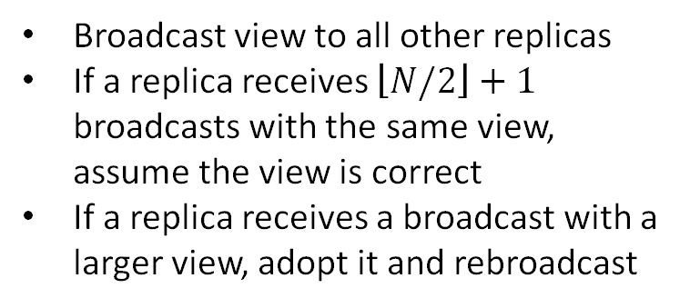
View Selection
Replica 0
Replica 1
Replica 2
Replica 3
Replica 4
All replicas have a view number
Goal is to have all replicas agree on the view
0
0
0
0
0
Broadcast view to all other replicas
If a replica receives $\left\lfloor N/2\right\rfloor +1$ broadcasts with the same view, assume the view is correct
If a replica receives a broadcast with a larger view, adopt it and rebroadcast
2
2
2
3
3
Time
3
3
3
Leader is replica with ID = hash(view)

Slide 63

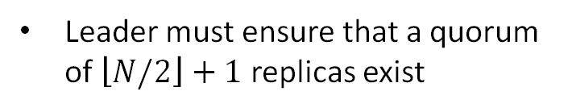
Prepare/Promise
Replica 0
Replica 1
Replica 2
Replica 3
Replica 4
Leader must ensure that a quorum of $\left\lfloor N/2\right\rfloor +1$ replicas exist
5
5
5
5
5
13
13
13
13
13
prepare view=5 clock= 13
promise view=5 clock=13
Time
Replicas promise to not accept any messages with view < v
Replicas won’t elect a new leader until the current one fails (measured using a timeout)

Slide 64
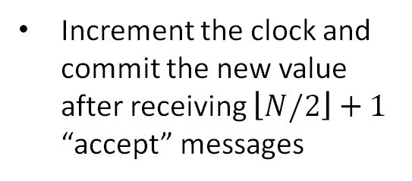
Commit/Accept
Replica 0
Replica 1
Replica 2
Replica 3
Replica 4
All client requests are serialized through the leader
5
5
5
5
5
13
13
13
13
13
write
commit clock=14
Replicas write the new value to temporary storage
Time
x
y
x
y
x
y
x
y
x
y
accept clock=14
Increment the clock and commit the new value after receiving $\left\lfloor N/2\right\rfloor +1$ “accept” messages
14
14
14
14
14
y
y
y
y
y
OK

Slide 65
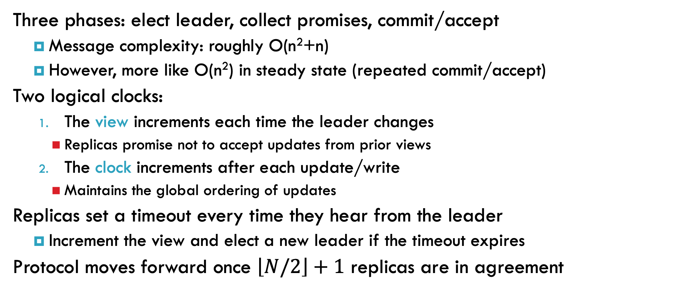
Paxos Review
Three phases: elect leader, collect promises, commit/accept
  Message complexity: roughly O(n²+n)
  However, more like O(n²) in steady state (repeated commit/accept)
Two logical clocks:
  The view increments each time the leader changes
    Replicas promise not to accept updates from prior views
  The clock increments after each update/write
    Maintains the global ordering of updates
Replicas set a timeout every time they hear from the leader
  Increment the view and elect a new leader if the timeout expires
Protocol moves forward once $\left\lfloor N/2\right\rfloor +1$ replicas are in agreement

Slide 66
Failure Modes
What happens if a commit fails?
What happens during a partition?
What happens after the leader fails?

Slide 67

Bad Commit
Replica 0
Replica 1
Replica 2
Replica 3
Replica 4
What happens if a quorum does not accept a commit?
13
13
13
13
13
commit clock=14
x
y
x
y
x
accept clock=14
Leader must retry until quorum is reached, or broadcast an abort
Time
commit clock=14
x
y
x
y
x
y
x
y
accept clock=14
Replicas that fall behind can reconcile by downloading missed updates from a peer
14
14
14
14
y
y
y
y

Slide 68

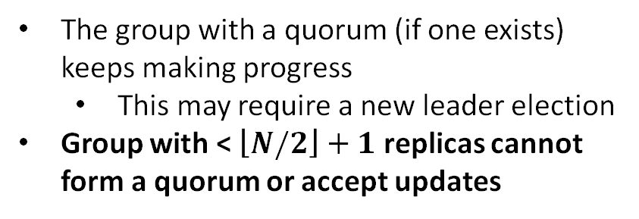
Partitions (1)
Replica 0
Replica 1
Replica 2
Replica 3
Replica 4
What happens during a partition?
0
0
0
0
0
1
The group with a quorum (if one exists) keeps making progress
  This may require a new leader election
Group with < $\left\lfloor N/2\right\rfloor +1$ replicas cannot form a quorum or accept updates
x
y
x
y
x
y
1
View/Elect
Time
y
y
y
View/Elect
Once partition is fixed, either:
  Hold a new leader election and move forward
  Or, reconcile with up-to-date peers

Slide 69
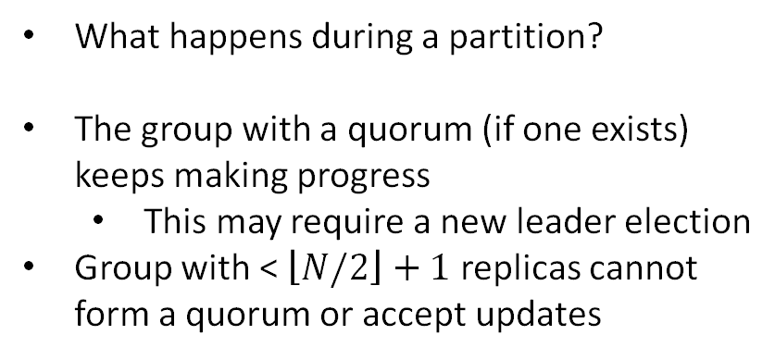
Partitions (2)
Replica 0
Replica 1
Replica 2
Replica 3
Replica 4
What happens during a partition?
The group with a quorum (if one exists) keeps making progress
  This may require a new leader election
Group with < $\left\lfloor N/2\right\rfloor +1$ replicas cannot form a quorum or accept updates
0
0
0
0
0
1
x
y
x
y
1
1
View/Elect
Time
What happens when the view = 0 group attempts to rejoin?
Promises for view = 1 prevent the old leader from interfering with the new quorum
Prepare
x
y
x
y
Commit

Slide 70


Leader Failure (1)
Replica 0
Replica 1
Replica 2
Replica 3
Replica 4
13
13
13
13
13
commit clock=14
x
x
x
x
What happens if there is an uncommitted update with no quorum?
x
y
Increment view, elect new leader
prepare clock= 13
Time
Leader is aware of uncommitted update
Leader must recommit the original clock=14 update
promise clock=13
commit clock=14’
x
y
x
y
x
y
x
y

Slide 71
Leader Failure (2)
Replica 0
Replica 1
Replica 2
Replica 3
Replica 4
13
13
13
13
13
commit clock=14
x
x
x
x
What happens if there is an uncommitted update with no quorum?
x
y
Increment view, elect new leader
prepare clock= 13
Time
Leader is unaware of uncommitted update
Leader announces a new update with clock=14’, which is rejected by replica 3
promise clock=13
commit clock=14’
x
z
x
z
x
z
Replica 3 is desynchronized, must reconcile with another replica

Slide 72
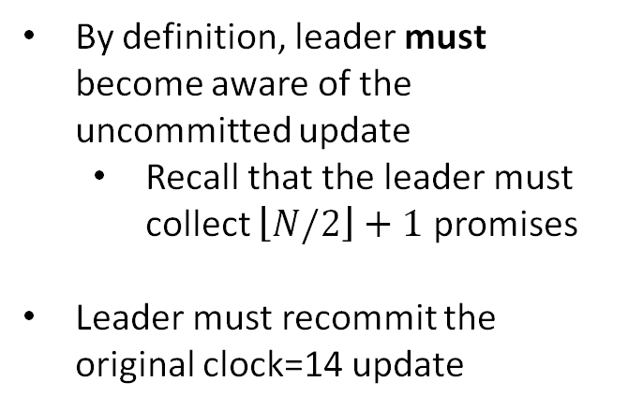
Leader Failure (3)
Replica 0
Replica 1
Replica 2
Replica 3
Replica 4
13
13
13
13
13
commit clock=14
x
x
x
x
What happens if there is an uncommitted update with a quorum?
x
y
x
y
x
y
Increment view, elect new leader
Time
By definition, leader must become aware of the uncommitted update
  Recall that the leader must collect $\left\lfloor N/2\right\rfloor +1$ promises
Leader must recommit the original clock=14 update
Send prepares, collect promises
commit clock=14
x
y
x
y
x
y
x
y

Slide 73
3: Viewstamped replication
Slides by B. Liskov

Slide 74
Viewstamped replication
Problem it solves: replication protocol
Model:
  Failstop failures
  Asynchronous communication
Uses quorums and ideas from 2PC
  2f+1 replicas to tolerate f failures
  Operations must intersect at at least one replica
  Availability for both reads and writes
  Read and write quorums of f+1 nodes
Appeared in PODC 1988, SOSP 1991, independent from Paxos.

Slide 75


Quorums
1. State:
…
2. State:
…
3. State:
…
Servers
X
write A
write A
write A
Clients

Slide 76
Quorums
1. State:
…
2. State:
…
3. State:
…
A
A
X
Servers
Clients

Slide 77
Quorums
1. State:
…
2. State:
…
3. State:
…
A
A
X
Servers
X
write B
write B
write B
Clients

Slide 78
Concurrent Operations
1. State:
…
2. State:
…
3. State:
…
A
B
A
B
B
A
Servers
write A
write B
write B
write A
write B
write A
Clients

Slide 79
Overview
Replicas must execute operations in the same order
Implies replicas will have the same state, assuming
  replicas start in the same state
  operations are deterministic
Uses a primary to order operations
Uses views to address primary failures, system moves through a sequence of views
  Primary runs the protocol
  Replicas watch the primary and do a view change if it fails

Slide 80
Replica State
A replica id i (between 0 and N-1)
  Replica 0, replica 1, …
A view number v#, initially 0
Primary is the replica with id
  i = v# mod N
A log of <op, op#, status> entries
  Status = prepared or committed

Slide 81
Normal Case
View: 3
Primary: 0
Log:
replica 0
7
Q
committed
write A,3
client 1
View: 3
Primary: 0
Log:
replica 1
7
Q
committed
client 2
View: 3
Primary: 0
Log:
replica 2
7
Q
committed

Slide 82
Normal Case
View: 3
Primary: 0
Log:
replica 0
7
Q
committed
prepare A,8,3
8
A
prepared
client 1
View: 3
Primary: 0
Log:
X
replica 1
7
Q
committed
client 2
View: 3
Primary: 0
Log:
replica 2
7
Q
committed

Slide 83
Normal Case
View: 3
Primary: 0
Log:
replica 0
7
Q
committed
8
A
prepared
client 1
View: 3
Primary: 0
Log:
replica 1
7
Q
committed
client 2
ok A,8,3
View: 3
Primary: 0
Log:
replica 2
7
Q
committed
8
A
prepared

Slide 84
Normal Case
result
View: 3
Primary: 0
Log:
replica 0
7
Q
committed
commit A,8,3
8
A
committed
client 1
View: 3
Primary: 0
Log:
X
replica 1
7
Q
committed
client 2
View: 3
Primary: 0
Log:
replica 2
7
Q
committed
8
A
prepared

Slide 85
View Changes
Used to mask primary failures
Replicas monitor the primary
  Client sends request to all
Replica requests next primary to do a view change

Slide 86
Correctness Requirement
Operation order must be preserved by a view change
For operations that are visible
  executed by server
  client received result
An operation could be visible if it prepared at f+1 replicas
  this is the commit point

Slide 87
View Change
View: 3
Primary: 0
Log:
replica 0
7
Q
committed
prepare A,8,3
8
A
prepared
client 1
View: 3
Primary: 0
Log:
X
replica 1
7
Q
committed
client 2
View: 3
Primary: 0
Log:
replica 2
7
Q
committed
8
A
prepared

Slide 88
View Change
X
View: 3
Primary: 0
Log:
replica 0
7
Q
committed
8
A
prepared
client 1
View: 3
Primary: 0
Log:
replica 1
7
Q
committed
client 2
View: 3
Primary: 0
Log:
replica 2
7
Q
committed
8
A
prepared

Slide 89
View Change
X
View: 3
Primary: 0
Log:
replica 0
7
Q
committed
8
A
prepared
client 1
View: 3
Primary: 0
Log:
do viewchange 4
replica 1
7
Q
committed
client 2
View: 3
Primary: 0
Log:
replica 2
7
Q
committed
8
A
prepared

Slide 90
View Change
X
View: 3
Primary: 0
Log:
X
replica 0
7
Q
committed
8
A
prepared
client 1
View: 4
Primary: 1
Log:
viewchange 4
replica 1
7
Q
committed
client 2
View: 3
Primary: 0
Log:
replica 2
7
Q
committed
8
A
prepared

Slide 91
View Change
X
View: 3
Primary: 0
Log:
replica 0
7
Q
committed
8
A
prepared
client 1
View: 4
Primary: 1
Log:
vc-ok 4,log
replica 1
7
Q
committed
client 2
View: 4
Primary: 1
Log:
replica 2
7
Q
committed
8
A
prepared

Slide 92
Double booking
Sometimes more than one operation is assigned the same number
  In view 3, operation A is assigned 8
  In view 4, operation B is assigned 8
Viewstamps
  op number is <v#, seq#>

Slide 93
Example
X
View: 3
Primary: 0
Log:
replica 0
7
Q
committed
8
A
prepared
client 1
View: 4
Primary: 1
Log:
replica 1
7
Q
committed
client 2
View: 4
Primary: 1
Log:
replica 2
7
Q
committed

Slide 94
Example
View: 3
Primary: 0
Log:
replica 0
7
Q
committed
8
A
prepared
client 1
View: 4
Primary: 1
Log:
replica 1
7
Q
committed
write B,4
8
B
prepared
client 2
View: 4
Primary: 1
Log:
replica 2
7
Q
committed

Slide 95
Example
View: 3
Primary: 0
Log:
replica 0
7
Q
committed
8
A
prepared
client 1
View: 4
Primary: 1
Log:
prepare B,8,4
replica 1
7
Q
committed
8
B
prepared
client 2
View: 4
Primary: 1
Log:
replica 2
7
Q
committed
8
B
prepared

Slide 96
Additional Issues
State transfer
Garbage collection of the log
Selecting the primary

Slide 97
Improved Performance
Lower latency for writes (3 messages)
  Replicas respond at prepare
  client waits for f+1
Fast reads (one round trip)
  Client communicates just with primary
  Leases
Witnesses (preferred quorums)
  Use f+1 replicas in the normal case

Slide 98
Summary so far …
State machine replication: approach to implementing fault-tolerant services
Process groups: membership and VS
Quorums: no membership, but leaders (or view), each operation requires a quorum,
Paxos and VR
  Approaches that rely on quorums for consensus and replication
  One can use Paxos to further build a state machine replication

Slide 99
5: Raft
Slides from Diego Ongaro and John Ousterhout

Slide 100
Replicated state machine
Clients
shl
Consensus
Module
State
Machine
Consensus
Module
State
Machine
Consensus
Module
State
Machine
Servers
Log
Log
Log
add
jmp
mov
shl
add
jmp
mov
shl
add
jmp
mov
shl
Replicated log => replicated state machine
  All servers execute same commands in same order
Consensus module ensures proper log replication
System makes progress as long as any majority of servers are up
Failure model: fail-stop (not Byzantine), delayed/lost messages

Slide 101
Raft’s Design Goals
Alternative to Paxos; Paxos is too complex and incomplete for real implementations
Algorithm for building real systems
  Must be correct, complete, and perform well
  Must also be understandable
“What would be easier to understand or explain?”
  Fundamentally different decomposition than Paxos
  Less complexity in state space
  Less mechanism

Slide 102
Raft Overview
Leader election:
  Select one of the servers to act as leader
  Detect crashes, choose new leader
Normal operation (basic log replication)
Safety and consistency after leader changes
Neutralizing old leaders
Client interactions
  Implementing linearizeable semantics
Configuration changes:
  Adding and removing servers

Slide 103
Server States
At any given time, each server is either:
  Leader: handles all client interactions, log replication
  Follower: completely passive
  Candidate: used to elect a new leader
Normal operation: 1 leader, N-1 followers
timeout,
new election
receive votes from
majority of servers
start
timeout,
start election
Follower
Candidate
Leader
“step
down”
discover server with higher term
discover current server or higher term

Slide 104
Terms
Term 1
Term 2
Term 3
Term 4
Term 5
time
Elections
Split Vote
Normal Operation
Time divided into terms:
  Election
  Normal operation under a single leader
At most 1 leader per term
Some terms have no leader (failed election)
Each server maintains current term value
Key role of terms: identify obsolete information

Slide 105
Raft Protocol Summary (see RAFT Paper)
Followers
RequestVote RPC
Respond to RPCs from candidates and leaders.
Convert to candidate if election timeout elapses without either:
  Receiving valid AppendEntries RPC, or
  Granting vote to candidate
Invoked by candidates to gather votes.
Arguments:
candidateId candidate requesting vote
term candidate's term
lastLogIndex index of candidate's last log entry
lastLogTerm term of candidate's last log entry
Results:
term currentTerm, for candidate to update itself
voteGranted true means candidate received vote
Implementation:
If term > currentTerm, currentTerm ← term
(step down if leader or candidate)
If term == currentTerm, votedFor is null or candidateId, and candidate's log is at least as complete as local log, grant vote and reset election timeout
Candidates
Increment currentTerm, vote for self
Reset election timeout
Send RequestVote RPCs to all other servers, wait for either:
  Votes received from majority of servers: become leader
  AppendEntries RPC received from new leader: step down
  Election timeout elapses without election resolution: increment term, start new election
  Discover higher term: step down
Leaders
Initialize nextIndex for each to last log index + 1
Send initial empty AppendEntries RPCs (heartbeat) to each follower; repeat during idle periods to prevent election timeouts
Accept commands from clients, append new entries to local log
Whenever last log index ≥ nextIndex for a follower, send AppendEntries RPC with log entries starting at nextIndex, update nextIndex if successful
If AppendEntries fails because of log inconsistency, decrement nextIndex and retry
Mark log entries committed if stored on a majority of servers and at least one entry from current term is stored on a majority of servers
Step down if currentTerm changes
AppendEntries RPC
Invoked by leader to replicate log entries and discover inconsistencies; also used as heartbeat .
Arguments:
term leader's term
leaderId so follower can redirect clients
prevLogIndex index of log entry immediately preceding new ones
prevLogTerm term of prevLogIndex entry
entries[] log entries to store (empty for heartbeat)
commitIndex last entry known to be committed
Results:
term currentTerm, for leader to update itself
success true if follower contained entry matching prevLogIndex and prevLogTerm
Implementation:
Return if term < currentTerm
If term > currentTerm, currentTerm ← term
If candidate or leader, step down
Reset election timeout
Return failure if log doesn’t contain an entry at prevLogIndex whose term matches prevLogTerm
If existing entries conflict with new entries, delete all existing entries starting with first conflicting entry
Append any new entries not already in the log
Advance state machine with newly committed entries
Persistent State
Each server persists the following to stable storage synchronously before responding to RPCs:
currentTerm latest term server has seen (initialized to 0 on first boot)
votedFor candidateId that received vote in current term (or null if none)
log[] log entries
Log Entry
term term when entry was received by leader
index position of entry in the log
command command for state machine

Slide 106
Heartbeats and Timeouts
Servers start up as followers
Followers expect to receive RPCs from leaders or candidates
Leaders must send heartbeats to maintain authority
If electionTimeout elapses with no RPCs:
  Follower assumes leader has crashed
  Follower starts new election
  Timeouts typically 100-500ms

Slide 107
Election Basics
Increment current term
Change to Candidate state
Vote for self
Send RequestVote RPCs to all other servers, retry until either:
  Receive votes from majority of servers:
    Become leader
    Send AppendEntries heartbeats to all other servers
  Receive RPC from valid leader:
    Return to follower state
  No-one wins election (election timeout elapses):
    Increment term, start new election

Slide 108
Elections, cont’d
Safety: allow at most one winner per term
  Each server gives out only one vote per term (persist on disk)
  Two different candidates can’t accumulate majorities in same term
Liveness: some candidate must eventually win
  Choose election timeouts randomly in [T, 2T]
  One server usually times out and wins election before others wake up
  Works well if T >> broadcast time
B can’t also get majority
Voted for candidate A
Servers

Slide 109
Log Structure
term
1
2
3
4
5
6
7
8
log index
1
add
1
cmp
1
ret
2
mov
3
jmp
3
div
3
shl
3
sub
leader
command
1
add
1
cmp
1
ret
2
mov
3
jmp
1
add
1
cmp
1
ret
2
mov
3
jmp
3
div
3
shl
3
sub
followers
1
add
1
cmp
1
add
1
cmp
1
ret
2
mov
3
jmp
3
div
3
shl
committed entries
Log entry = index, term, command
Log stored on stable storage (disk); survives crashes
Entry committed if known to be stored on majority of servers
  Durable, will eventually be executed by state machines

Slide 110
Normal Operation
Client sends command to leader
Leader appends command to its log
Leader sends AppendEntries RPCs to followers
Once new entry committed:
  Leader passes command to its state machine, returns result to client
  Leader notifies followers of committed entries in subsequent AppendEntries RPCs
  Followers pass committed commands to their state machines
Crashed/slow followers?
  Leader retries RPCs until they succeed
Performance is optimal in common case:
  One successful RPC to any majority of servers

Slide 111
Log Consistency
High level of coherency between logs:
If log entries on different servers have same index and term:
  They store the same command
  The logs are identical in all preceding entries
If a given entry is committed, all preceding entries are also committed
1
2
3
4
5
6
1
add
1
cmp
1
ret
2
mov
3
jmp
3
div
1
add
1
cmp
1
ret
2
mov
3
jmp
4
sub

Slide 112
AppendEntries Consistency Check
Each AppendEntries RPC contains index, term of entry preceding new ones
Follower must contain matching entry; otherwise it rejects request
Implements an induction step, ensures coherency
1
2
3
4
5
leader
1
add
1
cmp
1
ret
2
mov
3
jmp
AppendEntries succeeds:
matching entry
follower
1
add
1
cmp
1
ret
2
mov
leader
1
add
1
cmp
1
ret
2
mov
3
jmp
AppendEntries fails:
mismatch
follower
1
add
1
cmp
1
ret
1
shl

Slide 113
Leader Changes
At beginning of new leader’s term:
  Old leader may have left entries partially replicated
  No special steps by new leader: just start normal operation
  The Leader’s log is “the truth”
  Will eventually make follower’s logs identical to leader’s
  Multiple crashes can leave many extraneous log entries:
log index
1
2
3
4
5
6
7
8
term
s₁
1
1
5
6
6
6
s₂
1
1
5
6
7
7
7
s₃
1
1
5
5
s₄
1
1
2
4
s₅
1
1
2
2
3
3
3

Slide 114
Safety Requirement
Committed → Present in future leaders’ logs
Restrictions on
commitment
Restrictions on
leader election
Once a log entry has been applied to a state machine, no other state machine must apply a different value for that log entry
Raft safety property:
  If a leader has decided that a log entry is committed, that entry will be present in the logs of all future leaders
This guarantees the safety requirement
  Leaders never overwrite entries in their logs
  Only entries in the leader’s log can be committed
  Entries must be committed before applying to state machine

Slide 115
Picking the Best Leader
1
2
3
4
5
1
1
1
2
2
Committed ?
Can’t tell which entries are committed!
During elections, choose candidate with log most likely to contain all committed entries
  Candidates include log info in RequestVote RPCs
  (index & term of last log entry)
  Voting server V denies vote if its log is “more complete”:
  (lastTerm_{V} > lastTerm_{C}) ||
  (lastTerm_{V} == lastTerm_{C}) && (lastIndex_{V} > lastIndex_{C})
  Leader will have “most complete” log among electing majority
1
1
1
2
1
1
1
2
2
unavailable during leader transition

Slide 116
Committing Entry from Current Term
Case #1/2: Leader decides entry in current term is committed
Safe: leader for term 3 must contain entry 4
1
2
3
4
5
6
s₁
1
1
2
2
2
Leader for
term 2
s₂
1
1
2
2
s₃
1
1
2
2
AppendEntries just
succeeded
s₄
1
1
2
Can’t be elected as
leader for term 3
s₅
1
1

Slide 117
Committing Entry from Earlier Term
Case #2/2: Leader is trying to finish committing entry from an earlier term
Entry 3 not safely committed:
  s5 can be elected as leader for term 5
  If elected, it will overwrite entry 3 on s1, s2, and s3!
1
2
3
4
5
6
s₁
1
1
2
4
Leader for
term 4
s₂
1
1
2
s₃
1
1
2
AppendEntries just
succeeded
s₄
1
1
s₅
1
1
3
3
3

Slide 118
New Commitment Rules
For a leader to decide an entry is committed:
  Must be stored on a majority of servers
  At least one new entry from leader’s term must also be stored on majority of servers
Once entry 4 committed:
  s₅ cannot be elected leader
  for term 5
  Entries 3 and 4 both safe
1
2
3
4
5
Leader for
term 4
s₁
1
1
2
4
s₂
1
1
2
4
s₃
1
1
2
4
s₄
1
1
s₅
1
1
3
3
3
Combination of election rules and commitment rules
makes Raft safe

Slide 119
Log Inconsistencies
Leader changes can result in log inconsistencies:
log index
1
2
3
4
5
6
7
8
9
10
11
12
leader for
term 8
1
1
1
4
4
5
5
6
6
6
(a)
1
1
1
4
4
5
5
6
6
Missing
Entries
(b)
1
1
1
4
(c)
1
1
1
4
4
5
5
6
6
6
6
possible
followers
(d)
1
1
1
4
4
5
5
6
6
6
7
7
Extraneous
Entries
(e)
1
1
1
4
4
4
4
(f)
1
1
1
2
2
2
3
3
3
3
3

Slide 120
Repairing Follower Logs
nextIndex
log index
1
2
3
4
5
6
7
8
9
10
11
12
leader for term 7
1
1
1
4
4
5
5
6
6
6
(a)
1
1
1
4
followers
(b)
1
1
1
2
2
2
3
3
3
3
3
New leader must make follower logs consistent with its own
  Delete extraneous entries
  Fill in missing entries
Leader keeps nextIndex for each follower:
  Index of next log entry to send to that follower
  Initialized to (1 + leader’s last index)
When AppendEntries consistency check fails, decrement nextIndex and try again:

Slide 121
Repairing Logs, cont’d
When follower overwrites inconsistent entry, it deletes all subsequent entries:
nextIndex
log index
1
2
3
4
5
6
7
8
9
10
11
leader for term 7
1
1
1
4
4
5
5
6
6
6
1
1
1
2
2
2
3
3
3
3
3
follower (before)
follower (after)
1
1
1
4

Slide 122
Neutralizing Old Leaders
Deposed leader may not be dead:
  Temporarily disconnected from network
  Other servers elect a new leader
  Old leader becomes reconnected, attempts to commit log entries
Terms used to detect stale leaders (and candidates)
  Every RPC contains term of sender
  If sender’s term is older, RPC is rejected, sender reverts to follower and updates its term
  If receiver’s term is older, it reverts to follower, updates its term, then processes RPC normally
Election updates terms of majority of servers
  Deposed server cannot commit new log entries

Slide 123
Client Protocol
Send commands to leader
  If leader unknown, contact any server
  If contacted server not leader, it will redirect to leader
Leader does not respond until command has been logged, committed, and executed by leader’s state machine
If request times out (e.g., leader crash):
  Client reissues command to some other server
  Eventually redirected to new leader
  Retry request with new leader

Slide 124
Client Protocol, cont’d
What if leader crashes after executing command, but before responding?
  Must not execute command twice
Solution: client embeds a unique id in each command
  Server includes id in log entry
  Before accepting command, leader checks its log for entry with that id
  If id found in log, ignore new command, return response from old command
Result: exactly-once semantics as long as client doesn’t crash

Slide 125
Configuration Changes
System configuration:
  ID, address for each server
  Determines what constitutes a majority
Consensus mechanism must support changes in the configuration:
  Replace failed machine
  Change degree of replication

Slide 126
Configuration Changes, cont’d
Cannot switch directly from one configuration to another: conflicting majorities could arise
C_{old}
C_{new}
Server 1
Majority of C_{old}
Server 2
Server 3
Server 4
Majority of C_{new}
Server 5
time

Slide 127
Joint Consensus
Raft uses a 2-phase approach:
  Intermediate phase uses joint consensus (need majority of both old and new configurations for elections, commitment)
  Configuration change is just a log entry; applied immediately on receipt (committed or not)
  Once joint consensus is committed, begin replicating log entry for final configuration
C_{old} can make
unilateral decisions
C_{new} can make
unilateral decisions
C_{new}
C_{old+new}
C_{old}
C_{old+new} entry
committed
C_{new} entry
committed
time

Slide 128
Joint Consensus, cont’d
Additional details:
  Any server from either configuration can serve as leader
  If current leader is not in C_{new}, must step down once C_{new} is committed.
C_{old} can make
unilateral decisions
C_{new} can make
unilateral decisions
C_{new}
C_{old+new}
leader not in C_{new}
steps down here
C_{old}
C_{old+new} entry
committed
C_{new} entry
committed
time

Slide 129
4: Byzantine replication

Slide 130
Byzantine-Resilient Replication
How to design replication protocols that do not block and can tolerate malicious participants
Use ideas from both Byzantine agreement and replication protocols (Viewstamped Replication)
Ensure safety and liveness

Slide 131
BFT: Assumptions
Provides safety without synchrony: ensures correct replies in spite of malicious servers
Assumes eventual time bounds for liveness: messages will make it when network is stable
Assumes asynchronous communication
for safety

Slide 132
BFT: Assumptions
Servers can be malicious, arbitrary behavior, f malicious servers
Failures are independent.
Crypto options
  Digital signatures
  HMACs, requires n² symmetric keys

Slide 133
BFT: Overview
Deterministic replicas start in same state
Replicas execute same requests in same order
Correct replicas produce identical replies
Uses a leader to coordinate the protocol; each leader associated with a view
Ensure ordering is not easy!
What to do when the leader fails?

Slide 134
Dealing with Malicious Behavior
Require 2f+1 out of 3f+1 participants to agree at each step
This ensures that any 2 sets of 2f+1 will intersect in a correct replica
Require at each step a proof that the 2f+1 agreed on the issue to ensure safety
When leader (primary) fails, new leader (view) elected

Slide 135
Client-Server Interaction
Client submits a request to the primary
If timeout occurs, suspects the primary and sends to every server
Servers order the request
Client waits for answers from servers. How many identical answers should a client wait for?
f+1 identical responses to be guaranteed
that at least one correct server returned
the correct value.
Notes:
f+1 identical responses to guarantee at least 1 correct server returned the correct state

Slide 136
BFT: Components
Normal case operation:
  primary is not faulty (does not fail and it is not malicious)
View changes:
  how to deal with view changes
Garbage collection:
  when it is time to garbage collect information maintained by each server

Slide 137
Safety and Liveness
Safety:
  ensure ordering of requests within a view and across view
Liveness:
  there is progress at each step, including selecting a new leader

Slide 138
BFT: Normal Case
Primary goal of normal case is to ensure ordering of requests within a view; also has a phase that works in combination with the view change protocol
Three phases:
  pre-prepare assigns order to requests
  prepare ensures servers agree on order within views
  commit ensures servers agree on order across views
Messages are logged and authenticated
Matching means: same view, sequence numbers, and message digest

Slide 139
Normal Case Details
Client c sends m = <REQUEST,o,t,c>_{c} to the primary. (o=operation,t=timestamp)
Primary p assigns sequence n to m and sends
<PRE-PREPARE,v,n,m>_{p} to other replicas, v is the current view; unique identifier is given by n and v
If server i accepts the message, it sends <PREPARE,v,n,d,i>_{i} to other replicas. (d is hash of the request). Signals that i agrees to assign n to m in v.
Once server i has a pre-prepare and 2f matching PREPARE messages, it sends <COMMIT,v,n,d,i>_{i} to other replicas. At this point, correct replicas agree on an order of requests within view v.
Once server i has 2f+1 matching prepare and commit messages (2f+1 prepare and 2f+1 commit), it executes m, then sends <REPLY,v,t,c,i,r>_{i} to the client.

Slide 140
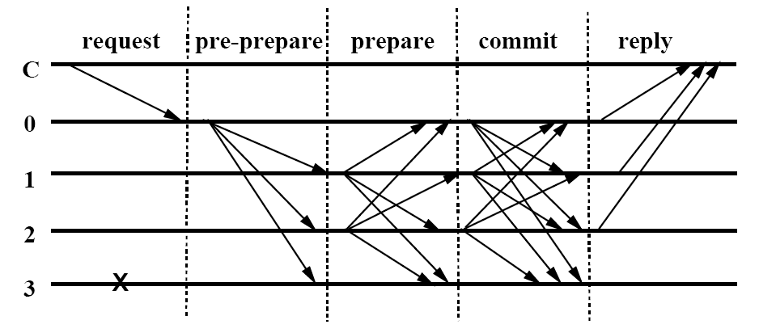
BFT: How Does It Work?

Slide 141
More Details
Servers accept pre-prepare <PRE-PREPARE,v,n,m> if
  Their current view is view v
  They did not accept pre-prepare for v,n with different request
All collected pre-prepare and 2f matching prepares serve as a certificate for the next step: P-certificate(m,v,n)
Request m executed after:
  having C-certificate(m,v,n)
  executing requests with sequence number less than n

Slide 142
BFT: View Change
Provide liveness when primary fails:
  Timeouts used to trigger view changes
  Mapping between primary and view number
  Increase current view number and select new primary (≡ view number mod 3f+1)
Preserve safety
  ensure replicas are in the same view long enough
  prevent denial-of-service attacks

Slide 143
BFT: View Change Details
When servers suspect the primary, they start a view change
  A backup starts timer when it is waiting for executing a request and stops it when it is no longer waiting
  If timer times out something is wrong with Primary
  Change view so that Primary gets changed
A backup sends <VIEW-CHANGE, v+1, n, C, P, i >_{σi}
  C is a proof of last stable check-point
  P is a proof of due requests after the check-point

Slide 144
BFT: View Change Details
When a primary of new view gets 2f VIEW-CHANGE messages, it declares new view
The new Primary sends < NEW-VIEW, v+1, V, O >_{σi}
V is a proof containing valid VIEW-CHANGE messages
O is a set containing PRE-PREPARE messages needed to carry the incomplete messages from previous view into new view

Slide 145
BFT: Garbage Collection
The logs are cleaned periodically
Before cleaning the logs a backup must be sure that all requests whose messages it is going to clean have been successfully executed
After fixed number of requests replicas send check-point signals < CHECKPOINT, n,d,i >_{σi}
When a replica receives 2f+1 check-point messages, it clears all messages for requests up to n.

Slide 146
Summary
BFT – requires a minimum of 3f+1 participant, 3 communication rounds and f+1 identical answers to the client
Scaling beyond BFT, one can combine fault-tolerant approaches (like Paxos) with BFT to achieve better performance on wide area networks.

