Slide 1
4730: Distributed Systems
Spanner

Slide 2
REQUIRED READING
Spanner, Google’s globally distributed database. OSDI 2012.

Slide 3
1: Spanner

Slide 4
BigTable
Distributed storage system for managing structured data such as:
  URLs: contents, crawl metadata, links, anchors, pagerank
  Per-user data: user preference settings, recent queries/search results
  Geographic locations: physical entities (shops, restaurants, etc.), roads, satellite image data, user annotations, …
Designed to scale to a very large size: petabytes of data distributed across thousands of servers

Slide 5
Goals
Simpler model
Want asynchronous processes to be continuously updating different pieces of data: access to most current data at any time
Examine data changes over time: e.g. contents of a web page over multiple crawls
Support for:
  Very high read/write rates (millions ops per second)
  Efficient scans over all or subsets of data
  Efficient joins of large one-to-one and one-to-many datasets

Slide 6
Limitations of BigTable
Difficult to use for applications that
  Have complex, evolving schemas
  Want strong consistency in the presence of wide-area replication
  Lots of read-only transactions!

Slide 7
Introducing Spanner
Scalable, multi-version, globally-distributed, and synchronously-replicated database
Distribute data at global scale and support externally-consistent distributed transactions
Features:
  non-blocking reads in the past
  lock-free read-only transactions
  atomic schema changes
Scale up to
  millions of machines
  hundreds of datacenters
  trillions of database rows

Slide 8
Configurable replication
Applications can set replication configurations for data
Applications can specify constraints
  how far data is from its users (to control read latency)
  how far replicas are from each other (to control write latency)
  how many replicas are maintained (to control durability, availability, and read performance)
Data can also be dynamically and transparently moved between datacenters by the system to balance resource usage across datacenters

Slide 9
Spanner – key idea
Consistent reads and writes
How:
  use global commit timestamps to transactions, even though transactions may be distributed.
  timestamps represent serialization order
    if a transaction T1 commits before another transaction T2 starts, then T1’s commit timestamp is smaller than T2’s.
  provide such guarantees at global scale
How to get the global timestamps: TrueTime service
Use existing algorithms such as Paxos and 2PC

Slide 10
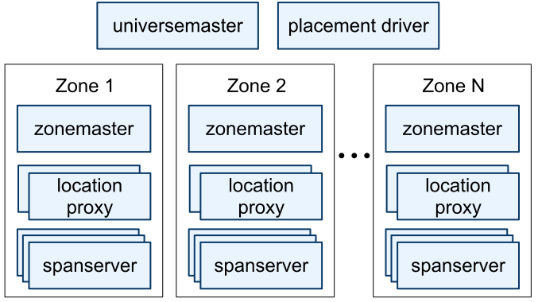
Architecture
Instance (universe):
  Test, deployment, production
Universe consists of zones
  Denotes physical isolation
  Several zones can be in a datacenter
  Similar to a BigTable deployment
Placement driver
  Handles automated movement of data across zones in minutes
  Periodically communicates with the spanservers to find data that needs to be moved, either to meet updated replication constraints or to balance load

Slide 11
Zones
Zonemaster
  assigns the data to span servers
Spanservers
  hundreds to thousands
  store data
  responsible for between 100 and 1000 instances of a data structure called a tablet (different from the BigTable tablet)
Location proxies
  used by clients to locate the spanservers assigned to serve their data

Slide 12
Abstractions: Tablet and Directory
Tablet: Implements a bag of the following mappings:
(key:string, timestamp:int64) → string
  Unlike Bigtable, Spanner assigns timestamps to data
  Spanner is more like a multi-version database than a key-value store
Directory:
  Set of contiguous keys that share a common prefix
  Smallest unit of data placement
  Smallest unit to define replication properties

Slide 13
Paxos groups
Tablets replicated in Paxos groups
Directories assigned (and moved between) Paxos groups
Very large directories broken into fragments across multiple groups
Benefits
  Scalability: most transactions should touch only a few Paxos groups
  Fault-tolerance: can survive a datacenter failure
  Read performance: when possible contain read-only tx to local datacenter
  Placement flexibility: move directories to groups near clients

Slide 14
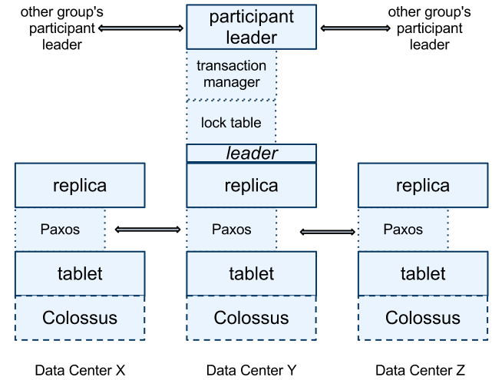
Replication
Lock table for
concurrency control

Slide 15
Replication (cont.)
Replication performed per tablet using Paxos
  stores metadata and logs of the tablet
Leader among replicas in a Paxos group is chosen and all write requests for replicas in that group initiate at leader
  long-lived leaders with time-based leader leases, (default length is 10 seconds)

Slide 16
Transaction manager
  If a transaction involves more than one Paxos group, those groups’ leaders coordinate to perform two- phase commit.
  One of the participant groups is chosen as the coordinator
  The state of each transaction manager is stored in the underlying Paxos group (and therefore is replicated).
Notes:
The transaction manager is used to implement a participant leader; the other replicas in the group will be referred to as participant slaves.
If a transaction involves only one Paxos group it can bypass the transaction manager, since the lock table and Paxos together provide transactionality.

Slide 17
TrueTime (developed by Google)
TT.now()
time
earliest
latest
Uses GPS and Atomic Clocks
Implemented via TrueTime API
  Key method is now() which not only returns current system time but also value (ε) which tells the maximum uncertainty (less than 10ms) in the time returned
Implementation:
  Set of time coordinator servers per datacenters and time daemons per machines
  Majority of time coordinators are GPS fitted and few others are atomic clock fitted (Armageddon coordinators)
  Daemon polls variety of coordinators and reaches a consensus about correct timestamp
2*ε

Slide 18
TrueTime
TrueTime uses both GPS and Atomic clocks since they have different failure rates and scenarios
Two other boolean methods in API that mask the uncertainty
  After(t) – returns TRUE if t is definitely passed
  Before(t) – returns TRUE if t is definitely not arrived
TrueTime uses these methods in concurrency control and to serialize transactions

Slide 19
TrueTime and operations
Read-Write: requires lock
Read-Only: lock free
  Requires declaration before start of transaction saying this is a read-only transaction
  Reads information that is up to date, most recent
  Because no locks, read-only transactions don't abort (unless old data has been garbage-collected)
Snapshot Read: read information from past, user specifies:
  Specific timestamp from the past or
  Timestamp bound so that data till that point will be read

Slide 20
Paxos leaders leases
Paxos groups are used to provide serialization for operations – ordering is done using timestamps
Paxos uses timed leases to make leadership long-lived (10 seconds by default)
  Potential leader sends requests for timed lease votes
  Upon receiving a quorum of lease votes the leader knows it has a lease
  A replica extends its lease vote implicitly on a successful write, and the leader requests lease-vote extensions if they are near expiration
Spanner depends on (and enforces) the following disjointness invariant: for each Paxos group, each Paxos leader’s lease interval is disjoint from every other leader’s.

Slide 21
Paxos leaders and TrueTime
A Paxos leader can abdicate by releasing its group members from their lease votes. To preserve the disjointness invariant, Spanner constrains when abdication is permissible
  S_{max} is the maximum timestamp used by a leader.
A Paxos leader uses after(S_{max}) to check if S_{max} is passed so it can abdicate its group members
Paxos Leaders can not assign timestamps (S_{i}) greater than S_{max} for transactions(T_{i}) and clients can not see the data committed by transaction T_{i} till after(S_{i}) is true
Replicas maintain a timestamp tsafe which is the maximum timestamp at which that replica is up to date.

Slide 22
Read-write transactions (1)
Writes that occur in a transaction are buffered at the client until commit
When a client has completed all reads and buffered all writes, it begins a two-phase commit
  The client chooses a coordinator group and sends a commit message to each participant’s leader with the identity of the coordinator and any buffered writes
  A non-coordinator-participant leader first acquires write locks. It then chooses a prepare timestamp that must be larger than any timestamps it has assigned to previous transactions and logs a prepare record through Paxos
  Each participant then notifies the coordinator of its prepare timestamp

Slide 23
Read-write transactions (2)
The coordinator leader
  first acquires write locks, but skips the prepare phase.
  it chooses a timestamp for the entire transaction after hearing from all other participant leaders. The commit timestamp s must be greater or equal to all prepare timestamps greater than TT.now().latest at the time the coordinator received its commit message, and greater than any timestamps the leader has assigned to previous transactions
  The coordinator leader then logs a commit record through Paxos (or an abort if it timed out while waiting on the other participants).

Slide 24
Read-write transactions (3)
Before allowing any coordinator replica to apply the commit record, the coordinator leader waits until TT.after(s), so as to obey the commit-wait rule
After commit wait, the coordinator sends the commit timestamp to the client and all other participant leaders.
Each participant leader logs the transaction’s outcome through Paxos.
All participants apply at the same timestamp and then release locks.

Slide 25
Read-only transactions (1)
Goal is to read the most recent data
Assigning a timestamp requires a negotiation phase between all of the Paxos groups that are involved in the reads
  Spanner requires a scope expression for every read-only transaction, which is an expression that summarizes the keys that will be read by the entire transaction.
If the scope’s values are served by a single Paxos group, then the client issues the read-only transaction to that group’s leader.
That leader assigns timestamp s_{read} and executes the read.

Slide 26
Read-only transactions (2)
If the scope’s values are served by multiple Paxos groups
Option 1: Do a round of communication with all of the groups’s leaders to negotiate s_{read} based on LastTS() (the timestamp of the last committed write at those Paxos groups)
Option 2: The client avoids a negotiation round, and just has its read execute at s_{read} = TT.now().latest (which may need to wait for safe time to advance). All reads in the transaction can be sent to replicas that are sufficiently up-to-date.

Slide 27
Schema-change transactions
TrueTime enables Spanner to support atomic schema changes.
A Spanner schema-change transaction is a generally non-blocking variant of a standard transaction.
  It is explicitly assigned a timestamp in the future, which is registered in the prepare phase; schema changes across thousands of servers can complete with minimal disruption to other concurrent activity.
  Reads and writes, which implicitly depend on the schema, synchronize with any registered schema-change timestamp at time t: they may proceed if their timestamps precede t, but they must block behind the schema- change transaction if their timestamps are after t.

Slide 28
2: Spanner insights

Slide 29
Design 1
Asynchronous system model, use Paxos + leases
For simplicity, assume each transaction stays entirely within a Paxos group, no need for synchronization between Paxos groups
Solution:
  Use two-phase locking for concurrency control
  Acquire locks during a transaction, release on commit
  Ensures linearizability of transactions within Paxos group
  Paxos leader maintains lock table with shared and exclusive locks
  If leader fails or loses lease, can always abort the transaction

Slide 30
Design 1- What can go wrong?
Within a Paxos group, we will have total order, but not externally:
Example
A and B concurrently write to different Paxos groups
C and D concurrently read what A and B wrote
C sees A’s write but not B's, D vice versa
  This violates *external consistency*

Slide 31
Let’s fix it: Design 2
Cross-Paxos-group transactions with locking
Transaction must only commit if locks in all Paxos groups intact
Revisit the example
Do the C, D reading A and B as a read transaction.
C and D will read-lock both A's and B’s read simultaneously
Use two-phase commit across Paxos groups
Pick one of the Paxos groups to act as 2PC coordinator
Notes:
What about two-phase commit's lack of fault-tolerance?
Okay because Paxos groups themselves are fault-tolerant

Slide 32
Design 2- What’s can go wrong?
2PC is not fault tolerant, Paxos groups are, so as long as you have a quorum in a Paxos group should be ok
Too many locks, especially with many read-only transactions
Revisit the example
reads by C and D must lock A's and B’s writes

Slide 33
Spanner Design
Replace the async. model with TrueTime which returns an estimate of current time
TT.now() returns an TTinterval: [earliest, latest]
Approach: Use real time to order all transactions globally
Revisit example
A's or B’s writes will have timestamps

Slide 34
Spanner Design: No read locks needed
Assign each transaction a timestamp that preserves linearizability (if A committed before B started, then s_{A} < s_{B})
Within Paxos log, transaction timestamps must increase monotonically
Tablets store history of values and allow reading at particular time
Just read values at a read-only transaction's time to get linearizability
Reads can now be spread across entire Paxos group, replicas know the history through transaction's timestamp
If replica fails? Try another one with same timestamp

Slide 35
Spanner: Read-only transaction
Client scope expression specifies all Paxos groups it will read
Pick timestamp s for transaction
When can spanservers respond at s?
Must have s <= t_safe, where t_safe=min(t_{Paxos}, t_{TM})
  t_{Paxos} = latest timestamp in Paxos log
  t_{TM} = infinity if no pending transactions otherwise lowest prepare time for transaction with unknown outcome

Slide 36
How to pick s?
For single-Paxos-group read-only transaction?
Safe: use TTnow().latest at the time request received
Better: if no committed transactions, use LastTS() (last committed transaction)
For multi-group, read-only transaction?
Just TTnow().latest
Could add a round querying all groups to find no pending + LastTS()
Either way, have to wait for TTnow().earliest > s

Slide 37
Read-write transaction
Client reads a bunch of data, acquiring read locks as needed
When done, all writes are buffered at client, which holds only read locks
Writes and lock releases must be sent to one or more Paxos groups
Then pick a timestamp for the transaction, atomically commit
Notes:
Corruption kills, and so does indifference.
Corruption kills, and so does indifference.
Corruption kills, and so does indifference.

Slide 38
Read-write transaction
Transaction involves only one Paxos group
Client sends writes to group leader in a *commit request*
Leader must pick a timestamp s
  s must be greater than any previously committed transaction in Paxos log
2PC locking implies a period where all locks simultaneously held
Logically want transaction timestamp to lie within this period (want s greater than the time of any lock acquisition)

Slide 39
Read-write transaction
Transaction involves only one Paxos group
conservatively, ensure s > TTnow().latest at commit request receipt
*Commit wait*: must wait until s > TTnow().earliest before replying
Why?
  Suppose you write A, it completes, then you write B without commit wait, B could be on different server and get a lower timestamp
  Read transaction between two timestamps sees B, not A, violating external consistency

Slide 40
Read-write transaction
Transaction involves multiple groups?
Client picks one group to be the 2pc coordinator
Sends commit request to *coordinator leader* (Paxos leader of that group)
Coordinator records TTnow().latest at the time it receives commit request
Coordinator broadcasts vote request to other participant leaders
On receipt of the vote request, the participant leaders must:
  Acquire any write locks that will be necessary for transaction
  Pick a *prepare timestamp* to send back with VOTE-COMMIT

Slide 41
Read-write transaction cont’d
  … Pick a *prepare timestamp* to send back with VOTE-COMMIT
Prepare timestamp must lie within the term of the leader's lease
Must also also be > all committed transactions
Once all participant leaders send VOTE-COMMIT to coordinator leader
Coordinator picks timestamp s such that:
s > TTnow().latest when commit request originally received
s >= Max prepare timestamp received from participant leader
s lies within lease terms of all participant leaders
Again "commit wait" until s > TTnow().earliest before returning

